Slide 1
COVID-19 Burnout: Steps for Moving Forward
Alyson VanAhn PhD LP
Associated Clinic of Psychology
In partnership with LeadingAge MN Foundation

Slide 2
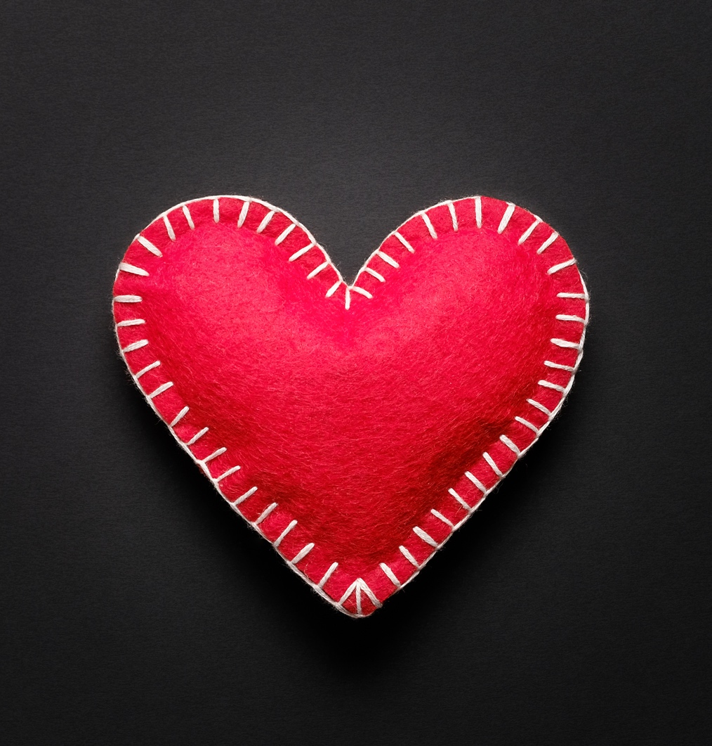
Welcome and Thank you!
Brief Background on this Project and Context
Learning Objectives
Recognize burnout in yourself and others.
Learn ways to help yourself avoid or recover from burnout.
Develop ways that your team can avoid or recover from burnout.

Slide 3
Official definition: a syndrome…from chronic workplace stress…that isn’t managed.* World Health Organization
Origins in medical community
Some good research
Difference between this and depression/anxiety
*Limitations to this definition
Burnout
Important adjustments to our definition(s):
Different types and phases: workplace, home, internal
All legitimate, some less likely to be acknowledged
Primary Risk Factor: working in health care.
Examples of what it looks like: headaches, Type II Diabetes, bowel trouble, substance use; sleep issues
Low satisfaction, more easily upset, hard to go to work, cynical about work/job

Slide 4
How to Keep Going:
Borrowing from Resilience
Practice sharing and distracting
Pause to acknowledge
Find tools
Repeat
Covid-19 Resilience

Slide 5
Pause to reflect and acknowledge:
(You are doing this right now by being here)
Transitions
Boundaries/structure
Security
Moral congruence
World as we knew it
Spontaneity, (now need to calculate risk benefit of everyday activities)
Rituals
Coping venues and activities
Many basic things we could count on before (school, predictability)
What have we lost?
Pause
A personal example

Slide 6
Find things we can do:
(It’s okay if these feel forced)
We will get to more certainty. (Self talk even if you don’t believe it.)
What’s in our control?
Manage by connecting, finding hobbies/new interests, inserting rituals and routine
Find ways to engage safely.
Individual activities (meditation, walks, new rituals)
Mind-body engagement
Deliberately reaching out to friends to engaging in processing AND distraction
Manage anxiety and sadness.
Choose a different story (think BEST versus worst case scenario)
See post-traumatic growth possibilities (new skills and strengths)
Reframing for yourself what is a success
Perfection was never possible
Find

Slide 7
Practice: How to avoid or overcome burnout
for you and your teams
Attend meetings like this, read materials. (see resources)
Find stories of others’ burnout and triumphs…share these.
Share at work about successes to reinforce what’s going well and our new definition of “victories.”
Offer warm thoughts, a favor, flexibility versus asking “what do you need” (we may not know what we need).
Get in the habit of looking for warning signs of burnout in yourself and team members. Act. Even a little action is helpful.
Adjust expectations: survival is great work! Helping others and helping them cope is tremendous! Maintaining your health, the best you can, allows others to keep going and to get care they need.
Create rituals to memorialize, acknowledge loss and highlight growth.
Give compliments and reassurance when good things are noted (this is easy and free, yet we often take these for granted).
Clarify for yourself and your teams what expectations are realistic. Believe that this is not “settling,” but instead you are doing the essentials for remaining healthy in a challenging situation.
Seek, and advocate for, professional and community support for your own and others’ mental health.
Practice

Slide 8
Reinforcement and Resources
https://grief.com/covid-19/
https://www.cdc.gov/mentalhealth/stress-coping/grief-loss/index.html
https://www.psychiatrictimes.com/view/navigating-covid-19s-lessons-on-burnout
https://www.mayoclinic.org/healthy-lifestyle/adult-health/in-depth/burnout/art-20046642
https://www.statnews.com/2021/11/05/has-burnout-fundamentally-changed-part-of-me-as-a-doctor/
https://www.shrm.org/resourcesandtools/hr-topics/people-managers/pages/covid-grief-.aspx

Slide 9
Thank you for all you are doing!
You are much better than you think and feel. Surviving counts,
and you can get beyond survival.
Expectations of yourself can and MUST change for you
to beat burnout!

