Slide 1
2024 LTC Imperative Workforce And Financial Survey
February 7, 2024

Slide 2
Key Takeaways
Workforce indicators are no longer worsening and, in some cases, seeing marginal improvement.
Overall position vacancies have improved slightly but the estimated 17,000 vacancies continue to challenge access.
Nursing facilities are declining fewer admissions but insufficient staffing and inability to meet specific client’s needs remain major impediments to hospital discharge.
Issues with DHS background study processing has created new employee onboarding delays.
Most Nursing Facilities Have Used Temporary Rate Add-On of $12.35 to Increase Wages and/or Address Operating Deficits .
Most Nursing Facilities Have or Plan to Use One Time Payment for Operating or Property Related Long-Term Debt Payments, Physical Plant Improvements.

Slide 3
Caregiver (CNA and ULP) Vacancy Rate Drops to Lowest in at Least Four Years for AL and Nursing Homes

Slide 4
LPN Vacancy Rate Drops to Lowest in at Least Four Years for AL and Nursing Homes

Slide 5
RN Vacancy Rates Remain Mostly Unchanged, with NFs Seeing a Slight Decrease but Staying much Higher than AL

Slide 6
Dietary Position Vacancy Rate Continues a Steep Decline for both NFs and ALs

Slide 7
Vacancies in Key LTC Employee Positions almost 17,000 Statewide in January 2024, down for all Positions Except Caregivers

Slide 8
Vacancies in Key LTC Employee Positions almost 17,000 Statewide in January 2024, down for all Positions Except Caregivers

Slide 9
AL Turnover Rates Improved for RNs and Dietary in 2023 but went slightly higher for Caregivers

Slide 10
Statewide NF Staff Turnover Improved Dramatically in 2023 for all Positions

Slide 11
AL Retention Rate Dropped in 2023 for Caregivers but Strong for other Positions

Slide 12
NF Retention Rate Increased Slightly in 2023 for all Positions
CNA

Slide 13
Average Number of Employees has Recovered from Pandemic much more for AL than NF

Slide 14
LTC Providers are Improving Staffing as New Hires Exceed Employees Leaving

Slide 15
Operating Margin Showed Improvement in 2023 Particularly for Nursing Facilities

Slide 16
Number of Declined Admission Referrals
Lower for Nursing Facilities in December 2023 by a Third

Slide 17
Many LTC Facilities Considering Sale with about 30 Nursing Facilities still Considering Closure

Slide 18
More than 30% of Providers are Spending Reserves or have Exhausted Reserves

Slide 19
Over 20% of LTC Providers are Using Credit or have already Exhausted Credit

Slide 20
Most AL Residents Receiving Services, EW Highest in Rural Areas, Disability Waivers in Metro and Northwest
Notes:
N

Slide 21
Nursing Facilities and Assisted Living Facilities Continue to Lose Employees to Staffing Agencies
Providers who have lost RN, LPN, CNAs etc., to SNSAs or Traveling Nursing Agencies report losing an average of:
Assisted Living Setting 1.75
Nursing Facility 1.9

Slide 22
Nursing Facilities Much More Likely to Use Pool

Slide 23
Of the Providers Using Pool in 2023, More than Half Report Using More Hours than in 2022

Slide 24
Providers Report Receiving Survey Deficiencies as Due to the inadequate training or lack of competency of SNSA staff

Slide 25
Providers Report the Delay in Onboarding New Staff Due to DHS Background Study Issues

Slide 26
Providers Report the Delay in Onboarding New Staff Due to DHS Background Study Issues

Slide 27
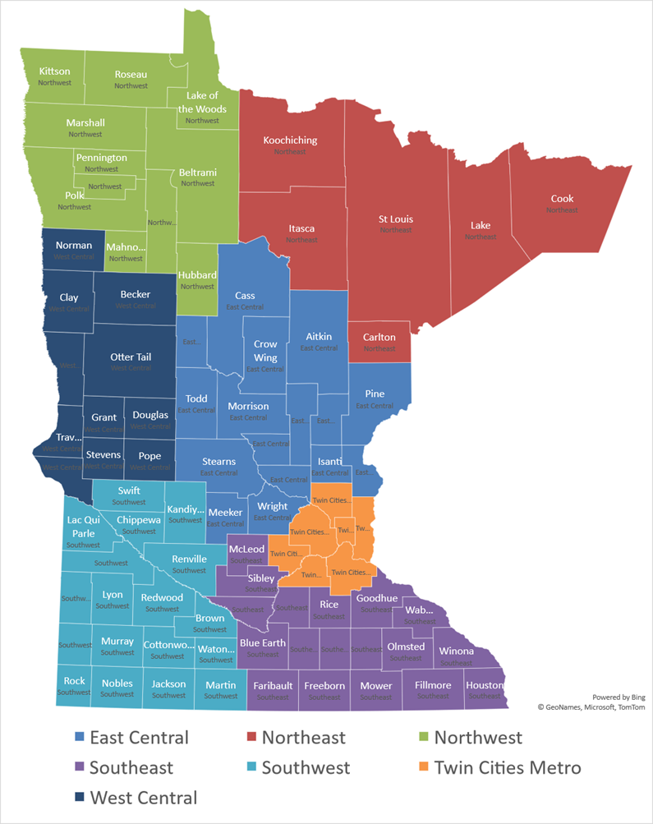
The Delay in Onboarding New Staff Due to DHS Background Study Issues Lengthier in Southeast, East Central, and Northeast Regions

Slide 28
25% of Nursing Facilities Report Not Having Adequate Access to TMA Training

Slide 29
Amount of Time Elapsed from Posting a Position to Making an Offer

Slide 30
Amount of Time Elapsed from Making an Offer to Actual First Day of Work

Slide 31
Most Nursing Facilities Have Used Temporary Rate Add-On of $12.35 to Increase Wages and/or Address Operating Deficits

Slide 32
Most Nursing Facilities Have or Plan to Use One Time Payment for Operating or Property Related Long-Term Debt Payments, Physical Plant Improvements

Slide 33
Nursing Facility Admission Remain Dependent on Staffing and Needs of Clients

Slide 34
Nearly All Nursing Facilities Using Workforce Incentive Grants to Provide Retention, Recruitment, and Incentive payments

Slide 35
Most Nursing Facilities to Distribute Workforce Incentive Grants Over the Year

Slide 36
Uses of 2024 Elderly Waiver Rate Increase as Reported on Required Distribution Plan

