Slide 1
HCBS Settings Attestation Update
August 10, 2017
Bobbie Guidry, VP Housing and Community Based Services
bguidry@leadingagemn.org
651-603-3508

Slide 2
Today’s Agenda
Overall Progress
Updates to Initial Attestations
Reassurance from DHS
DHS Next Step Activity
Hardship Extension Request
HWS Lease Requirements – Changes and timelines

Slide 3
State of Attestations
92% of HCBS settings completed the attestation. (5,413 submissions)
2,873 of these submissions attested to full compliance
78% of Customized Living settings completed the attestation. (989)
338 of these attested to full compliance
85% of Adult Day settings completed the attestation. (152)
109 of these attested to full compliance
Notes:
State received initial approval of the MN State Transition plan. CMS also extended the final deadline for full compliance for all states but because there is much work to do, the Federal extension did not affect the State progression.
Attestations were due by 4/30 with full compliance due by 9-1 unless a hardship waiver is requested which extends the compliance date to the end of the year.

Slide 4
Transition Plan Timelines/Milestones
Notes:
In phase 2

Slide 5
Attestation “Not yet” providers
8/4/17 an email reminder went to providers that submitted an attestation, but indicated “not yet” compliant in at least one area
  The emails informed providers that they need to update their attestation to “comply” or file for a hardship extension prior to Sept 1
  The email also contained the new video on “how to update” an attestation and tips on how to comply with the top areas that providers indicated that they are not yet compliant.
Notes:
Tools on the DHS HCBS setting rule page - Links to these tools are also in Advantage

Slide 6
Attestation “Non-responsive” providers
  DHS has attempted contacts with these providers by email and phone
  A letter will be mailed to providers on the list this week. Please note, DHS will be taking the following action, if attestations are not submitted by Sept. 1, 2017 (unless provider submits a hardship extension):
    “Minnesota Health Care Programs (MHCP) will stop your ability to bill for services and will not allow new service agreements to be authorized.”
Notes:
We know there are errors on the list – so let us or DHS know if you are contacted incorrectly.

Slide 7
“not yet providers” - Updating your Attestation
Select the link to open the online attestation form
Select update a submitted attestation (do not create a new attestation)
Enter the license or HFID
Use the same license or HFID number found in the confirmation email you received after your initial attestation form submission
Enter your email address –the same email address on this email
Select lookup and then Start Attestation
Use the next button at the top of the form to navigate the form and update your responses
Go to the last page of the form and upload supporting documents
Select submit attestation (not Save)
Notes:
Process for updating--

Slide 8
Attestation question 8 - Employment: To meet this new requirement, providers need to:
  Support people who would like to work by providing access to flexible scheduling of services and activities during times that compliment a person’s work schedule.
  Ensure all people have the opportunity and supports to seek employment. The rule states that people who want to work must be supported in their choice, and that no barriers would be in place if they chose to work. Many older adults choose to retire or not to seek employment.
  Use and upload with the online attestation form, the Staff Orientation Record or Staff Annual Training Record showing staff are trained on supporting people to enable them to work or volunteer in the community. For example, staffing and services support flexible scheduling, accommodating a person’s work schedule, and delivering services that complement a person’s schedule.
Notes:
The Question that had the fewest folks in compliance – was Employment – confusion on how this applied and what our responsibilities are.

Slide 9
LeadingAge MN sample policy – CL/HWS
Notes:
Most common outstanding item related to Employment – so we have sample policies available for this item.

Slide 10
LeadingAge MN sample policy - ADS

Slide 11
Attestation question 2- Lockable door: To meet this new requirement, providers need to:
  Ensure that each person has a lockable unit door.
  Use and upload with the online attestation form, a blank copy of the lease / housing with services contract which informs people of their rights to privacy, including a lockable unit door.
  Use and upload with the online attestation form, the Staff Orientation Record or Staff Annual Training Record showing staff are trained on people’s right to privacy. For example, staff will knock or request to enter a room and receive permission prior to entering. Staff will only access a person’s unit without their approval as needed for health and safety.

Slide 12
Memory Care
For settings that are secured memory care, review the Frequently Asked Questions webpage for the response to the common question, “Can we have a policy for secured memory care that everyone receives?” :
“No, you cannot have a blanket policy that covers everyone in that setting. Every person in that setting must have an assessment that shows his or her need for a secure environment. This modification must be written in every person’s support plan. See the Modifying/restricting HCBS standards section below for more information. If a person is able to come and go safely, then he or she needs a code or another way to move freely about the building.”
Notes:
While everyone has a right to a lockable door, they also have a right to free movement so a modification is needed if someone needs a secure unit.

Slide 13
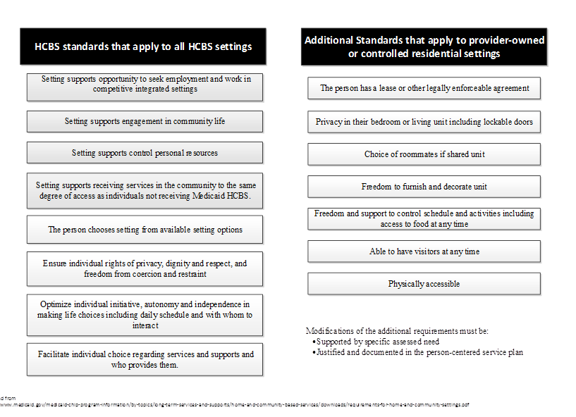
HCBS Standards

Slide 14
Modification of the Standards:
The federal rule does allow for modifications to some of the requirements
Those that can be modified are the additional requirements of provider-owned or controlled residential settings, with the exception of the last bullet, as all settings must be physically accessible to the individual.
The modifications must be based on an individual’s documented support needs, and providers may not modify any of the standards in a way that would affect or restrict all individuals in a setting.

Slide 15
Legislative change to 144D HWS Contract Act
New Housing with Services Contract Requirements Related to Resident Rights effective May 31, 2017
The Minnesota Department of Health will enforce January 1, 2018.
DHS expects compliance by September 1, 2017, unless an extension request is submitted – extending the compliance deadline to December 31, 2017.
Notes:
For those of you who answered that you were in compliance on the lease, you will now need to update the lease or supporting documents

Slide 16
What changes were made to Chapter 144D (HWS Contract Act)?
Who will these changes apply to?
Subd. 2a. Additional contract requirements. (a) For a resident receiving one or more health-related services from the establishment's arranged home care provider, as defined in section 144D.01, subdivision 6, the contract must include the requirements in paragraph(b)

Slide 17
Changes to 144D continued
(b) The contract must include a statement:
(1) regarding the ability of a resident to furnish and decorate the resident's unit within the terms of the lease;
(2) regarding the resident's right to access food at any time;
(3) regarding a resident's right to choose the resident's visitors and times of visits;
(4) regarding the resident's right to choose a roommate if sharing a unit; and
(5) notifying the resident of the resident's right to have and use a lockable door to the resident's unit. The landlord shall provide the locks on the unit. Only a staff member with a specific need to enter the unit shall have keys, and advance notice must be given to the resident before entrance, when possible.

Slide 18
The contract must include statements:
regarding the ability of a resident to furnish and decorate the resident’s unit within the terms of the lease.
Implementation Guidance: This means that people can decorate their room or apartment, including choosing decorations, linens, furniture and other household items that are within the resident’s budget.

Slide 19
regarding the resident’s right to access food at any time.
Implementation Guidance: This means that people can choose when, where, and with whom they would like to eat. If a person misses a meal due to an activity, they do not have to wait for the next meal to eat. People are allowed to store snacks in their unit or a designated area that is accessible to them at all times.

Slide 20
regarding a resident’s right to choose the resident’s visitors and times of visits.
Implementation Guidance: This means that people choose who their visitors are, and have privacy during the visits without any restrictions on the time of visits and where they visit their guests.

Slide 21
regarding the resident’s right to choose a roommate if sharing a unit.
Implementation Guidance: This means that people share a room with a person that they are compatible with and know how they can request a choice of or change in roommates.

Slide 22
notifying the resident of the resident’s right to have and use a lockable door to the resident’s unit. The landlord shall provide the locks on the unit. Only a staff member with a specific need to enter the unit shall have keys, and advance notice must be given to the resident before entrance, when possible.
Implementation Guidance: This means that staff will respect people’s privacy by knocking or requesting to enter a room and receive permission prior to entering. Staff only access a person’s unit without their approval as needed for health and safety.

Slide 23
144D changes
Apply to all residents (who receive one or more health related service)
A signature demonstrating receipt of the new rights is required from existing residents
A hardship extension can be requested
For HUD housing the changes could be in the form of “house rules”

Slide 24
What happens if you fall into the “presumed not to be HCBS?”
Those settings will trigger the heightened scrutiny process
A state may overcome the presumption that a setting has institutional qualities by submitting evidence to CMS demonstrating the setting does not have the qualities of an institution AND that it does have the qualities of a home and community-based setting
When the state submits this evidence to CMS, the state triggers a process known as “heightened scrutiny”
Under the heightened scrutiny process, CMS reviews the evidence submitted by the state.
Notes:
DHS rep at SLN last week – main message that DHS does not want to lose providers and will assist to help providers get into compliance if possible.

Slide 25
The Evidence package may include:
Provider Attestation and supporting documentation
Provider Transition Plan – if needed
On-site Assessment – if needed
Submitted documentation from provider
Public Comments regarding the setting
Any evidence that will support the setting as HCBS compliant

Slide 26
How does a person’s experience fit into the HCBS settings rule?
Ensure person’s experience matches the rule requirements
Validate provider attestation
Federal reporting
Notes:
You be aware that there will also be an annual, Person’s Experience Survey, conducted by their case manager.

Slide 27
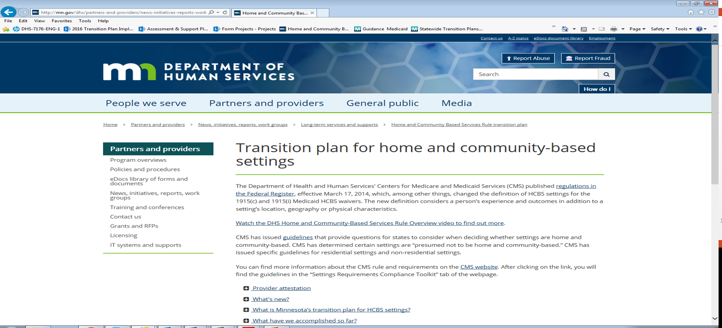
MN HCBS webpage mn.gov/dhs/hcbs
Notes:
Additional information, forms, and FAQ on the DHS website

Slide 28
Questions for DHS
Email: HCBS.settings@state.mn.us
www.mn.gov/dhs/hcbs

Slide 29
For More Information on the Settings Rule…
Bobbie Guidry
Vice President of Housing and Community Services
651.603.3508
bguidry@leadingagemn.org

