Slide 1
Survey on Admission Policies
November 8, 2022

Slide 2
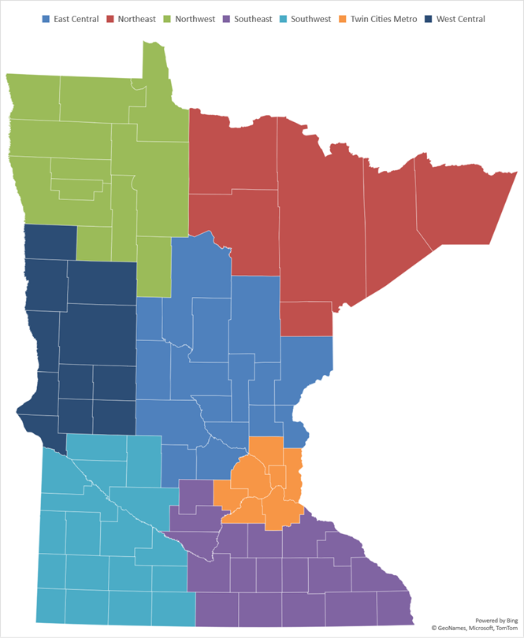
Background
Survey emailed on October 31, 2022
Survey closed on November 7, 2022
Respondents
Region | Assisted Living | Nursing Facility
East Central | 35 | 20
Northeast | 13 | 18
Northwest | 12 | 13
Southeast | 38 | 36
Southwest | 24 | 19
Twin Cities Metro | 116 | 43
West Central | 24 | 14
State | 262 | 163

Slide 3
Nursing Facility Census Remains Historically Low 4 of 5 Nursing Facilities Have Placed Hold on Admissions during the Pandemic

Slide 4
Nearly All Nursing Facilities that Have Placed Hold on Admissions Report Turning Away More Hospital Admissions than Before the Pandemic

Slide 5
Assisted Living Census Remains Historically Low More than 50% of Assisted Living Facilities in East Central and West Central Have Placed Hold on Admissions during the Pandemic

Slide 6
Nearly 70% of Assisted Living Facilities that Have Placed Hold on Admissions Report Turning Away More Hospital Admissions than Before the Pandemic

Slide 7
One-Third of Assisted Living Residents are Enrolled in Medicaid Waiver

Slide 8
Typical Nursing Facility Decline Nearly 15 Admission Referrals during October 2022
Average Number of Declined Admission Referrals Decline by Facility for October 2022
Estimated Number of Declined Admission Referrals for Minnesota in October 2022

Slide 9
Miniscule Number of Nursing Facilities Report Not Turning Down Any Admission Referrals in October

Slide 10
More than a Third of Nursing Facilities in Minnesota Report Turning Down 21 or More Admission Referrals in October

Slide 11
Assisted Living Facilities More Likely to Report Not Turning Down Any Admission Referrals During Month of October 2022

Slide 12
More than 60% of Assisted Living Facilities in Minnesota Report Turning Down 1 to 5 Admission Referrals During Month of October 2022

Slide 14
Insufficient Staffing, Ability to Meet Specific Needs, and Weekends Used Most Frequently when Deciding to Admit

Slide 15
Waiting Lists for Admission Vary by Region and Provider Type

Slide 16
An estimated 727 unregistered staff are working as nursing assistants who will need to complete training and/or testing for certification before the nurse aide training waiver expires. 8/17/2020, the estimate was nearly 1,200.

