Slide 1
Financial Status Survey of Nursing Facilities and Assisted Living Facilities
April 19, 2023

Slide 2
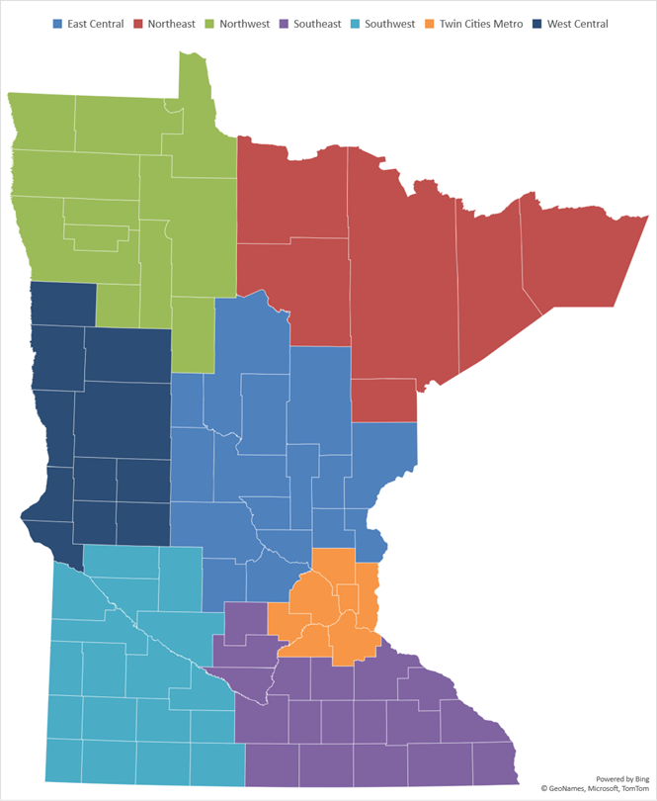
Background
Survey emailed on April 5, 2023
Survey closed on April 13, 2023
Respondents
Region | Assisted Living | Nursing Facility
East Central | 25 | 17
Northeast | 10 | 7
Northwest | 13 | 10
Southeast | 22 | 19
Southwest | 19 | 17
Twin Cities Metro | 68 | 38
West Central | 18 | 16
State | 175 | 124

Slide 3
Key Findings
Denied admissions (or referrals) by nursing facilities have increased.
The number of nursing facilities that have exhausted their reserves has increased.
Nursing facilities show an increase in the number considering closure. Assisted living facilities in greater Minnesota much more likely to be considering sale or closure.
Respondents (esp., nursing facilities) reporting lack of interest in posted CNA, LPN, and RN positions.
Providers have dropped unfilled positions from their budgets. Without new funding and increased census, this is the new normal for staffing and access.

Slide 4
Number of Estimated Unregistered Staff Working as Nursing Assistants Remains Unchanged
An estimated 782 unregistered staff are working as nursing assistants who will need to complete training and/or testing for certification before the nurse aide training waiver expires on May 11, 2023 and unregistered staff have until September 10, 2023 to complete training/testing.
10/15/2022, the estimate was nearly 727.
8/17/2020, the estimate was nearly 1,200.

Slide 5
Providers have Dropped Unfilled Positions from Their Budgets
Without New Funding and Increased Census, this is the New Normal
Unfilled Positions Decreases from the 18,400 Unfilled Key LTC Employee Positions That Were Reported in January 2023.

Slide 6
Assisted Living Facilities Struggle to Garner interest in Open Positions with Aides in Greater Minnesota the Most Difficult
Despite offering higher pay than in the past, Facility is currently receiving “little to no” interest for the following vacant positions

Slide 7
Nursing Facilities Report Little or No Interest in Open Direct Care Positions Despite Offering Higher Pay
Despite offering higher pay than in the past, Facility is currently receiving “little to no” interest for the following vacant positions

Slide 8
Number of Nursing Facilities that Report the Exhaustion of Reserves has Increase from 5% to 15%.
Nursing Facilities and Use of Financial Reserves
7-County Metro
Greater Minnesota

Slide 9
32% of Assisted Living Setting Report Their Reserves are Exhausted
32% Statewide

Slide 10
42% of Nursing Facilities and Assisted Living Settings that are Using Reserves or Planning to Use, Have Six or Fewer Months Before Exhaustion

Slide 11
38% of Nursing Facilities and Assisted Living Settings Have Exhausted, Began Using, or Plan to Access Their Line of Credit

Slide 12
Of Those Settings that Have Exhausted Their Line of Credit…….
24% Have Applied for Additional Lines of Credit or Borrowing
Of the 24%:
  43% were denied
  43% Do Not Know Yet
  14% were approved for additional credit or borrowing

Slide 13
Greater Minnesota Nursing Facilities continue to pursue capacity reduction strategies to maintain financial solvency (e.g., placing nursing facility beds on layaway, closing beds)
7-County Metro
Greater Minnesota

Slide 14
Assisted Living Settings Less Likely to Pursue Capacity Reduction

Slide 15
Considering Sale or Closure of Nursing Facility
Several sales, including one organization with 11 nursing facilities, occurred between August 2022 and April 2023.

Slide 16
Assisted Living Facilities Considering Sale or Closure (April 2023)

Slide 17
In the next 9-months, if state Medicaid reimbursement is not increased and the economic and workforce crisis continues, what is the percent chance your facility will reduce capacity?

Slide 18
In the next 9-months, if state Medicaid reimbursement is not increased and the economic and workforce crisis continues, what is the percent chance you will put your facility up for sale?

Slide 19
In the next 9-months, if state Medicaid reimbursement is not increased and the economic and workforce crisis continues, what is the percent chance you will close your facility?

Slide 20
While Most Nursing Facilities are Accepting Some Admissions from Hospitals………..

Slide 21
Ability to Meet Specific Needs, Insufficient Staffing, and Weekends Used Most Frequently when Deciding to Admit

Slide 22
Number of Admission Referrals Declined by Typical Nursing Facility Increases from 14.6 to 21 (or by 44%)

Slide 23
Nursing Facilities Located in Twin Cities, Southeast, and West Central Decline the Highest Number of Referrals

Slide 24
Assisted Living Facilities in Southeast and East Central Decline the Highest Number of Referrals

Slide 25
Number of Referrals Declined Increases in March 2023. Nearly All Are Attributable to Nursing Facilities

Slide 26
Criteria used to assess sale or closure Please check any of the following that describes your nursing facility today. | Assisted Living Facility | Nursing Facility
We do not have enough licensed staff (especially, to cover nights and weekends). | 39.4% | 74.2%
Pool agencies will not send staff until accounts payable are current. | 2.3% | 2.4%
Setting is in breach of covenant with financial institution(s) | 2.3% | 8.1%
Pool agencies will not send staff unless payment is received prior to start of shift. | 1.7% | 0.8%
Setting has inadequate referrals to operate at full capacity. | 31.4% | 16.9%
Setting is currently limiting census to an amount below capacity because you are unable to staff to full capacity | 16.6% | 62.9%
Setting has physical plant deficiencies that require an expenditure of at least $100,000 | 5.7% | 25.8%
Staffing availability, staff turnover, and loss of experienced staff has increased likelihood of regulatory problems for the facility. | 41.1% | 50.8%
We are part of a multifacility organization and depend on corporate office for financial support and resources. | 26.9% | 34.7%
Daily census remains well below pre-pandemic levels. | 38.3% | 62.9%
Our services are needed by our market. | 64.0% | 89.5%
Setting is unable to provide wage increases needed to compete with other employers. | 49.7% | 58.1%
More than once a week leadership staff are working shifts providing direct care (floor nurse, C.N.A., etc.) or other services including housekeeping, dietary etc. | 54.9% | 66.1%
Facility is receiving “little to no” interest for posted vacant positions. | 54.3% | 72.6%

Slide 27
Assisted Living Facilities Please check any of the following that describes your assisted living facility today. | Considering Sale | Considering Closure | Not Considering Sale or Closure
We do not have enough licensed staff (especially, to cover nights and weekends). | 66.7% | 72.7% | 35.1%
Pool agencies will not send staff until accounts payable are current. | 4.2% | 0.0% | 2.0%
Setting is in breach of covenant with financial institution(s) | 8.3% | 18.2% | 1.3%
Pool agencies will not send staff unless payment is received prior to start of shift. | 0.0% | 0.0% | 2.0%
Setting has inadequate referrals to operate at full capacity. | 54.2% | 63.6% | 27.8%
Setting is currently limiting census to an amount below capacity because you are unable to staff to full capacity | 33.3% | 36.4% | 13.9%
Setting has physical plant deficiencies that require an expenditure of at least $100,000 | 12.5% | 18.2% | 4.6%
Staffing availability, staff turnover, and loss of experienced staff has increased likelihood of regulatory problems for the facility. | 66.7% | 81.8% | 37.1%
We are part of a multifacility organization and depend on corporate office for financial support and resources. | 29.2% | 18.2% | 26.5%
Daily census remains well below pre-pandemic levels. | 45.8% | 54.5% | 37.1%
Our services are needed by our market. | 79.2% | 81.8% | 61.6%
Setting is unable to provide wage increases needed to compete with other employers. | 75.0% | 90.9% | 45.7%
More than once a week leadership staff are working shifts providing direct care (floor nurse, C.N.A., etc.) or other services including housekeeping, dietary etc. | 79.2% | 81.8% | 51.0%
Facility is receiving “little to no” interest for posted vacant positions. | 83.3% | 81.8% | 49.7%

Slide 28
Nursing Facilities Please check any of the following that describes your nursing facility today. | Considering Sale | Considering Closure | Not Considering Sale or Closure
We do not have enough licensed staff (especially, to cover nights and weekends). | 66.7% | 72.7% | 75.2%
Pool agencies will not send staff until accounts payable are current. | 6.7% | 9.1% | 1.9%
Setting is in breach of covenant with financial institution(s) | 40.0% | 36.4% | 3.8%
Pool agencies will not send staff unless payment is received prior to start of shift. | 0.0% | 0.0% | 1.0%
Setting has inadequate referrals to operate at full capacity. | 13.3% | 27.3% | 16.2%
Setting is currently limiting census to an amount below capacity because you are unable to staff to full capacity | 80.0% | 90.9% | 60.0%
Setting has physical plant deficiencies that require an expenditure of at least $100,000 | 46.7% | 72.7% | 21.9%
Staffing availability, staff turnover, and loss of experienced staff has increased likelihood of regulatory problems for the facility. | 53.3% | 90.9% | 48.6%
We are part of a multifacility organization and depend on corporate office for financial support and resources. | 46.7% | 45.5% | 33.3%
Daily census remains well below pre-pandemic levels. | 80.0% | 72.7% | 60.0%
Our services are needed by our market. | 93.3% | 90.9% | 89.5%
Setting is unable to provide wage increases needed to compete with other employers. | 53.3% | 54.5% | 59.0%
More than once a week leadership staff are working shifts providing direct care (floor nurse, C.N.A., etc.) or other services including housekeeping, dietary etc. | 66.7% | 72.7% | 65.7%
Facility is receiving “little to no” interest for posted vacant positions. | 93.3% | 100.0% | 68.6%

