Slide 1
Long-Term Care Workforce in Crisis March 2015

Slide 2
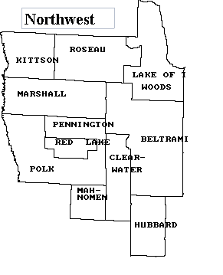
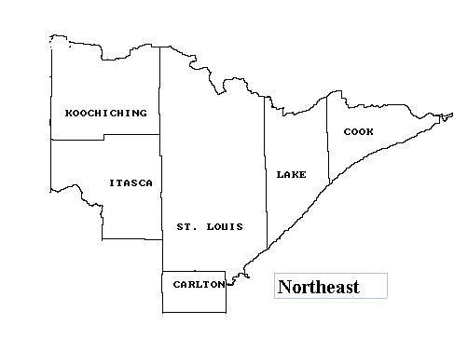
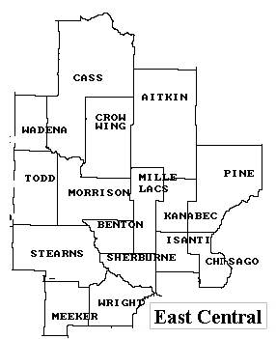
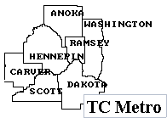
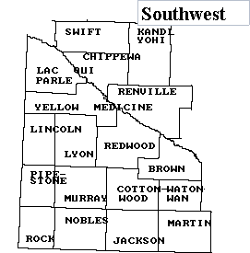
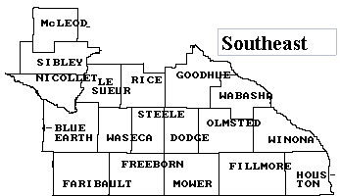
Counties by Region

Slide 3
Vacant Positions in Nursing Homes Jumped in 2014: Increased in a Year by almost 1,000 to more than 2,500
Source: Long Term Care Imperative 2015 Legislative Survey

Slide 4
Nursing Home Vacancies Grew by Over 2.5 Positions per Home in 2014
Source: Long Term Care Imperative 2015 Legislative Survey

Slide 5
Nursing Home Employee Vacancy Rates Spiked to 12% or Higher for Caregivers in 2014
Source: Long Term Care Imperative 2015 Legislative Survey

Slide 6
Nursing Home RN Vacancy Rate Highest in Metro Area in 2014
Source: Long Term Care Imperative 2015 Legislative Survey

Slide 7
Nursing Home LPN Vacancy Rate Highest in Northeast in 2014
Source: Long Term Care Imperative 2015 Legislative Survey

Slide 8
Nursing Home NAR Vacancy Rate Highest in Northeast in 2014
Source: Long Term Care Imperative 2015 Legislative Survey

Slide 9
Nursing Home RN Turnover Rate Increases Dramatically in 2014- Highest in West Central and Southeast Regions
Source: Long Term Care Imperative 2015 Legislative Survey

Slide 10
Nursing Home LPN Turnover Rate Increases Modestly in 2014- Highest in West Central and Southeast Regions
Source: Long Term Care Imperative 2015 Legislative Survey

Slide 11
Nursing Home Direct Care Staff Turnover Rate was More than 50% in 2014- Highest in Northeast Region
Source: Long Term Care Imperative 2015 Legislative Survey

Slide 12
Over 1,500 Nursing Home Admissions Denied During 2014 Due to Insufficient Staffing
Source: Long Term Care Imperative 2015 Legislative Survey
Notes:
12% of nursing homes completely shut off admissions at some point

Slide 13
Employee Vacancy Rates in Minnesota Senior Housing Increased Dramatically in 2014
Source: Long Term Care Imperative 2015 Legislative Survey
Notes:
Vacancy rates higher in nursing homes, where all positions are double digits

Slide 14
Employee Turnover in Minnesota Senior Housing Increased Significantly in 2014
Source: Long Term Care Imperative 2015 Legislative Survey
Notes:
Turnover rates much lower than nursing homes

