Slide 1
Job Posting Process
Select the type of position you have available (job/internship)
Add basic information about the position
Select the job titles that best describe the opening
Answer job-specific sliding-scale questions
Complete payment and select optional premium job boards
Promote your posting
Evaluate candidates utilizing Fit Assessments

Slide 2
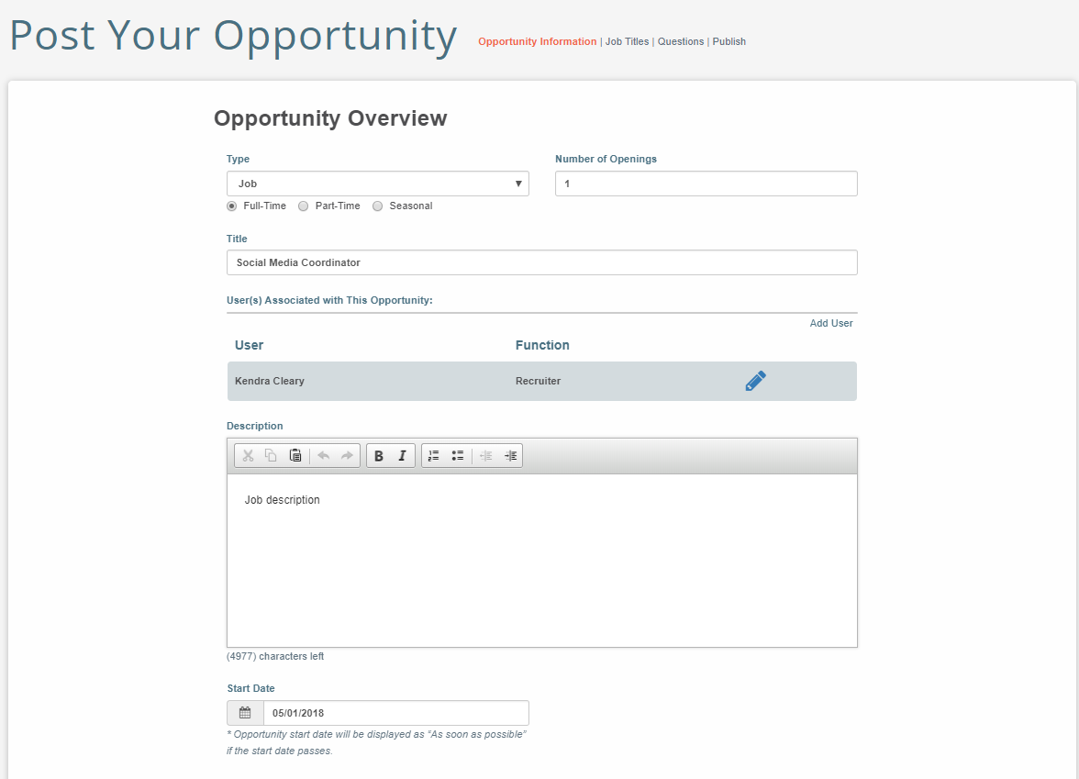
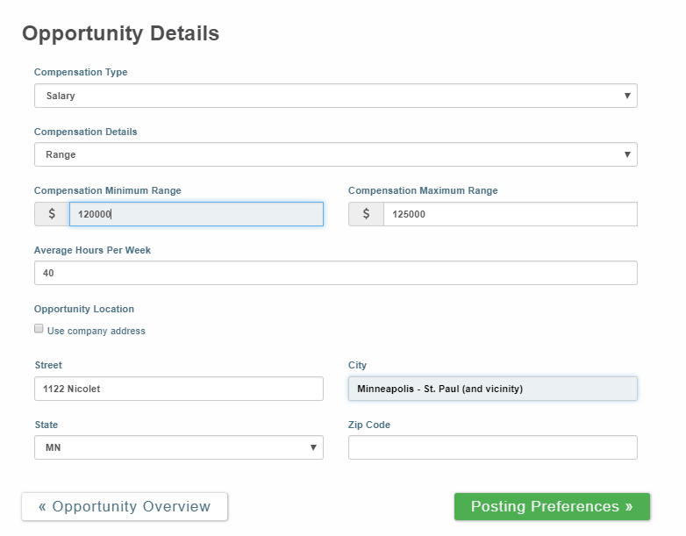
Opportunity Overview & Details
Employers enter our system by building a short company profile, then move to the opportunity posting process.
Enter basic job information, description and details.
The system will default to your company address, but you can change locations if you recruit for multiple offices.
Notes:
The Exchange’s questions are set up on a sliding likert scale that is similar for the employer and the job-seeker. There are an average of 20-30 questions associated with each position, and they concentrate on job characteristics and activities, but also soft skills, organization culture and work style.
Answer 20-30 questions on average on specific skill requirements of position. Questions concentrate on job characteristics and activities, plus two questions on organization culture. Send to hiring manager to complete questionnaire (easy click and send) Can also flag specific questions for hiring manager review Candidate will answer same questions, from perspective of preference and skill.

Slide 3
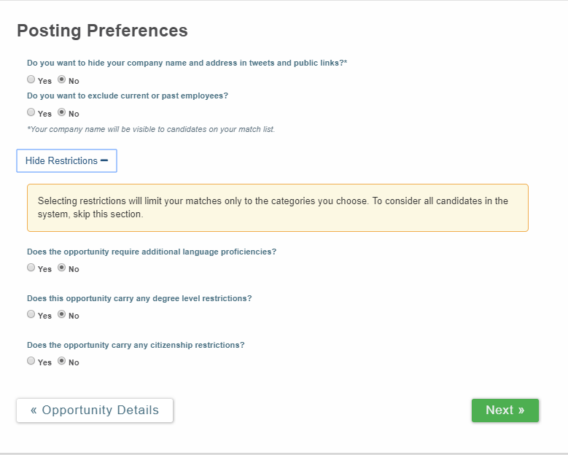
Posting Preferences
Employers may mark a posting as “sensitive.“ Sensitive postings will not be matched to current or past employees.
Restrictions are hidden to protect you from EEOC compliance issues. However, you may elect additional language proficiencies, degree levels or citizenship restrictions if applicable.

Slide 4
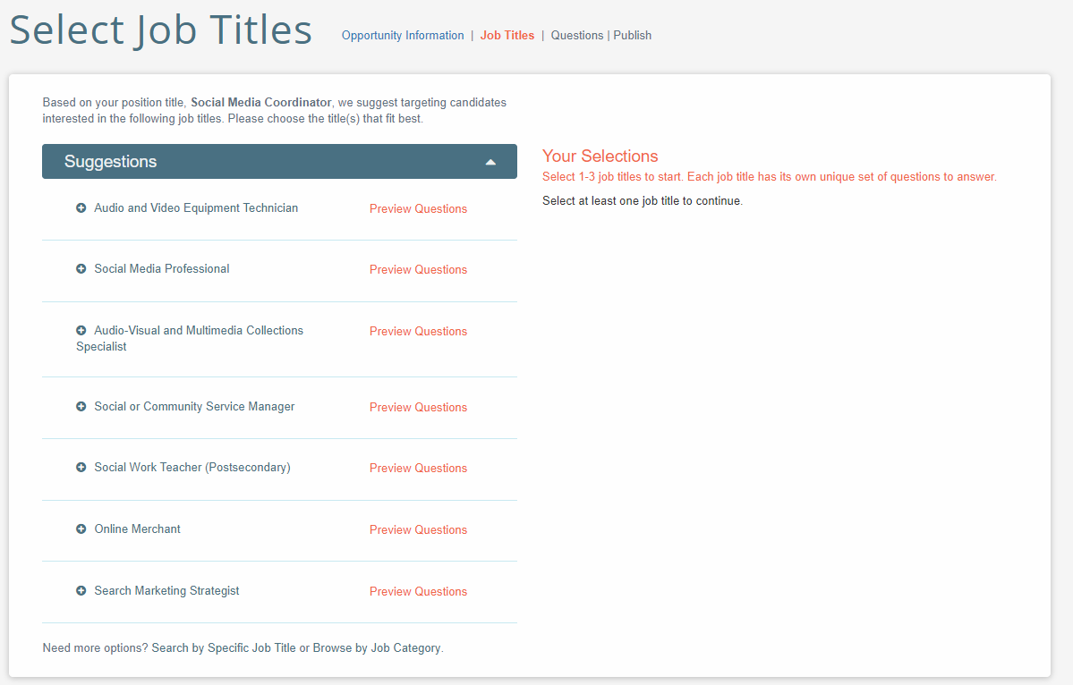
Select Job Title(s)
Our system will provide you with suggested job titles. Click Preview Questions to see if this title matches your opportunity.
You may select up to 3 job titles to create a customized questionnaire for your position.
Not finding your correct title? Click links at bottom of the page to Search by Specific Job Title or Browse by Job Category.

Slide 5
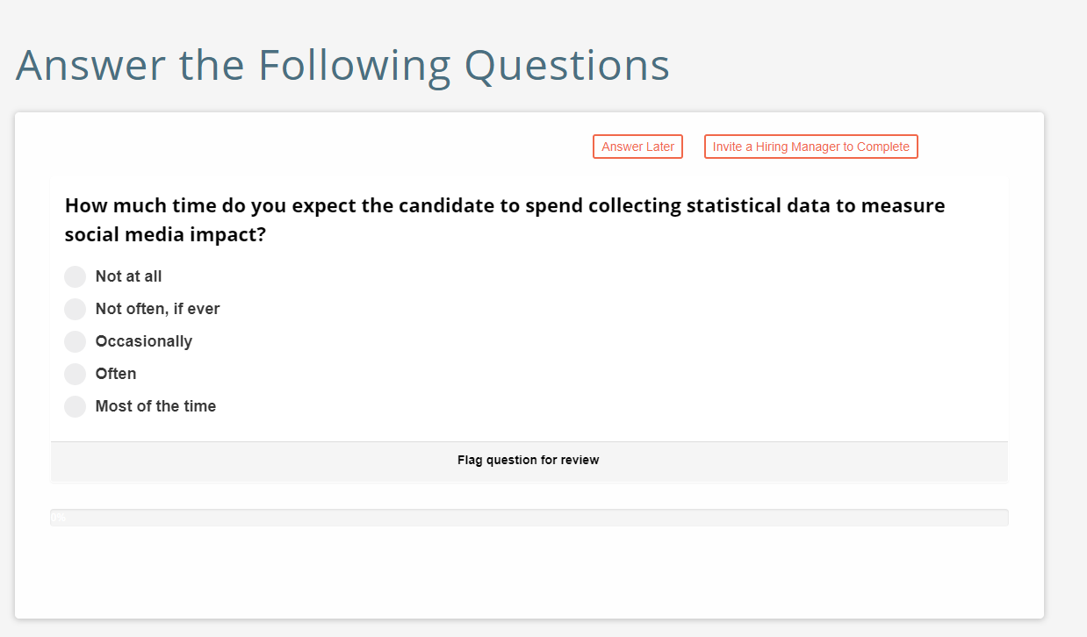
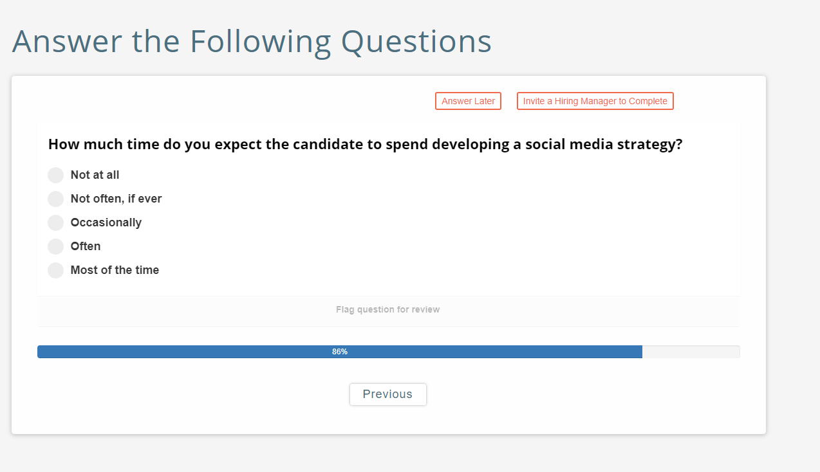
Customize Questionnaire for YOUR opening
Parallel questions are asked of employers and job-seekers based on work preferences and skills
Based on 1,400 Department of Labor job titles and over 100,000 job characteristics
Concentrated on job characteristics and activities, plus two questions on organization culture
Survey on specific job skill requirements should take less than 5 minutes to complete

Slide 6
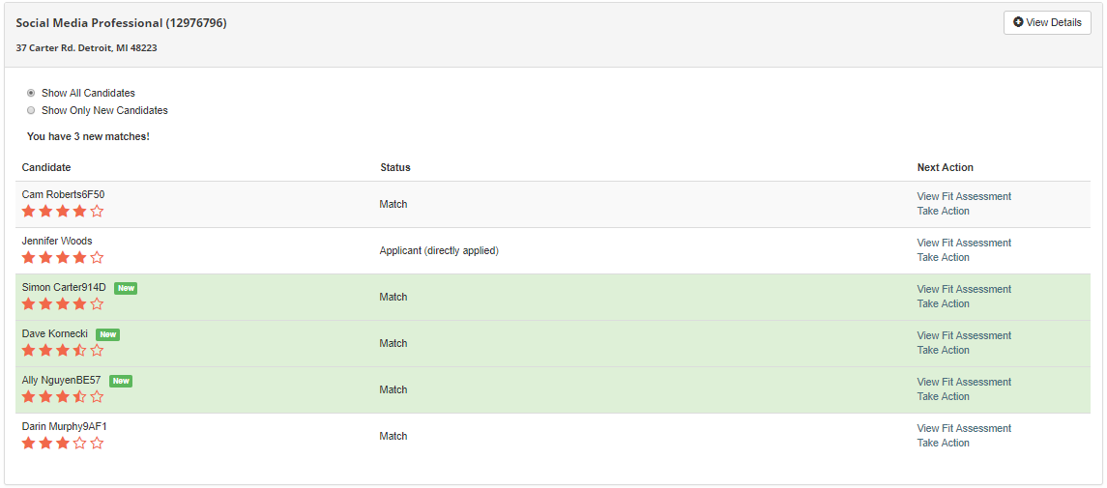
Candidate Dashboard
All candidates are screened, scored and stack-ranked within seconds using patented technology.
Employers can see all direct applicants and you may receive up to 7 system matches.
Review each candidate by clicking View Fit Assessment. Next, choose Take Action and select from drop down menu to schedule phone or live interview. If not interested, remove candidate from consideration.

Slide 7
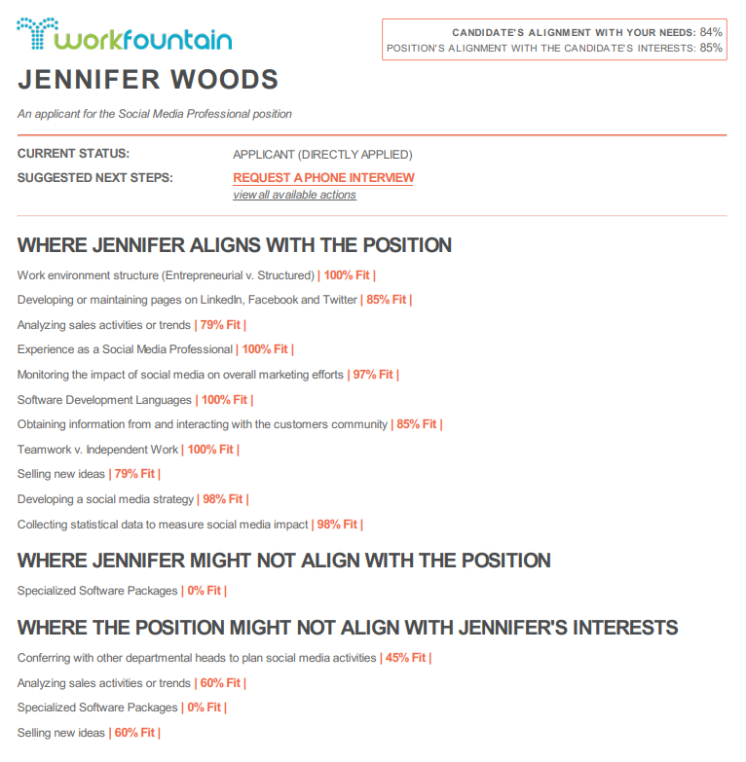
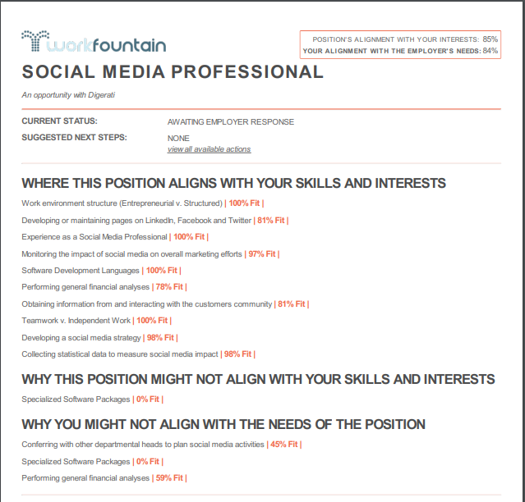
Fit Assessments
Available to both Employer and Candidate
Employer
Review candidate based on skill, ability, and interest alignment
Accelerate hiring without sacrificing time, quality, or applicant diversity
Furnish a standardized view of the information needed to make an initial candidate assessment
Candidate
For the first time ever, candidates receive immediate, unbiased feedback on their application

