Slide 1
2023
Long-Term Care Imperative Workforce Survey
February 2023

Slide 2
Survey Background
Sent to all Assisted Living and Care Center members of LeadingAge MN and CPM in mid-January
Survey closed February 1, 2023
200 assisted living responses and 97 Care Center responses

Slide 3
Key Takeaways
Vacancies remain very high, with more than 18,500 Nursing Facility and Assisted Living positions open. This number has declined somewhat because providers are assuming that they cannot plan to serve as many people going forward.
Vacancy rates for aide and nursing positions in Nursing Facilities are more than 20% and have increased for licensed nurses in the last year
Nursing Facilities are still 15% below the number of employees they had before the pandemic
Turnover spiked in the last year, reaching 80% for aides in nursing facilities. Turnover also increased slightly for nurses in both assisted living and nursing facilities.

Slide 4
Nursing Assistant and Unlicensed Aide Vacancy Rate Improved in Last Year
Remains much Higher for NFs
Notes:
AL 17% vacant, NF 25%

Slide 5
LPN Vacancy Rate Remains Stable in AL
NFs saw a Spike in last Year to 27%
Notes:
AL 20% vacant

Slide 6
RN Vacancy Rates Remain Mostly Unchanged
NFs at more than 20% of Positions Unfilled
Notes:
AL 16% vacant, NF 22%

Slide 7
Over 20% of Positions Remain Unfilled
Notes:
Some improvement due to slightly lower vacancy rates, most due to fewer budgeted positions

Slide 8
AL Nurse Turnover Rates went Higher in 2022
Aide Turnover Declined but Remained High

Slide 9
Statewide NF Staff Turnover in 2022 Spiked
Considerably for Nursing Positions
Notes:
81% aide turnover and 58% RN turnover are unprecedented

Slide 10
AL Employee Retention Rates in 2022 Declined for Nurses but Increased for Other Staff

Slide 11
NF Employee Retention Rates in 2022 Declined for Aides but Increased for Other Staff
Source: 2023 LTC Imperative Legislative Workforce Survey

Slide 12
Average Number of AL Employees Increases Slightly
Returning Settings to Pre-pandemic Number

Slide 13
Number of NF Employees Remains Well Below Pre-Pandemic Level
Statewide + East Central, Northwest, Southeast, and West Central Worsened Further in 2022

Slide 14
Most AL Residents Receive Services
EW Highest in Rural Areas, Disability Waivers in Metro and Northwest
Notes:
One third of AL residents not on services (issue with ALL requirement). Metro lowest for EW- the 20% number has been very consistent statewide over the years.

Slide 15
Over 1 in 4 NF and AL Report Losing Employees to Staffing Agencies
Providers who have lost RN, LPN, CNAs etc., to SNSAs or Traveling Nursing Agencies report losing an average of:
  Assisted Living Setting: 2.1 Employees
  Nursing Facility: 3.3 Employees
Notes:
Smaller numbers than we expected

Slide 16
Assisted Living License Requirements have Increased R.N. Workloads
92% of Respondents state that the requirements of Assisted Living Licensure, the workloads of RNs have increased.
Assisted Living Facilities estimate that R.N. workloads have increased by 13.6 hours per week.

Slide 17
Nearly 25% of Assisted Living Settings Need Additional R.N. Staffing to Meet the Requirement of Assisted Living Licensure
Nearly 1 NEW RN (FTE) per setting was reported by the 17% of AL settings that hired additional RN staff
8.4% would hire more R.N. staff but are unable to find

Slide 18
Number of Employees Utilizing the Nurse Aide Training Waiver Continues to Decline
An estimated 553 unregistered staff are working as nursing assistants who will need to complete training and/or testing for certification before the nurse aide training waiver expires.
November 2023, the estimate was 727.
8/17/2020, the estimate was nearly 1,200.

Slide 19
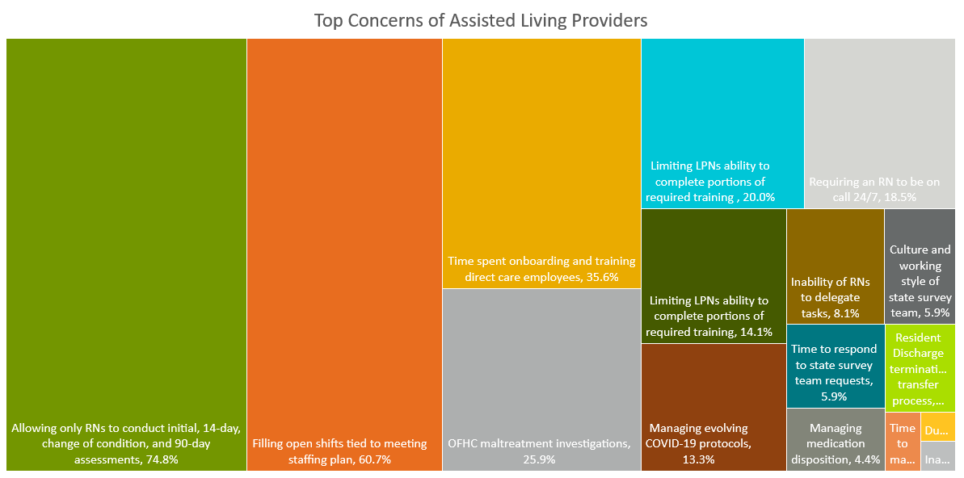
Notes:
RNs only allowed to do assessments
Filling open shifts to meet the staffing plan

Slide 20
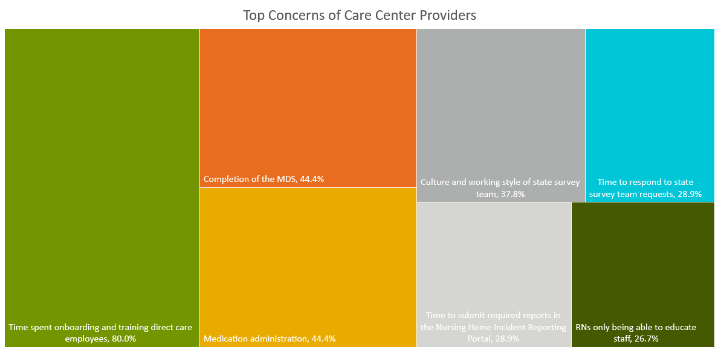
Notes:
Time spent onboarding direct care employees
MDS completion and Med Administration (tie)

Slide 21
Conclusions
The workforce challenges aren’t really improving, but providers are adjusting to a new normal
This could mean ongoing financial uncertainty for providers that are unable to serve a critical capacity of people due to the lack of workforce
Providers will have to adjust business practices AND the state must act to make sure we can ensure access for a growing population of older adults.

