Slide 1
Long-Term Care Rapid Survey Data Collection

Slide 2

Week of 8/24/2020
Separate surveys emailed to nursing facilities and HWS/AL settings on 8/24
Survey closed 8/25 at Noon
171 Nursing facility respondents
203 HWS/AL respondents

Slide 3
Nursing Facility Baseline Testing

Slide 4
Assisted Living / Housing Baseline Testing

Slide 5
How was the lab paid for conducting the employee testing?

Slide 6
Nursing facilities, with Baseline Test, also conducting surveillance testing (choose all that apply)

Slide 7
Assisted Living, with Baseline Test, also conducting surveillance testing (choose all that apply)

Slide 8
An average of 3-Days for nursing facility tests to return

Slide 9
Assisted Living and Nursing Facilities
Days to Receive Lab Results

Slide 10
Rejected when Requesting Testing via REDcap Survey

Slide 11
Most Nursing Facilities Plan to Use Staff to Collect Specimens and Have an Existing Relationship with a Lab

Slide 12
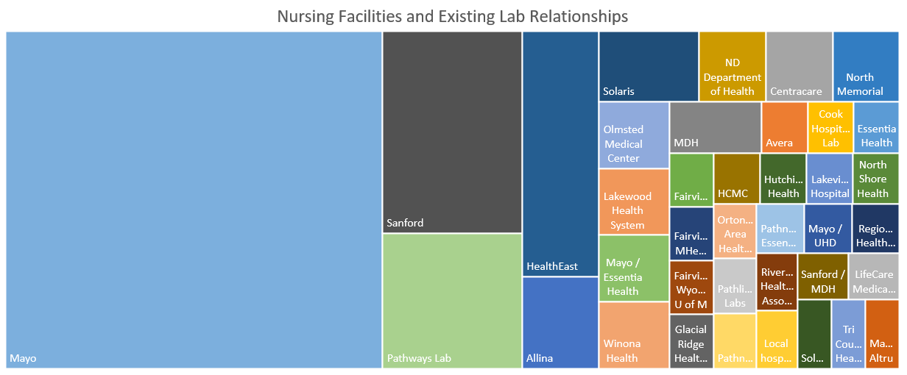

Slide 13
More than half of nursing facilities do not know if lab has enough supplies for weekly testing

Slide 14
Point of Care Testing Information
14 nursing facilities have POC testing equipment
7 indicated they have either BD Veritor Plus or Abbott NOW models
7 indicated they have a plan for negative test results.
  3 did not know
  3 do not have a plan

Slide 15
¾ of nursing facilities would use regional testing location for employees
Reasons for answering “No” often mentioned
Staff dislike of travel
Cost of travel
Travel distance
Chance of exposure
Inefficient if employees socially distance and drive alone.

Slide 16
Week of 8/17/2020
Separate surveys emailed to nursing facilities and HWS/AL settings on 8/17
Survey closed 8/18 at 10:15AM
144 Nursing facility respondents
207 HWS/AL respondents

Slide 17
Caregiver Positions Unfilled
Similar for Nursing Facilities (NARs) and Assisted Living (ULP)

Slide 18
Nurse Aide Training Waiver Integral to Nursing Facility Staffing
7.3% of caregivers were hired under waiver and not currently on the registry
Nearly 1,200 estimated caregivers fall under waiver presently

Slide 19
Nearly 10,000 Unfilled Caregiver Positions
Nursing Facilities and CNAs
370 Settings
2,721 Unfilled Caregiver Positions
Senior Housing / Assisted Living and ULPs
1,769 Settings
7,059 Unfilled Caregiving Positions

