Slide 1
Long-Term Care Rapid Survey Data Collection

Slide 2

Week of 3/29/2021 – Employee Vaccination
Survey emailed to nursing facilities on 3/30/2021
Survey closed 4/1/2021 at 11:00AM
145 Assisted Living Respondents
110 Nursing Facility respondents

Slide 3
Percent of Employees Vaccinated Is Roughly the Same by Setting

Slide 4
Very Small Percentage Are Using Financial Incentives to Encourage Employee Vaccinations

Slide 5
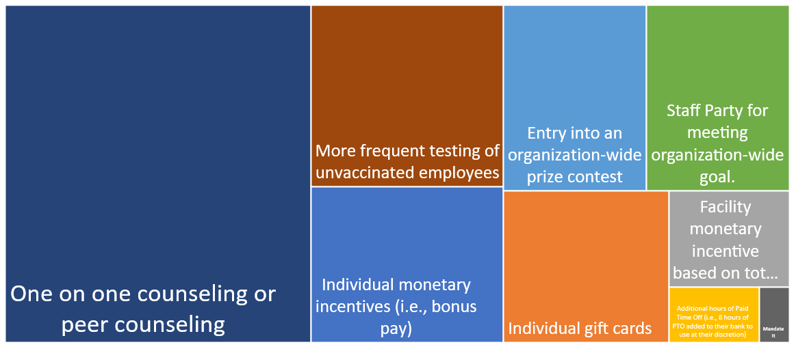
One on One Counseling the Most Utilized Strategy/Incentive (including non-financial incentives) for Employee COVID-19 vaccination

Slide 6
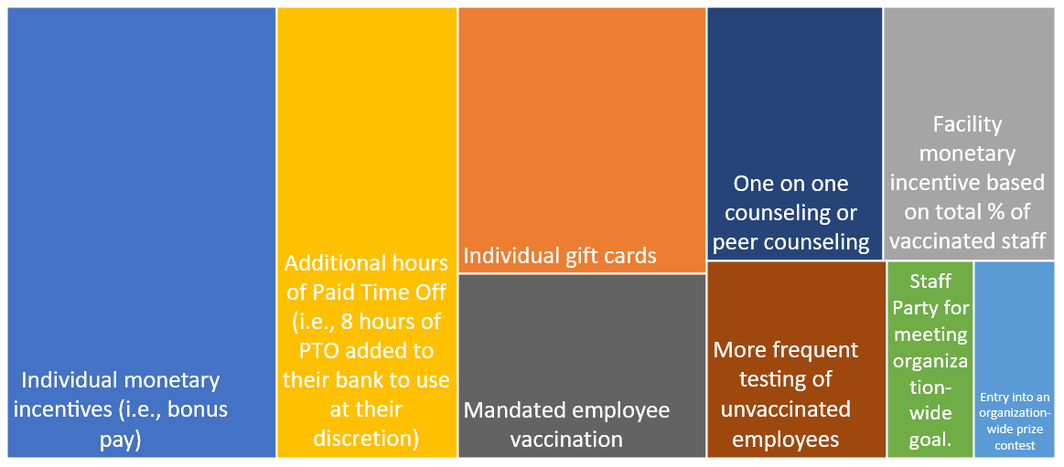
Monetary Incentives, Additional PTO, Gift Cards, and a Vaccination Mandate Thought to Be Best Strategies/Incentives
Choose Up to Three Strategy/Incentives that you THINK will Increase Employee COVID-19 vaccination

Slide 7
Week of 3/1/2021 – Visitation Policies
Survey emailed to nursing facilities on 3/3/2021
Survey closed 3/4/2021 at 11:00AM
223 Assisted Living Respondents
153 Nursing Facility respondents

Slide 8
4 out 5 Permitting Indoor Visitation
No Differentiation between Provider Type

Slide 9
Reasons Vary for Not Currently Permitting Indoor Visitation (multiple answers allowed)

Slide 10
Providers Perceive over 60% of Families are Somewhat or Very Satisfied with Visitation Policies

Slide 11
Slight Difference in Perceived Family Satisfaction between Providers with “No In-person” Visitation and Providers with In-Person Visitation

Slide 12
Nearly All Providers Are Offering Group Activities, as Permitted under Current MDH/CMS Guidance

Slide 13
Communal Dining, as permitted under current MDH/CMS guidance, Available at Most Settings

Slide 14
Week of 12/21/2020- Nursing Assistants
Survey emailed to nursing facilities on 12/21
Survey closed 12/22 at Noon
120 Nursing facility respondents

Slide 15
Over 2,600 Unfilled Nursing Assistant Positions in Minnesota Nursing Facilities
Unfilled NAR Positions in Unchanged since August

Slide 16
Nurse Aide Training Waiver Continues to be Integral to Nursing Facility Staffing
Over 1,000 employees currently working under the Nurse Aide Training Waiver

Slide 17
Week of 12/7/2020- Labs and Testing
Survey emailed to nursing facilities and assisted living settings on 12/10
Survey closed 12/11 at Noon
143 Nursing facility respondents
152 Assisted Living respondents

Slide 18
Nursing Facilities Use and Type of Testing Higher than Assisted Living

Slide 19
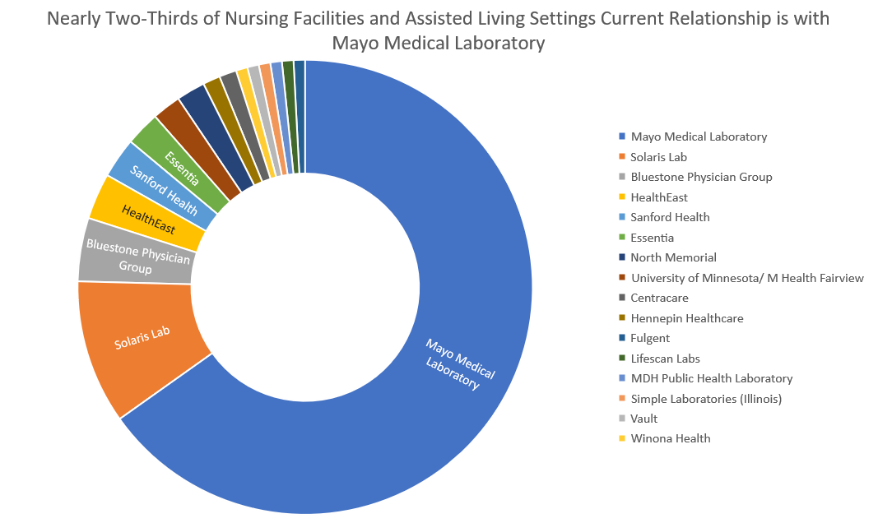

Slide 20
Most Recent Round of Testing
Upon the lab receiving the specimens, 80% of labs returned the results within 3-Days

Slide 21
Most Recent Round of Testing
Mayo Medical Laboratory Lags Slightly

Slide 22
Very Few Providers Switched Labs in the Last Month

Slide 23
Nursing Facilities More Likely to Utilize Antigen Tests

Slide 24
Week of 11/30/2020- Essential Caregivers and Visitation Policies
Survey emailed to nursing facilities and assisted living settings on 12/1
Survey closed 12/2 at Noon
154 Nursing facility respondents
171 Assisted Living respondents

Slide 25
Since November 1, 2020…..
Nearly All Nursing Facilities and Most Assisted Living Settings Have Had Resident Or Employee Test Positive

Slide 26
Few Residents Left Over Thanksgiving Weekend- More of an Issue in Assisted Living
Percent of Residents that Left Building during Thanksgiving Weekend
Number of Respondents Where at Least One Resident Who Left

Slide 27
Some Providers Continuing Outdoor Visits

Slide 28
Colder Weather Means Fewer Providers Hosting Outdoor Visits

Slide 29
Essential Caregiver Programs Adopted at Same Rate by Assisted Living Settings and Nursing Facilities:
40% of NF and 25% of AL Programs Currently Suspended

Slide 30
Percent of Residents with Essential Caregiver Plateaus

Slide 31
Some Nursing Facilities and Assisted Living Settings with Essential Caregiver Programs Have Changed Program Since November 1-
More than half have suspended program or imposed limits

Slide 32
Week of 11/9/2020- Fingerprint Background Checks
Survey emailed to nursing facilities and assisted living settings on 11/10
Survey closed 11/12 at 9:00AM
119 Nursing facility respondents
124 Assisted Living respondents

Slide 33
Number of Road Miles of Travel to a Fingerprinting Site
More than a third have to go more than 30 miles

Slide 34
Providers who Report that Background Studies are a Barrier to Onboarding new Employees
About a third who have needed background studies report issues

Slide 35
Have New Employees or those on Emergency Studies Experienced Delays or Barriers
Almost 40% have had issues

Slide 36
More than a Quarter of Providers Have Issues with Timeliness of Fingerprint Background Studies

Slide 37
How Many Prospective Candidates Have Declined to Follow Through due to Fingerprint Requirement
More than 10% of Providers have had at least One

Slide 38
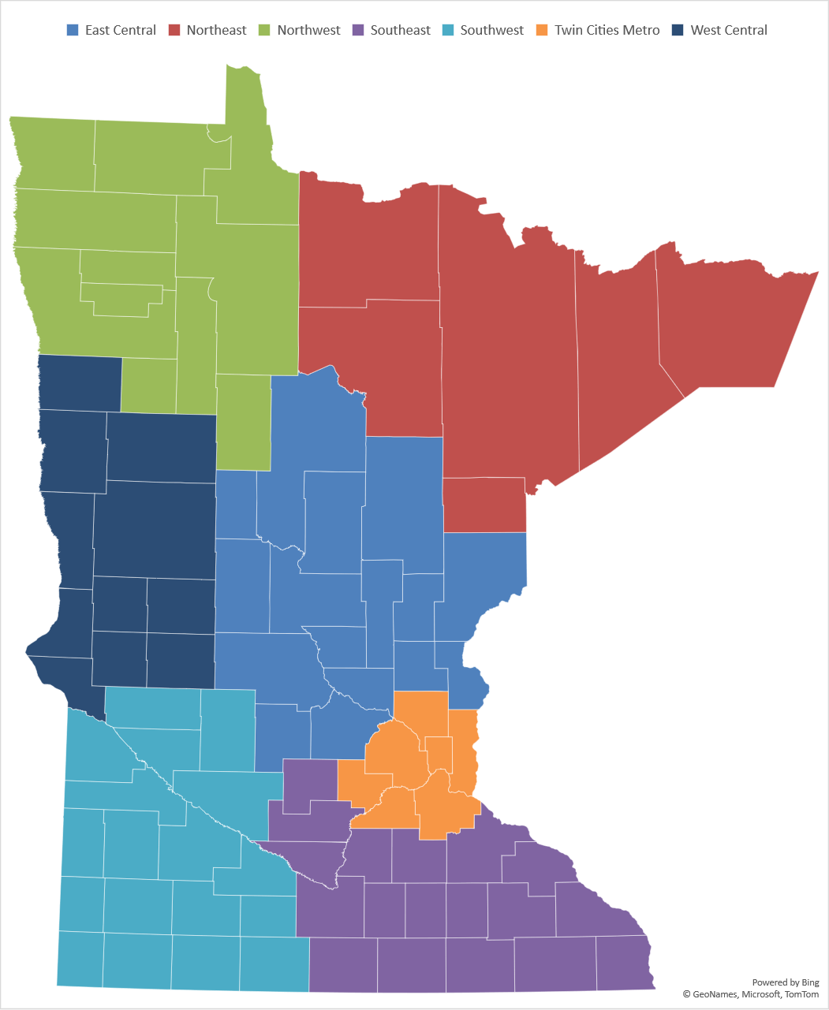
Fingerprint Background Study Issues Exist Statewide- Most Significant in Northern MN

Slide 39
Week of 10/19/2020- Testing and Labs
Survey emailed to nursing facilities and assisted living settings on 10/21
Survey closed 10/27 at 8:00AM
224 Nursing facility respondents
171 Assisted Living respondents

Slide 40
Surveillance testing not common in AL

Slide 41
Use of Point of Care antigen testing equipment- large share are not using

Slide 42
Point of Care testing equipment

Slide 43
Existing relationship with Labs to conduct PCR tests exists for most providers

Slide 44
Mayo Medical Laboratory performing majority of tests- several other labs have a share

Slide 45
Nursing facilities and Assisted Living Report Similar Experiences
Number of days to receive test results improving, but still short of 48-hour standard in most cases
“For your most recent round of testing, upon the lab receiving the specimens, how many days did the lab take to return the majority of the results?”
Nursing Facilities
Assisted Living

Slide 46
Significant minority of providers have concerns about PCR labs, most not investigating saliva testing as an alternative

Slide 47
Week of 10/12/2020- Visitation Policies
Survey emailed to nursing facilities and assisted living on 10/12
Survey closed 10/13 at 10:00AM
145 Nursing facility respondents
150 Assisted Living respondents

Slide 48
More Assisted Living Settings and Nursing Facilities are Developing a Dedicated Location / Visitation “Center” to Host Indoor Visits
60% of ALs and 75% of NFs will use the dedicated location/visitation “center” as a substitute for visits in resident rooms

Slide 49
Essential Caregiver Program Use Increases for Assisted Living Settings and Nursing Facilities

Slide 50
Number of Assisted Living Clients with an Essential Caregiver Increases between August 31 and October 12

Slide 51
Of those Settings with Essential Caregiver Programs……
Nearly all of the nursing facilities requiring the testing of essential caregivers conduct the tests.

Slide 52
A Majority of Respondents Provide Essential Caregivers with PPE

Slide 53
Week of 10/5/2020- Background Checks
Survey emailed to nursing facilities and assisted living on 10/2
Survey closed 10/5 at 10:00AM
128 Nursing facility respondents
124 Assisted Living respondents

Slide 54
LTC Accounts for more than 5,000 new Hires Each Month

Slide 55
LTC has more than 23,000 Employees working on Emergency Background Checks

Slide 56
More than 15% of LTC Staff Have to Go More than 40 Miles Round Trip for Fingerprinting-
Approximately 4,000 LTC Employees Impacted

Slide 57
Week of 9/28/2020- Admission Policies
Survey emailed to nursing facilities on 9/28
Survey closed 9/29 at 11:00AM
164 Nursing facility respondents

Slide 58
Nearly half of Minnesota’s nursing facilities have had to place a hold on all new admissions since the beginning of the pandemic

Slide 59
On 9/28/2020
Only a very small portion of nursing facilities had a hold on admissions
About one-third are maintaining a waiting list for new admissions

Slide 60
Nearly all nursing facilities are taking admissions from hospitals.
But more hospital referrals are turned down due to admissions criteria when compared to pre-COVID-19 pandemic

Slide 61
Ability to meet specific needs, staffing, and room availability inform decisions to admit from hospital

Slide 62
Week of 9/21/2020- PPE Supplies
Survey emailed to nursing facilities and assisted living/housing with services on 9/21
Survey closed 9/22 at 11:00AM
162 Nursing facility respondents
164 assisted living/housing with services respondents

Slide 63
Nursing facility respondents more likely to have COVID-19 positive resident or employee

Slide 64
Overwhelming number of respondents have implemented PPE conservation strategies

Slide 65
Of those settings conserving PPE, multiple strategies are often used

Slide 66
Most Assisted Living without Covid-19 Positive in Building Report at Least 2-Weeks Supply of PPE, Except for Respirators

Slide 67
Assisted Living with Covid-19 Positive, Most have adequate PPE Supply other than Respirators

Slide 68
Most Nursing Facilities without Covid-19 Positive Report at Least 2-Weeks Supply of PPE, Respirators have Least Supply

Slide 69
Nursing Facilities with Covid-19 Positive, have Shorter PPE Supplies in General than Other Providers

Slide 70
Percent of Providers without a reliable source of resupply by PPE-
Respirators especially difficult to find

Slide 71
Week of 9/14/2020- Antigen Testing
Separate surveys emailed to nursing facilities on 9/14
Survey closed 9/15 at 11:00AM
168 Nursing facility respondents

Slide 72
Over 75% of nursing facilities have received a POC Device
- Of these nearly all received the BD Veritor System

Slide 73
Over 75% of nursing facilities with a POC Device have not performed tests

Slide 74
Many reasons why a nursing facility with a POC has not begun testing

Slide 75
It is not known if there will be enough supplies to operate POC devices

Slide 76
Week of 8/31/2020- Visitation Policy
Separate surveys emailed to nursing facilities and HWS/AL settings on 8/31
Survey closed 9/1 at 11:00AM
164 Nursing facility respondents
224 HWS/AL respondents

Slide 77
Assisted Living Settings and Nursing Facilities and Type of Visitation

Slide 78
Outdoor Visits Since June 17, 2020
Of those settings with outdoor visits
  Nursing facilities have averaged 3.1 per resident
  Assisted Living have averaged 2.45 per resident

Slide 79
Essential Caregivers
Visits Since July 25, 2020
Of those settings with Essential Caregivers
  23.4% of nursing facility residents have an essential caregiver
  28.4% of assisted living residents have an essential caregiver

Slide 80
Most Settings Do Not Intend to Move to
Level 2 this Week

Slide 81
Reasons for Settings Not Intending to Move to
Level 2 this Week

Slide 82
Week of 8/24/2020- Testing Issues
Separate surveys emailed to nursing facilities and HWS/AL settings on 8/24
Survey closed 8/25 at Noon
171 Nursing facility respondents
203 HWS/AL respondents

Slide 83
Nursing Facility Baseline Testing

Slide 84
Assisted Living / Housing Baseline Testing

Slide 85
How was the lab paid for conducting the employee testing?

Slide 86
Nursing facilities, with Baseline Test, also conducting surveillance testing (choose all that apply)

Slide 87
Assisted Living, with Baseline Test, also conducting surveillance testing (choose all that apply)

Slide 88
An average of 3-Days for nursing facility tests to return

Slide 89
Assisted Living and Nursing Facilities
Days to Receive Lab Results

Slide 90
Requesting Testing via REDcap survey

Slide 91
Most Nursing Facilities Plan to Use Staff to Collect Specimens and Have an Existing Relationship with a Lab

Slide 92
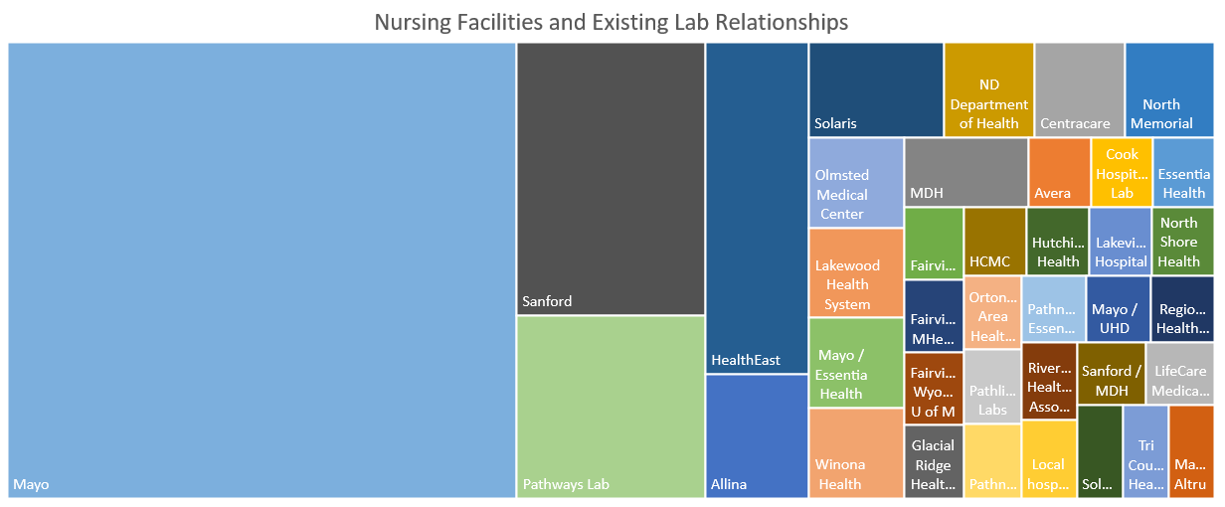

Slide 93
More than half of nursing facilities do not know if lab has enough supplies for weekly testing

Slide 94
Point of Care Testing Information
14 nursing facilities have POC testing equipment
7 indicated they have either BD Veritor Plus or Abbott NOW models
7 indicated they have a plan for negative test results.
  3 did not know
  3 do not have a plan

Slide 95
¾ of nursing facilities would use regional testing location for employees
Reasons for answering “No” often mentioned
Staff dislike of travel
Cost of travel
Travel distance
Chance of exposure
Inefficient if employees socially distance and drive alone.

Slide 96
Week of 8/17/2020- Staffing Issues
Separate surveys emailed to nursing facilities and HWS/AL settings on 8/17
Survey closed 8/18 at 10:15AM
144 Nursing facility respondents
207 HWS/AL respondents

Slide 97
Caregiver Positions Unfilled
Similar for Nursing Facilities (NARs) and Assisted Living (ULP)

Slide 98
Nurse Aide Training Waiver Integral to Nursing Facility Staffing
7.3% of caregivers were hired under waiver and not currently on the registry
Nearly 1,200 estimated caregivers fall under waiver presently

Slide 99
Nearly 10,000 Unfilled Caregiver Positions
Nursing Facilities and CNAs
370 Settings
2,721 Unfilled Caregiver Positions
Senior Housing / Assisted Living and ULPs
1,769 Settings
7,059 Unfilled Caregiving Positions

