Slide 1
Long-Term Care Rapid Survey Data Collection

Slide 2

Week of 10/19/2020- Testing and Labs
Survey emailed to nursing facilities and assisted living settings on 10/21
Survey closed 10/27 at 8:00AM
224 Nursing facility respondents
171 Assisted Living respondents

Slide 3
Surveillance testing not common in AL

Slide 4
Use of Point of Care antigen testing equipment- large share are not using

Slide 5
Point of Care testing equipment

Slide 6
Existing relationship with Labs to conduct PCR tests exists for most providers

Slide 7
Mayo Medical Laboratory performing majority of tests- several other labs have a share

Slide 8
Nursing facilities and Assisted Living Report Similar Experiences
Number of days to receive test results improving, but still short of 48-hour standard in most cases
“For your most recent round of testing, upon the lab receiving the specimens, how many days did the lab take to return the majority of the results?”
Nursing Facilities
Assisted Living

Slide 9
Significant minority of providers have concerns about PCR labs, most not investigating saliva testing as an alternative

Slide 10
Week of 10/12/2020- Visitation Policies
Survey emailed to nursing facilities and assisted living on 10/12
Survey closed 10/13 at 10:00AM
145 Nursing facility respondents
150 Assisted Living respondents

Slide 11
More Assisted Living Settings and Nursing Facilities are Developing a Dedicated Location / Visitation “Center” to Host Indoor Visits
60% of ALs and 75% of NFs will use the dedicated location/visitation “center” as a substitute for visits in resident rooms

Slide 12
Essential Caregiver Program Use Increases for Assisted Living Settings and Nursing Facilities

Slide 13
Number of Assisted Living Clients with an Essential Caregiver Increases between August 31 and October 12

Slide 14
Of those Settings with Essential Caregiver Programs……
Nearly all of the nursing facilities requiring the testing of essential caregivers conduct the tests.

Slide 15
A Majority of Respondents Provide Essential Caregivers with PPE

Slide 16
Week of 10/5/2020- Background Checks
Survey emailed to nursing facilities and assisted living on 10/2
Survey closed 10/5 at 10:00AM
128 Nursing facility respondents
124 Assisted Living respondents

Slide 17
LTC Accounts for more than 5,000 new Hires Each Month

Slide 18
LTC has more than 23,000 Employees working on Emergency Background Checks

Slide 19
More than 15% of LTC Staff Have to Go More than 40 Miles Round Trip for Fingerprinting-
Approximately 4,000 LTC Employees Impacted

Slide 20
Week of 9/28/2020- Admission Policies
Survey emailed to nursing facilities on 9/28
Survey closed 9/29 at 11:00AM
164 Nursing facility respondents

Slide 21
Nearly half of Minnesota’s nursing facilities have had to place a hold on all new admissions since the beginning of the pandemic

Slide 22
On 9/28/2020
Only a very small portion of nursing facilities had a hold on admissions
About one-third are maintaining a waiting list for new admissions

Slide 23
Nearly all nursing facilities are taking admissions from hospitals.
But more hospital referrals are turned down due to admissions criteria when compared to pre-COVID-19 pandemic

Slide 24
Ability to meet specific needs, staffing, and room availability inform decisions to admit from hospital

Slide 25
Week of 9/21/2020- PPE Supplies
Survey emailed to nursing facilities and assisted living/housing with services on 9/21
Survey closed 9/22 at 11:00AM
162 Nursing facility respondents
164 assisted living/housing with services respondents

Slide 26
Nursing facility respondents more likely to have COVID-19 positive resident or employee

Slide 27
Overwhelming number of respondents have implemented PPE conservation strategies

Slide 28
Of those settings conserving PPE, multiple strategies are often used

Slide 29
Most Assisted Living without Covid-19 Positive in Building Report at Least 2-Weeks Supply of PPE, Except for Respirators

Slide 30
Assisted Living with Covid-19 Positive, Most have adequate PPE Supply other than Respirators

Slide 31
Most Nursing Facilities without Covid-19 Positive Report at Least 2-Weeks Supply of PPE, Respirators have Least Supply

Slide 32
Nursing Facilities with Covid-19 Positive, have Shorter PPE Supplies in General than Other Providers

Slide 33
Percent of Providers without a reliable source of resupply by PPE-
Respirators especially difficult to find

Slide 34
Week of 9/14/2020- Antigen Testing
Separate surveys emailed to nursing facilities on 9/14
Survey closed 9/15 at 11:00AM
168 Nursing facility respondents

Slide 35
Over 75% of nursing facilities have received a POC Device
- Of these nearly all received the BD Veritor System

Slide 36
Over 75% of nursing facilities with a POC Device have not performed tests

Slide 37
Many reasons why a nursing facility with a POC has not begun testing

Slide 38
It is not known if there will be enough supplies to operate POC devices

Slide 39
Week of 8/31/2020- Visitation Policy
Separate surveys emailed to nursing facilities and HWS/AL settings on 8/31
Survey closed 9/1 at 11:00AM
164 Nursing facility respondents
224 HWS/AL respondents

Slide 40
Assisted Living Settings and Nursing Facilities and Type of Visitation

Slide 41
Outdoor Visits Since June 17, 2020
Of those settings with outdoor visits
  Nursing facilities have averaged 3.1 per resident
  Assisted Living have averaged 2.45 per resident

Slide 42
Essential Caregivers
Visits Since July 25, 2020
Of those settings with Essential Caregivers
  23.4% of nursing facility residents have an essential caregiver
  28.4% of assisted living residents have an essential caregiver

Slide 43
Most Settings Do Not Intend to Move to
Level 2 this Week

Slide 44
Reasons for Settings Not Intending to Move to
Level 2 this Week

Slide 45
Week of 8/24/2020- Testing Issues
Separate surveys emailed to nursing facilities and HWS/AL settings on 8/24
Survey closed 8/25 at Noon
171 Nursing facility respondents
203 HWS/AL respondents

Slide 46
Nursing Facility Baseline Testing

Slide 47
Assisted Living / Housing Baseline Testing

Slide 48
How was the lab paid for conducting the employee testing?

Slide 49
Nursing facilities, with Baseline Test, also conducting surveillance testing (choose all that apply)

Slide 50
Assisted Living, with Baseline Test, also conducting surveillance testing (choose all that apply)

Slide 51
An average of 3-Days for nursing facility tests to return

Slide 52
Assisted Living and Nursing Facilities
Days to Receive Lab Results

Slide 53
Requesting Testing via REDcap survey

Slide 54
Most Nursing Facilities Plan to Use Staff to Collect Specimens and Have an Existing Relationship with a Lab

Slide 55
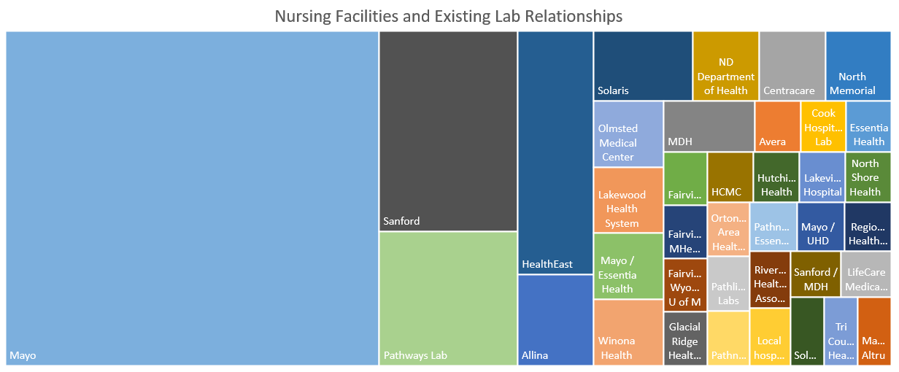

Slide 56
More than half of nursing facilities do not know if lab has enough supplies for weekly testing

Slide 57
Point of Care Testing Information
14 nursing facilities have POC testing equipment
7 indicated they have either BD Veritor Plus or Abbott NOW models
7 indicated they have a plan for negative test results.
  3 did not know
  3 do not have a plan

Slide 58
¾ of nursing facilities would use regional testing location for employees
Reasons for answering “No” often mentioned
Staff dislike of travel
Cost of travel
Travel distance
Chance of exposure
Inefficient if employees socially distance and drive alone.

Slide 59
Week of 8/17/2020- Staffing Issues
Separate surveys emailed to nursing facilities and HWS/AL settings on 8/17
Survey closed 8/18 at 10:15AM
144 Nursing facility respondents
207 HWS/AL respondents

Slide 60
Caregiver Positions Unfilled
Similar for Nursing Facilities (NARs) and Assisted Living (ULP)

Slide 61
Nurse Aide Training Waiver Integral to Nursing Facility Staffing
7.3% of caregivers were hired under waiver and not currently on the registry
Nearly 1,200 estimated caregivers fall under waiver presently

Slide 62
Nearly 10,000 Unfilled Caregiver Positions
Nursing Facilities and CNAs
370 Settings
2,721 Unfilled Caregiver Positions
Senior Housing / Assisted Living and ULPs
1,769 Settings
7,059 Unfilled Caregiving Positions

