Slide 1
Long-Term Care Workforce Survey
Assisted Living Facilities and Nursing Facilities
September 2021

Slide 2

2021 Workforce Survey Background
Survey emailed to nursing facilities and assisted living settings on 9/7
Survey closed 9/13 at 10:00AM
124 Nursing facility respondents
193 Assisted Living respondents

Slide 3
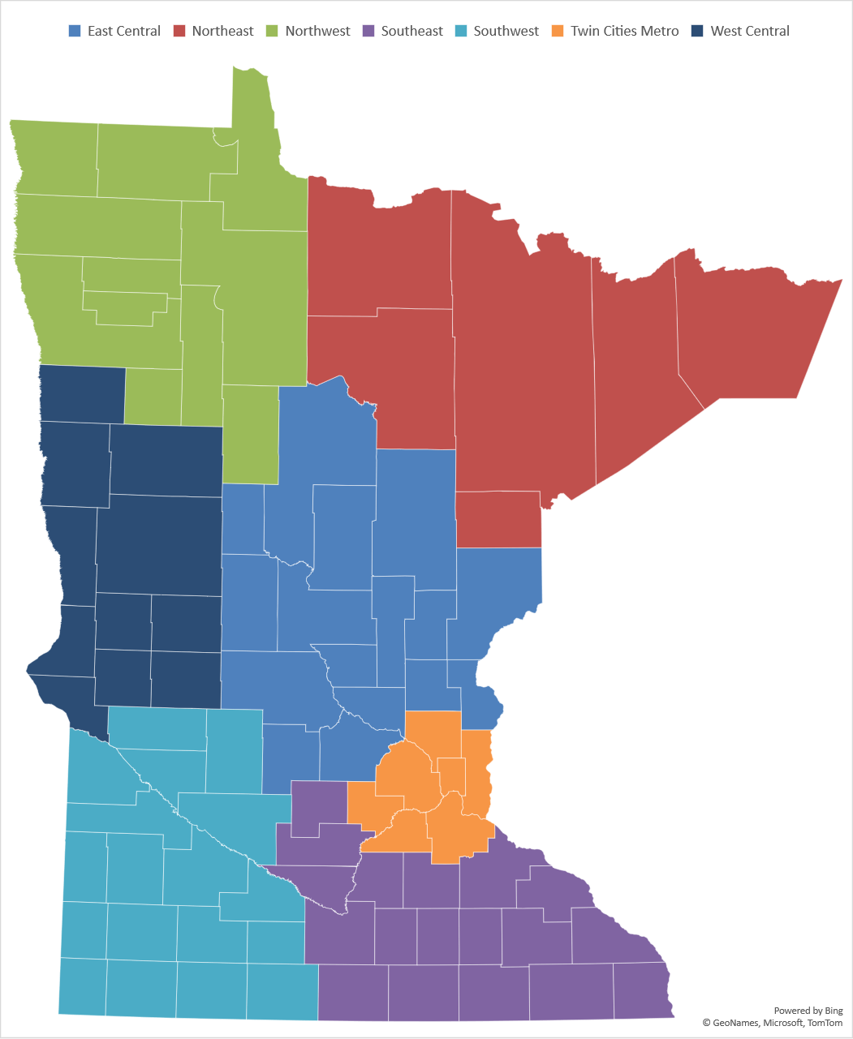
Responses by Region
Region | Assisted Living | Nursing Facility | All Responses
East central | 32 | 15 | 47
Northeast | 14 | 15 | 29
Northwest | 9 | 8 | 17
Southeast | 29 | 27 | 56
Southwest | 21 | 21 | 42
Twin cities metro | 65 | 22 | 87
West central | 23 | 16 | 39
Statewide | 193 | 124 | 317

Slide 4
Key Learnings from the Data
Minnesota has a crisis in caregiving. We are facing unprecedented, record-level workforce shortages in assisted living and nursing homes across our state.
  We learned that there are 23,000 unfilled positions in these senior care settings, up from 8,000 unfilled positions reported in survey conducted in June.
  The crisis is not limited to one part of the state or one type of care. All regions of the state are impacted.
  We are losing ground– in August we experienced 1.5 resignations per hire.
Staffing shortages are throughout care settings
  25% of all LPN positions are unfilled
  20% of RN positions are unfilled
  20% of home health aides and CNA positions unfilled
  20% of dietary, laundry and housekeeping positions unfilled

Slide 5
Key Learnings from the Data
Providers are meeting current resident needs with expanded use of overtime and temporary staff
  40% of nursing homes are using temporary staff. Far more would use it if they could find temporary staff.
  Almost all providers are using more overtime and double shifts to compensate for staffing shortages
Shortages of staff are impacting access to care across the continuum.
  70% of nursing homes are limiting admissions due to lack of staff to care for additional residents. That’s up from 41% in July
  More than 25% of nursing homes have reported a hold on all new admissions

Slide 6
Over 23,000 Nursing Assistant, LPN, RN, Dietary, Housekeeping, and Laundry Positions Unfilled

Slide 7
25% of LPN Positions are Unfilled throughout MN

Slide 8
20% of RN Positions Unfilled Throughout MN

Slide 9
More than 20% of Nursing Assistant and Home Health Aide Positions Unfilled

Slide 10
Nearly 20% of Dietary, Housekeeping and Laundry Positions Unfilled

Slide 11
Losing Ground: Employee Resignations Exceeded New Hires by Over 2,000 in August 2021
Assisted Living and Nursing Facilities

Slide 12
20% of Shifts Filled with Overtime and Temporary Staff
% of Daily Shifts Unfilled Prior to Overtime and SNSAs

Slide 13
Almost All Providers Using more OT and Double Shifts this Year
Percent of Providers who Increased OT and Double Shift use in 2021 compared to 2020

Slide 14
Most Nursing Facilities are using Temporary Staff and Would Use More if Available

Slide 15
Increasing Number of Providers Limiting Census Due to Staffing
Up from 41% in July

Slide 16
More than 25% of Nursing Facilities Have Hold on All New Admissions

Slide 17
Workforce Solutions
Immediate Action
  Use American Rescue Plan Funds for Strike Teams and Staff Respite to help providers in Staffing Crisis
Near-Term Action
  In a special session this year, ask legislators to appropriate money to allow upfront investment in caregiver wage increases to bolster recruitment and retention
Longer-Term Action
  In the 2022 legislative session, adjust payment systems for both nursing facilities and Elderly Waiver providers to better reflect the ongoing need for workforce investments and responsiveness to market conditions.

