Slide 1
Minimum Staffing Final Rule
Month Day, Year

Slide 2
Where We Have Come From
Feb. 2022
Biden Administration’s issues reform plan to improve quality and safety in LTC
2022/2023
CMS nursing home staffing study
Sep. 2023
Proposed rule published
Nov. 2023
Proposed rule comment period closes with over 46,000 comments submitted
Apr. 22, 2023
Final rule released
May 10, 2024
Final rule scheduled to “officially” be published

Slide 3
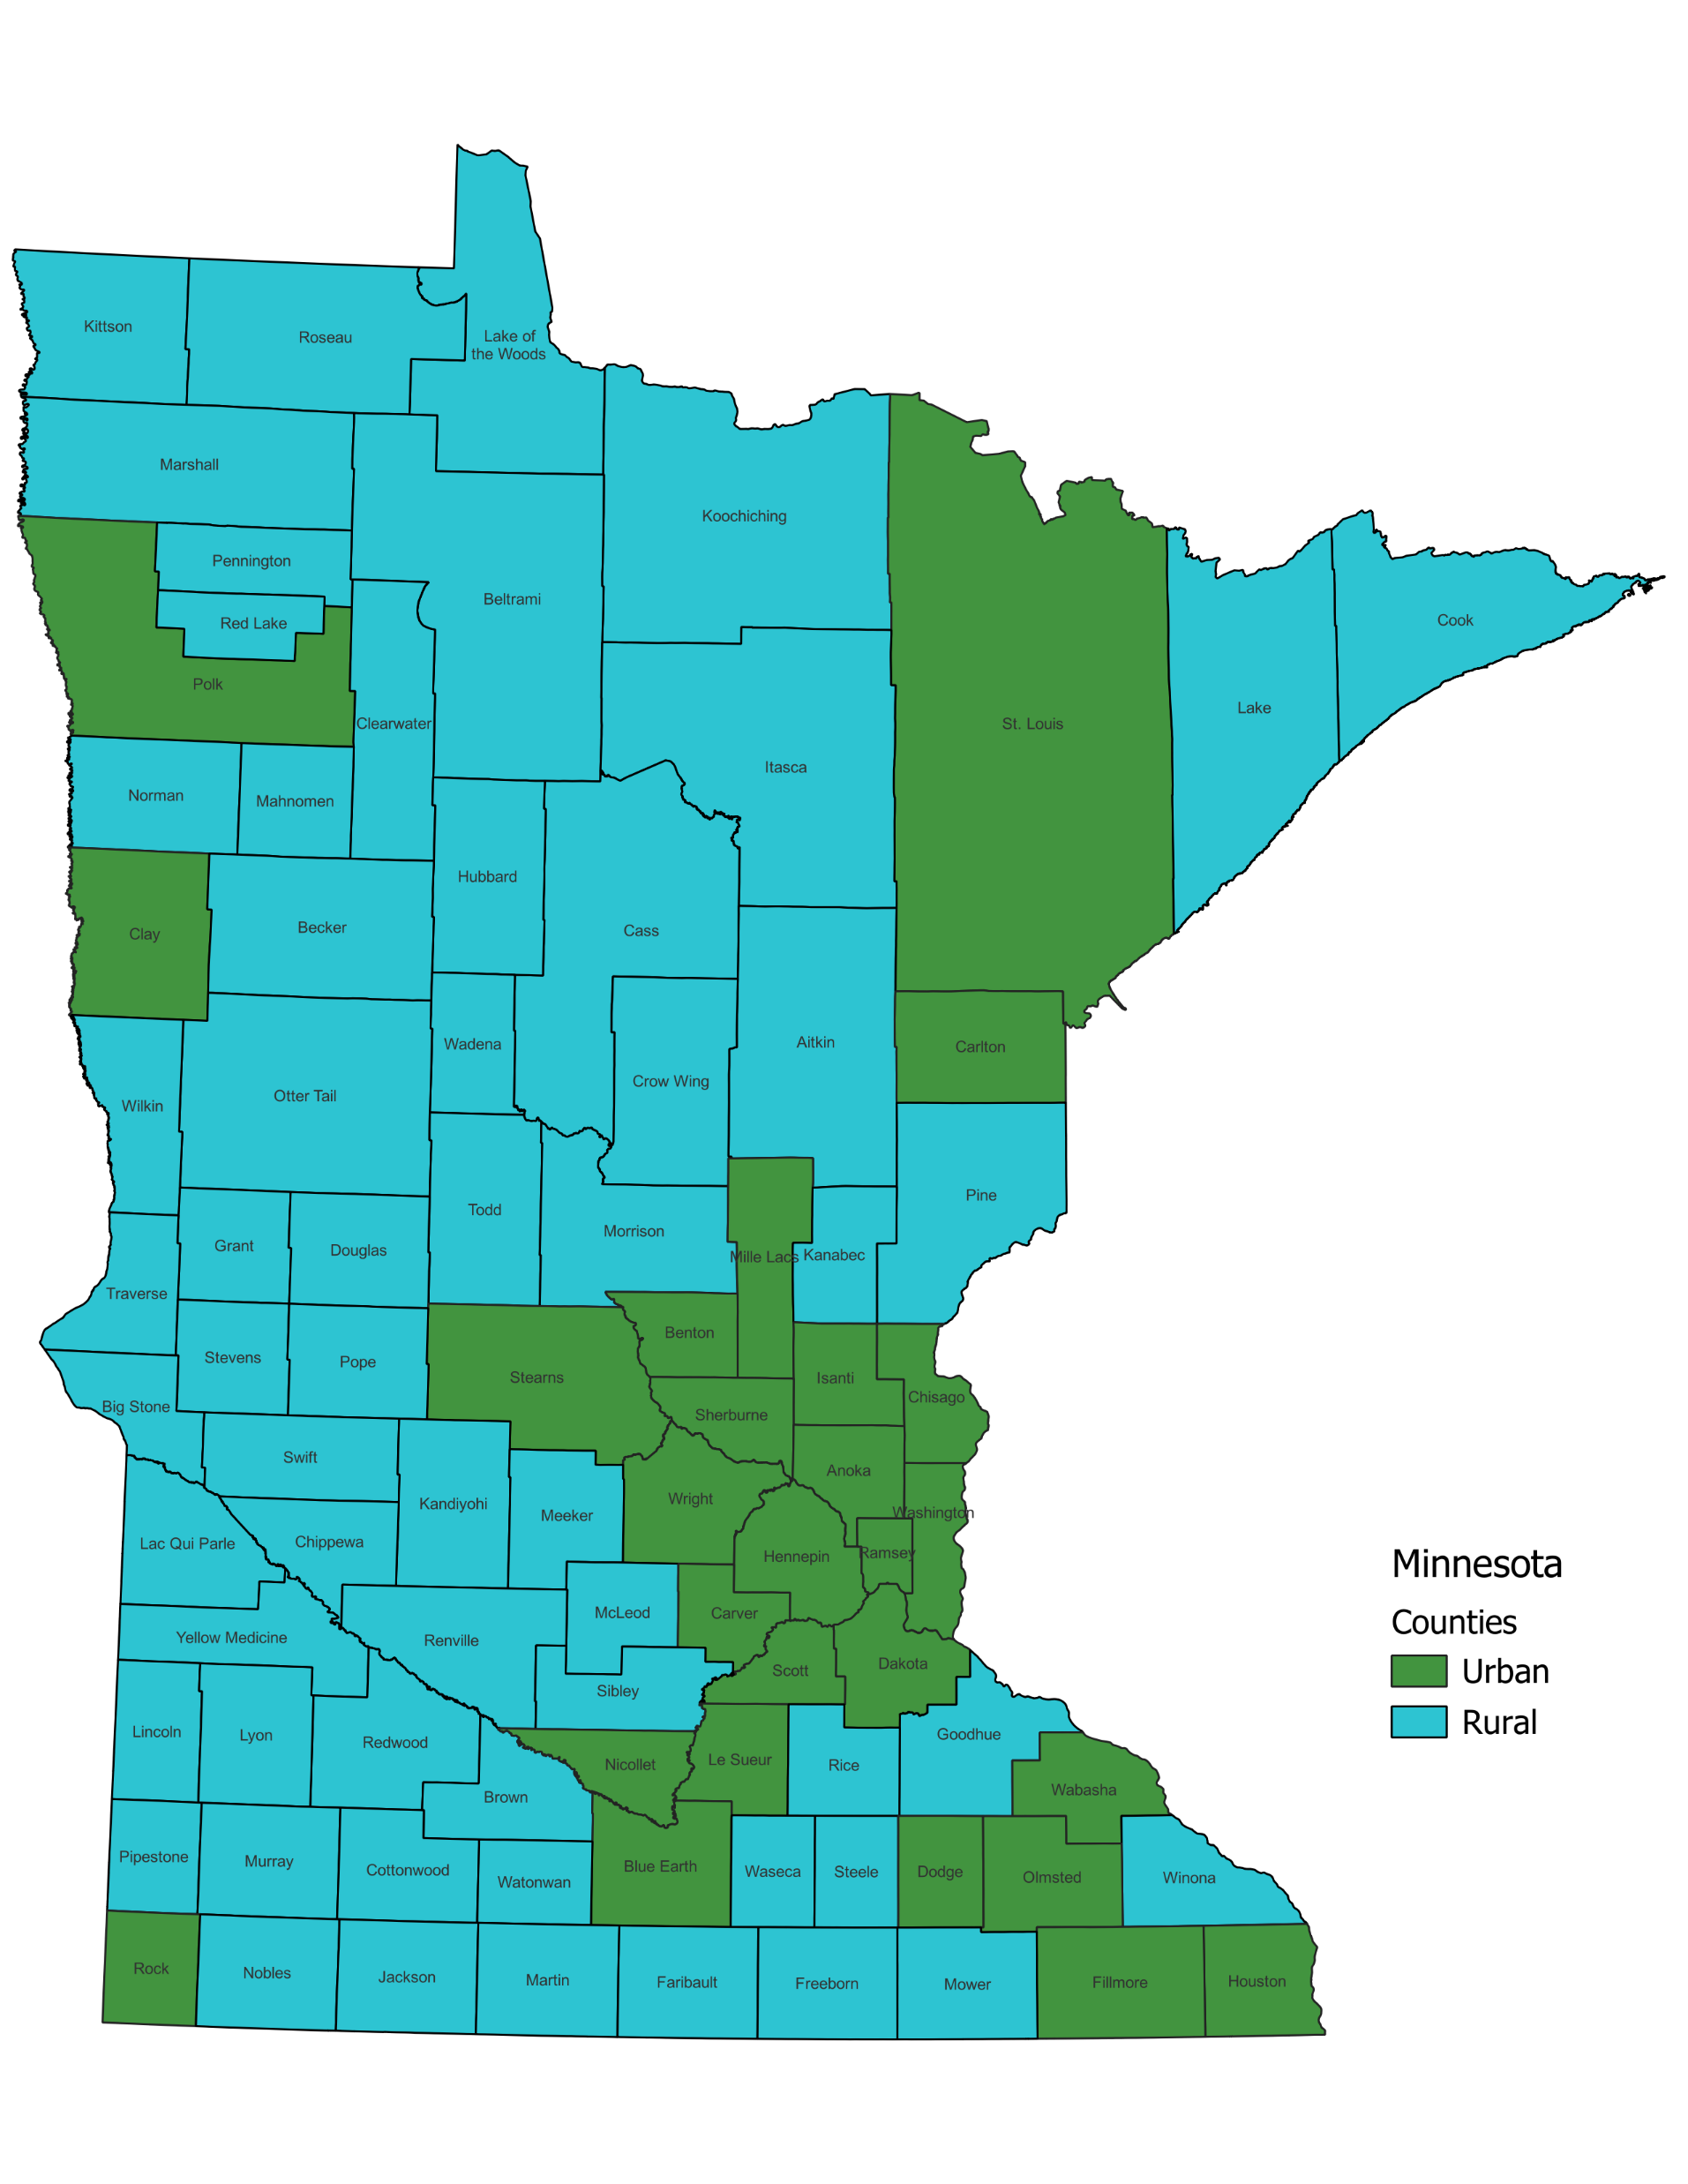
Minimum Staffing Final Rule
Four main parts
Phase 1 - Facility Assessment
Phase 2 - 24/7 RN on-site requirement
Phase 2 - Total Nurse Staffing HPRD requirement
Phase 3 - RN/NA minimum staffing HPRD
Medicaid payment transparency
Staggered implementation
Notes:
Map image reveals the delineation for implementation urban and rural counties. There is a slightly different set of urban and rural counties for exemptions purposes. For example, ROCK and SIBLEY are the two counties that are impacted by the differences between the two concepts. Implementation is based upon the Office of Management and Budget definitions while the exemptions are based upon the Bureau of Labor Statistics - Occupational Employment and Wage Statistics definitions for urban and rural counties.

Slide 4
Facility Assessment
Evidenced-based, data driven
Input from staff and representatives
Drive staffing decisions: acuity, behavioral health issues
Including plan for all shifts and weekends
Staffing plan for recruitment/retention
Staffing contingency plan – different than emerg. prep. req’t
Effective: 90 days after final rule publication (Aug. 8, 2024)

Slide 5
24/7 Registered Nurse Requirement
Replaces existing requirement for 8 hours / 7 days
On-site, available to provide direct resident care
DON hours would count
Round-the-clock, not 24 payroll hours
Maintain existing waiver process for 8 hours / 7 days
Exemption for 8 hours of the 24/7 requirement require physician, physician assistant, nurse practitioner, or registered nurse availability to respond to calls
Effective: 2 years after final rule publication (3 years for rural)

Slide 6
3.48 Total Nurse Staffing HPRD
Two distinct parts:
RN/NA minimum staffing requirement
0.55 RN and 2.45 NA HPRD
“Other licensed nursing” staff component
0.48 “other licensed nursing” HPRD
On-site, available to provide direct resident care
NA hours include CNAs and TMAs
LPN hours count towards
0.55 RN HPRD only during Phases 1 and 2
At Phase 3 implementation LPN hours only count towards 0.48 “other licensed nursing” staff HPRD or towards the NA HPRD if assigned to such role
Implemented and enforced independent of a facility’s case-mix
Effective: 2 years after final rule publication (3 years for rural)

Slide 7
Exemptions
Exemption based on:
Location: Workforce availability - Minimum of 20% below national average for applicable nurse staffing type provider-to-population ratio
Good faith efforts to hire and retain staff - Documentation showing number of job postings, duration of vacancies, job offers made, and competitive wage offerings
Financial commitment - Documentation on financial resources expended annually on nurse staffing relative to revenue
Available for the 3.48 Total Nurse Staffing HPRD and each of the 0.55 RN and 2.45 NA HPRD minimum staffing requirements
Current 8 hour / 7 days per week RN requirement exemption remains

Slide 8
Exemption Ineligibility
Ineligibility based upon:
Noncompliance with exemption notice requirements
Noncompliance with PBJ submissions
SFF designation
Insufficient staffing citation within the past 12 months for:
Widespread with actual harm
Pattern with actual harm
Immediate Jeopardy

Slide 9
Exemption Notifications
Failure to provide notifications can result in waiver ineligibility
Notice must include exemption status, the degree to which standards are not met
Posting in prominent and publicly viewable area in nursing home
Individual notice provided to current and prospective residents
Copy of notice must be sent to ombudsman
CMS will post exemption on Care Compare

Slide 10
Medicaid Payment Transparency
Reporting provision for state Medicaid agency (DHS)
Reported on state website, federal Medicare website
Data is from nursing home PBJ data and other state mandated reports
Will need to be compatible with CMS HCBS Access Rule (80/20 - Sufficiency of Payments Rule)
Effective: 4 years after final rule publication
Notes:
“Other state mandated reports” may be new or revisions to current cost reporting to achieve MN DHS’ requirement to comply with new CMS requirement. Because MN DHS will be required to report to CMS at Year 4 (5/10/2028), we expect that state reporting requirements may change during 2027-2028 to receive the data it will need to report to CMS.

Slide 11
Staggered Implementation
Based upon publication date of: May 10, 2024
3 Phases of implementation
Based upon definitions of:
Rural – defined by Office of Management and Budget
Urban – anything not rural
Impacts
24/7 RN requirement and 3.48 total nurse staffing HPRD (2 year/3 years)
0.55 RN and 2.45 NA minimum requirement (3 years/5 years)
Does not impact:
Facility Assessment requirement (Aug. 8, 2024)
Medicaid payment transparency requirement (4 years)

Slide 12
Staggered Implementation (cont.)
Rural
Facility Assessment
24/7 onsite RN and 3.48 Total Nurse Staffing HPRD
0.55 RN / 2.45 NA HPRD
Urban
5/10/24
8/8/24
5/11/26
5/10/27
5/10/28
5/10/29
NOTE: Arrows indicate the time leading up to the implementation date which is represented by the dashed line.

Slide 13
Enforcement
Enforced through survey and certification process
Nurse staffing standard
Uses PBJ data
Not limited to most recent quarterly PBJ data
Surveyor observations during surveys
Subject to remedies (aka penalties)
Waiver of one requirement does not mean waiver of the others

Slide 14
Board Discussions
What strategic investments are needed for resources, processes, or workforce?
What strategic initiatives (relationships) need to begin now?
What strategic alternative options exist, or should we consider now?
Notes:
Dedicate Board Discussions to Issues Raised by the Final Rule
Simply put, more staffing will be needed in the future. Having dedicated conversations and efforts to address compliance with the final rule will be critical. There is some time before implementation, therefore, asking questions and acting upon them now is key. Some of those question include:
Long Range Planning
The final rule is clear there is a future transition from LPN usage to more RN usage as well as increases to the nurse aide requirements coming. The time is now to ask about your organization’s ability to increase staffing to sufficient levels for compliance with the final rule’s requirements. If shortfalls are discovered, it is now when there is time to fix the situation to address those challenges, obstacles or pitfalls.
Open Your Pipeline of Nurses
Build relationships with colleges and universities to bring nursing students into your community. Bringing students into the community exposes them to the wonderful population we serve in skilled nursing and helps the students experience a sense of helping someone’s life be more meaningful. Remember, on average about one-third of the working age population is not considered to be a labor force participant. Pulling some of these folks off the sidelines is essential to long-term success, given the imbalance of supply and demand for workers over the next five years.
Strategic Initiatives
Combined with focusing on the employee experience is the concept of opening nursing pipelines and relationships for developing prospective employee candidates. Many of these initiatives and relationships take time, even years, to establish and become productive. The question to ask now is what strategies and other initiatives should your organization be undertaking to become compliant down the road?
Consider Strategic Alternatives
Assess your market. It is not too early to begin serious, long-term strategic planning. In some communities, there are years-long trends that have been exacerbated by the pandemic that have fundamentally changed how nursing homes fit into the continuum. You need to understand those changes, what your competitors are doing, and what the future holds. This begins with a solid market assessment and a Strengths, Weaknesses, Opportunities, and Threats (SWOT) analysis.
Can your organization make strategic investments in community-based care or independent living settings?
Are alternative payment models worthy of time and resource investment?

Slide 15
Questions

