Slide 1

Nursing Facility Occupancy Survey Data
2019

Slide 2
Survey Responses
260 Responses
Responses by Region:
Twin Cities Metro | 77
Northeast | 19
Northwest | 16
East Central | 39
West Central | 25
Southeast | 46
Southwest | 38

Slide 3
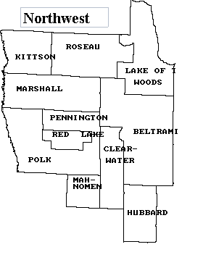
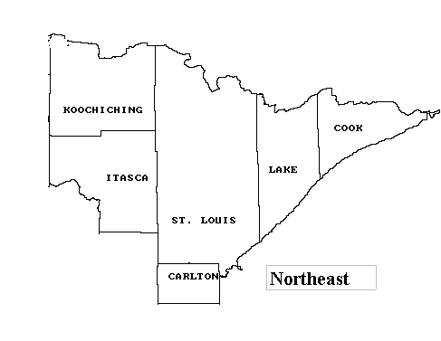
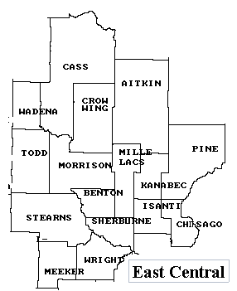
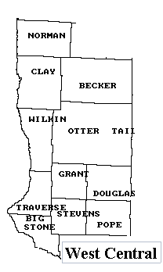
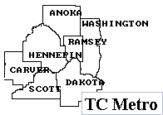
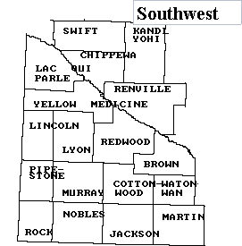
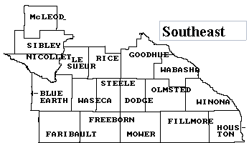
Counties by Region

Slide 4
Nursing Home Occupancy Falls in 2019- Fourth Quarter had Lowest Occupancy of the Decade
Source: Combined Association Occupancy Surveys

Slide 5
Occupancy for Minnesota’s
Nursing Homes – Twin Cities Metro
Highest Average in State in 2019
Source: Combined Association Occupancy Surveys

Slide 6
Occupancy for Minnesota’s
Nursing Homes – Northeast
Tied for Second Lowest in State in 2019
Source: Combined Association Occupancy Surveys

Slide 7
Occupancy for Minnesota’s
Nursing Homes – Northwest
Significant Drop in 2019 but Remains Second Highest in State
Source: Combined Association Occupancy Surveys

Slide 8
Occupancy for Minnesota’s
Nursing Homes – East Central
Improved to State Average in 2019
Source: Combined Association Occupancy Surveys

Slide 9
Occupancy for Minnesota’s
Nursing Homes – West Central
Large Drop During 2019 to Fall Below State Average
Source: Combined Association Occupancy Surveys

Slide 10
Occupancy for Minnesota’s
Nursing Homes – Southeast
Lowest in State in 2018 and 2019
Source: Combined Association Occupancy Surveys

Slide 11
Occupancy for Minnesota’s
Nursing Homes – Southwest
Second Lowest in State in 2018 and 2019
Source: Combined Association Occupancy Surveys

