Slide 1
Nursing Facility Occupancy Survey Data
2020

Slide 2
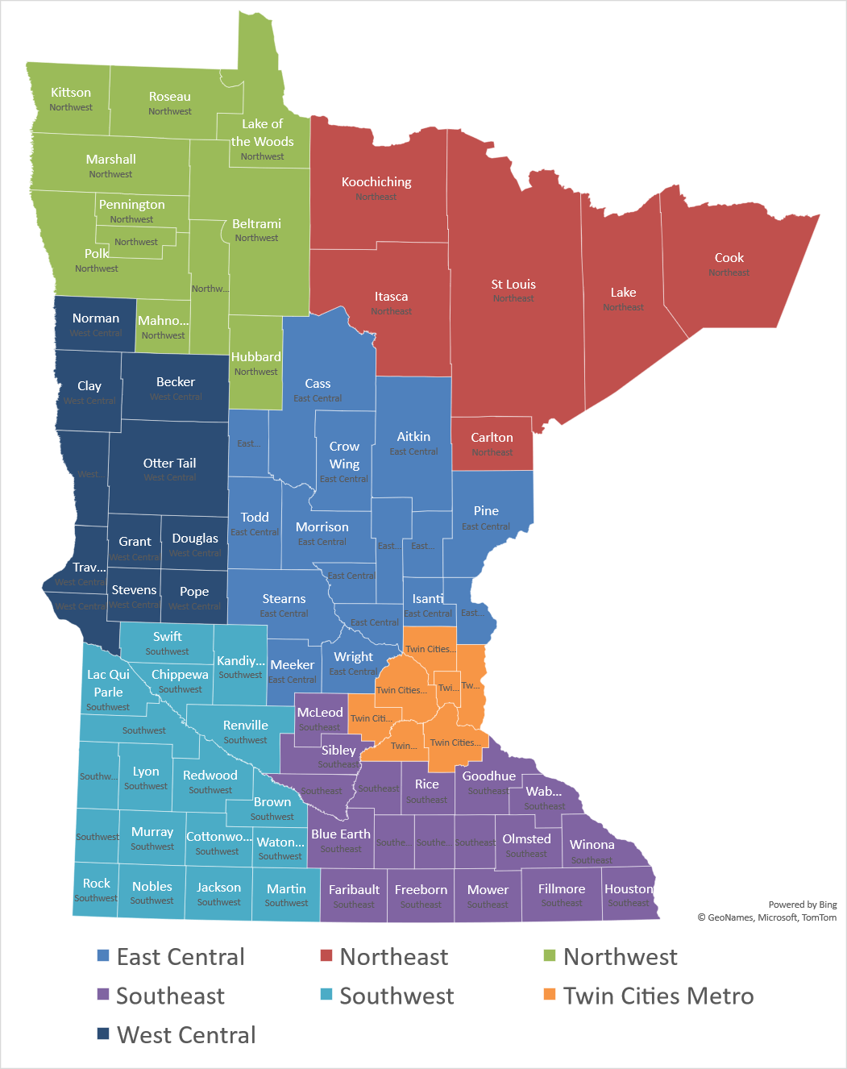
Region
East Central
Northeast
Northwest
Southeast
Southwest
Twin Cities Metro
West Central
205 Survey Responses for Full Year

Slide 3
Nursing Home Occupancy Falls Dramatically due to COVID-19:
No Recovery Yet- 57% Report Even Lower Occupancy in 2021
Source: Combined Association Occupancy Surveys

Slide 4
Occupancy for Minnesota’s
Nursing Homes – Twin Cities Metro
Biggest Early Pandemic Impact of any Region
Source: Combined Association Occupancy Surveys

Slide 5
Occupancy for Minnesota’s
Nursing Homes – Northeast
Performed Better During Pandemic than any other Region
Source: Combined Association Occupancy Surveys

Slide 6
Occupancy for Minnesota’s
Nursing Homes – Northwest
Performed Better During Pandemic than most Regions
Source: Combined Association Occupancy Surveys

Slide 7
Occupancy for Minnesota’s
Nursing Homes – East Central
Biggest Pandemic Impact of any Region
Source: Combined Association Occupancy Surveys

Slide 8
Occupancy for Minnesota’s
Nursing Homes – West Central
Moved Closer to State Average During Pandemic
Source: Combined Association Occupancy Surveys

Slide 9
Occupancy for Minnesota’s
Nursing Homes – Southeast
Particularly Large Pandemic Impact at End of Year
Source: Combined Association Occupancy Surveys

Slide 10
Occupancy for Minnesota’s
Nursing Homes – Southwest
Particularly Large Pandemic Impact at End of Year
Source: Combined Association Occupancy Surveys

Slide 11
Care Center Occupancy Similar Across Regions
Region | 1st Quarter | 4th Quarter | Change
 | Occupancy | Occupancy
Twin Cities Metro | 87.9% | 76.8% | -11.1%
Northeast | 88.6% | 80.5% | -8.2%
Northwest | 88.8% | 79.9% | -8.9%
East Central | 87.0% | 73.4% | -13.6%
West Central | 84.7% | 75.6% | -9.1%
Southeast | 87.1% | 74.4% | -12.6%
Southwest | 86.9% | 74.4% | -12.4%
Statewide | 87.3% | 76.1% | -11.2%
Source: Combined Association Occupancy Surveys

Slide 12
Pandemic has had Unprecedented Impact on Nursing Facility Occupancy
Just over Half of Providers Experienced an Occupancy Drop of more than 10% from first to fourth quarter 2020
Only 12% of Providers Experienced an Occupancy Increase from first to fourth quarter 2020
41% of Providers Indicated that Space Needed for Quarantining New Residents was a Factor in Low Occupancy
Despite Record Low Occupancy at the End of 2020 more than half of Providers are Seeing even Lower Levels in 2021
Source: Combined Association Occupancy Surveys

