Slide 1
Nursing Facility Occupancy Survey Data
First Three Quarters 2021

Slide 2
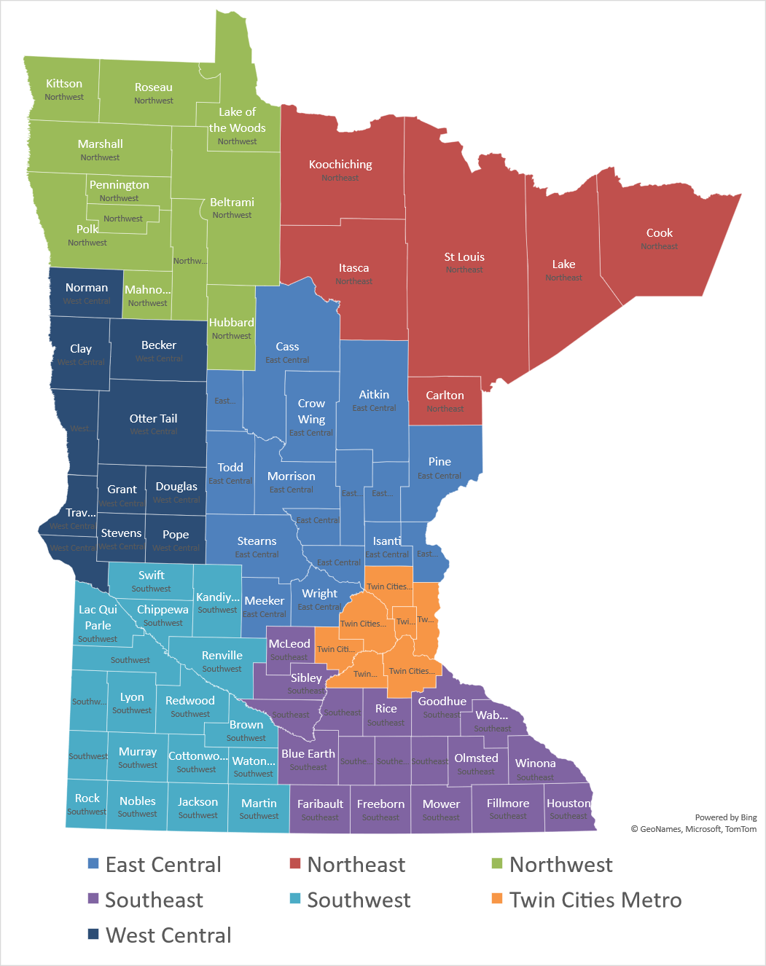
Region
East Central
Northeast
Northwest
Southeast
Southwest
Twin Cities Metro
West Central
192 Survey Responses for Full Year

Slide 3
Nursing Home Occupancy Falls Dramatically due to COVID-19:
Recovery Happening Slowly in 2021
Source: Combined Association Occupancy Surveys

Slide 4
Occupancy for Minnesota’s
Nursing Homes – Twin Cities Metro
Biggest Early Pandemic Impact of any Region- Above State Avg in 2021
Source: Combined Association Occupancy Surveys

Slide 5
Occupancy for Minnesota’s
Nursing Homes – Northeast
Fell Well Below State Average in Third Quarter of 2021
Source: Combined Association Occupancy Surveys

Slide 6
Occupancy for Minnesota’s
Nursing Homes – Northwest
Recently Fallen Below State Average after having Highest Occupancy in 2020
Source: Combined Association Occupancy Surveys

Slide 7
Occupancy for Minnesota’s
Nursing Homes – East Central
Occupancy Recovering throughout 2021
Source: Combined Association Occupancy Surveys

Slide 8
Occupancy for Minnesota’s
Nursing Homes – West Central
Occupancy Recovering throughout 2021 but Remains below State Average
Source: Combined Association Occupancy Surveys

Slide 9
Occupancy for Minnesota’s
Nursing Homes – Southeast
Well below State Average all of 2021
Source: Combined Association Occupancy Surveys

Slide 10
Occupancy for Minnesota’s
Nursing Homes – Southwest
Falling Farther behind State Average as 2021 goes on
Source: Combined Association Occupancy Surveys

Slide 11
Limiting Census Due to Staffing
Huge Jump in Limiting Census from July to November with almost all Rural Regions Severely Impacted by Labor Shortage
Source: Combined Association Occupancy Surveys

Slide 12
Occupancy Recovery Varies around State
About Half of Providers saw an increase in Occupancy from second quarter to third quarter of 2021
Central MN had most providers with census improvement in third quarter
Source: Combined Association Occupancy Surveys

