Slide 1
Nursing Facility Occupancy Survey Data
2022-
First Quarter

Slide 2
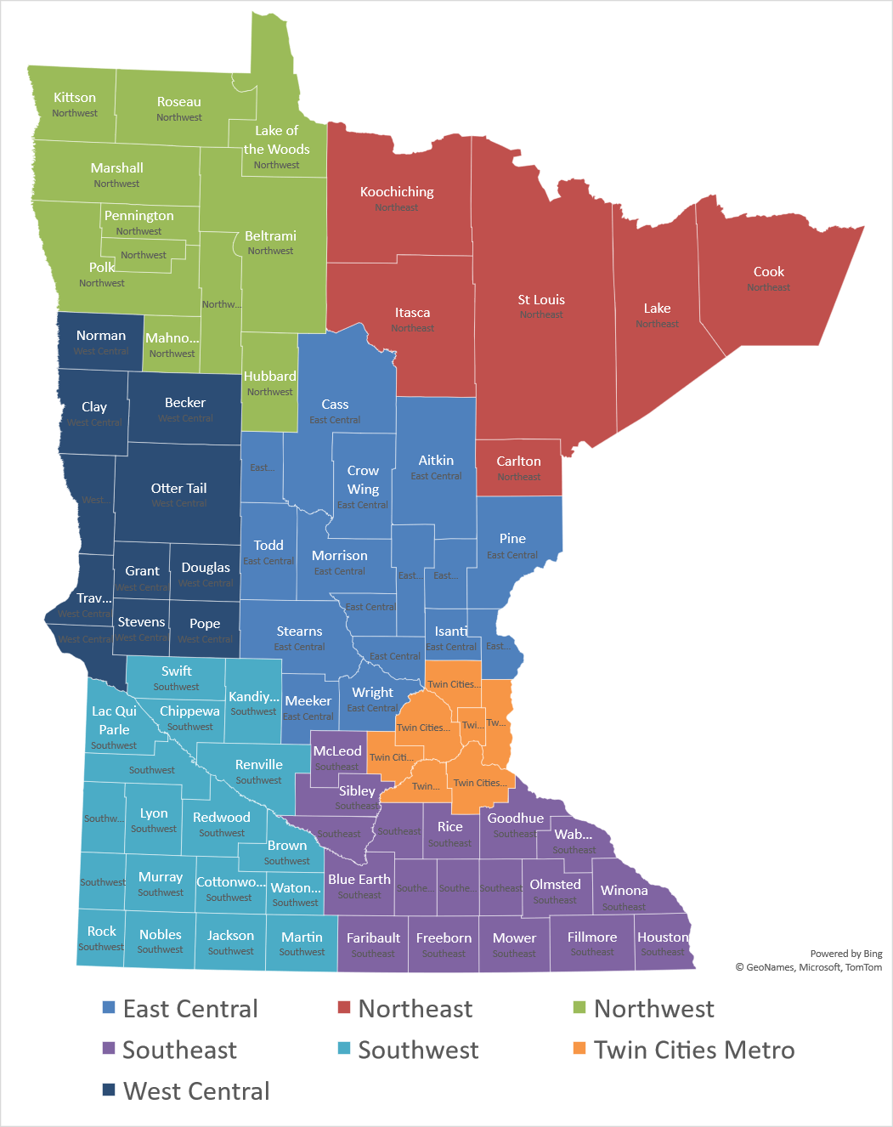
Region
East Central
Northeast
Northwest
Southeast
Southwest
Twin Cities Metro
West Central
208 Survey Responses for Full Year

Slide 3
Nursing Home Occupancy Falls Dramatically due to COVID-19:
Recovery Stalled Late in 2021 Due to Workforce Crisis
Source: Combined Association Occupancy Surveys

Slide 4
Occupancy for Minnesota’s
Nursing Homes – Twin Cities Metro
Biggest Early Pandemic Impact of any Region- Above State Avg Since Late 2020
Source: Combined Association Occupancy Surveys

Slide 5
Occupancy for Minnesota’s
Nursing Homes – Northeast
Staying above State Average throughout the Pandemic
Source: Combined Association Occupancy Surveys

Slide 6
Occupancy for Minnesota’s
Nursing Homes – Northwest
Staying above State Average throughout the Pandemic
Source: Combined Association Occupancy Surveys

Slide 7
Occupancy for Minnesota’s
Nursing Homes – East Central
Fell Well Below Average at Height of Pandemic and Stayed there Since
Source: Combined Association Occupancy Surveys

Slide 8
Occupancy for Minnesota’s
Nursing Homes – West Central
Just Exceeded State Average for First Time in a Year
Source: Combined Association Occupancy Surveys

Slide 9
Occupancy for Minnesota’s
Nursing Homes – Southeast
Fell Below Average at Height of Pandemic and Stayed there Since, Hit Unprecedented Low in First Quarter 2022
Source: Combined Association Occupancy Surveys

Slide 10
Occupancy for Minnesota’s
Nursing Homes – Southwest
Above Average Occupancy Since Beginning of 2021
Source: Combined Association Occupancy Surveys

Slide 11
Limiting Census Due to Staffing
Need to Limit Census Due to Inadequate Staff Remains a Significant Problem Statewide
Source: Combined Association Occupancy Surveys

