Slide 1
Nursing Facility Occupancy Survey Data 2022

Slide 2
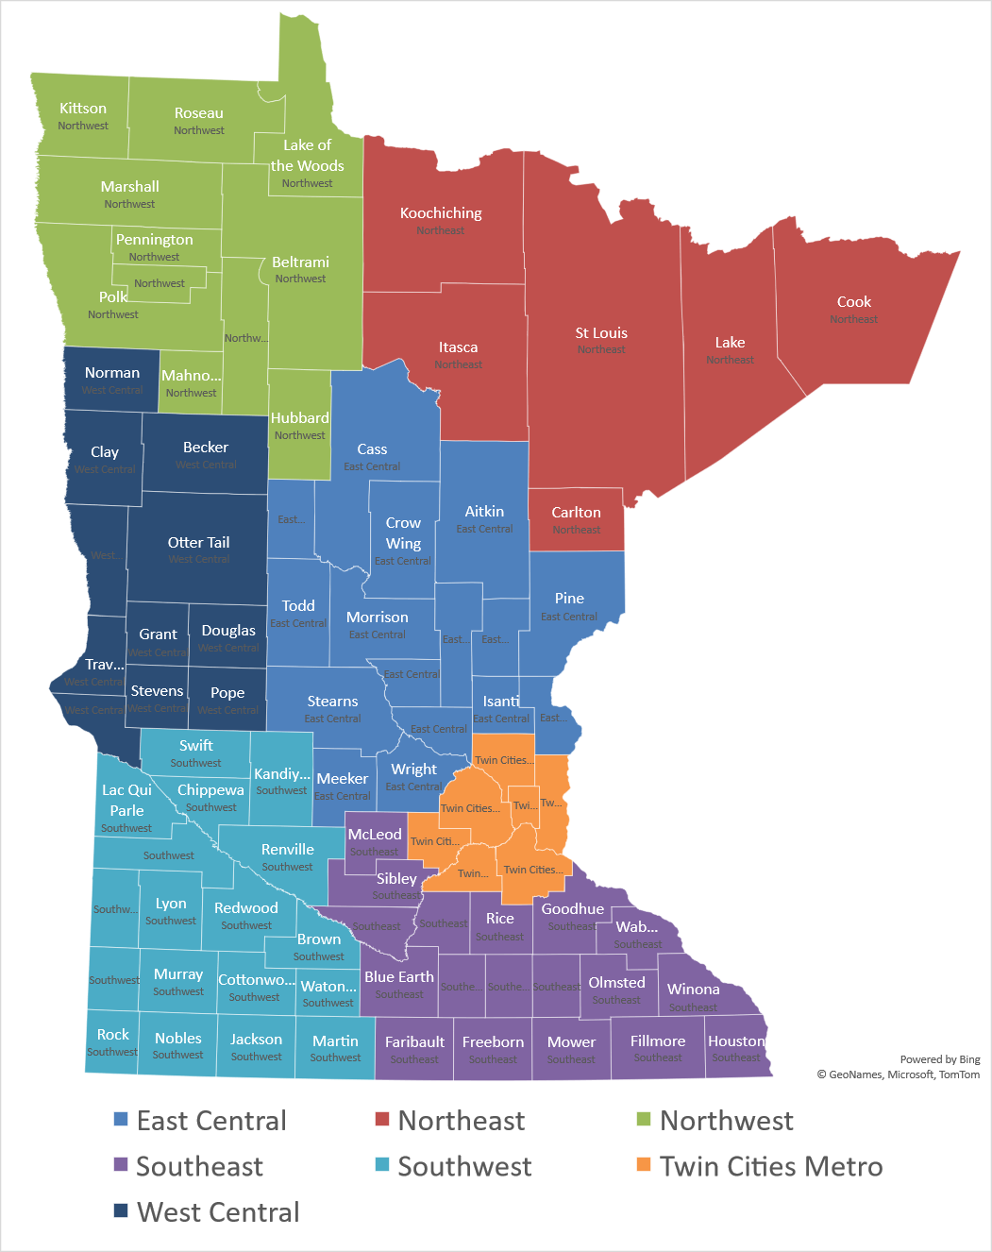
Region
East Central
Northeast
Northwest
Southeast
Southwest
Twin Cities Metro
West Central
193 Survey Responses for Full Year

Slide 3
Nursing Home Occupancy Remains Low in 2022 Due to Workforce Crisis- Still Almost 10% Below Pre-Pandemic Levels
Source: Combined Association Occupancy Surveys

Slide 4
Occupancy for Minnesota’s Nursing Homes – Twin Cities Metro Consistently a Little Above State Avg for last two years
Source: Combined Association Occupancy Surveys

Slide 5
Occupancy for Minnesota’s Nursing Homes – Northeast After Performing Relatively Strongly Dropped below State avg in Second Half of 2022
Source: Combined Association Occupancy Surveys

Slide 6
Occupancy for Minnesota’s Nursing Homes – Northwest Strongest Region in 2022 but Small Sample (9 Facilities)
Source: Combined Association Occupancy Surveys

Slide 7
Occupancy for Minnesota’s Nursing Homes – East Central Showing Some Improvement in Second Half of 2022, but was Second Lowest Occupancy Region for the Year
Source: Combined Association Occupancy Surveys

Slide 8
Occupancy for Minnesota’s Nursing Homes – West Central Above State Average for most of 2022
Source: Combined Association Occupancy Surveys

Slide 9
Occupancy for Minnesota’s Nursing Homes – Southeast Region most Harmed by Labor Shortage- Lowest Occupancy Region in 2022 by more than Four Percentage Points
Source: Combined Association Occupancy Surveys

Slide 10
Occupancy for Minnesota’s Nursing Homes – Southwest Above State Average for all of the Last Two Years
Source: Combined Association Occupancy Surveys

Slide 11
Limiting Census Due to Staffing in 2022 More than 70% of Facilities Reported Needing to Limit Admissions all Year, Slight Improvement in 4th qtr Driven by Metro Area
Source: Combined Association Occupancy Surveys

