Slide 1
Nursing Facility Occupancy Survey Data Second Quarter 2023

Slide 2
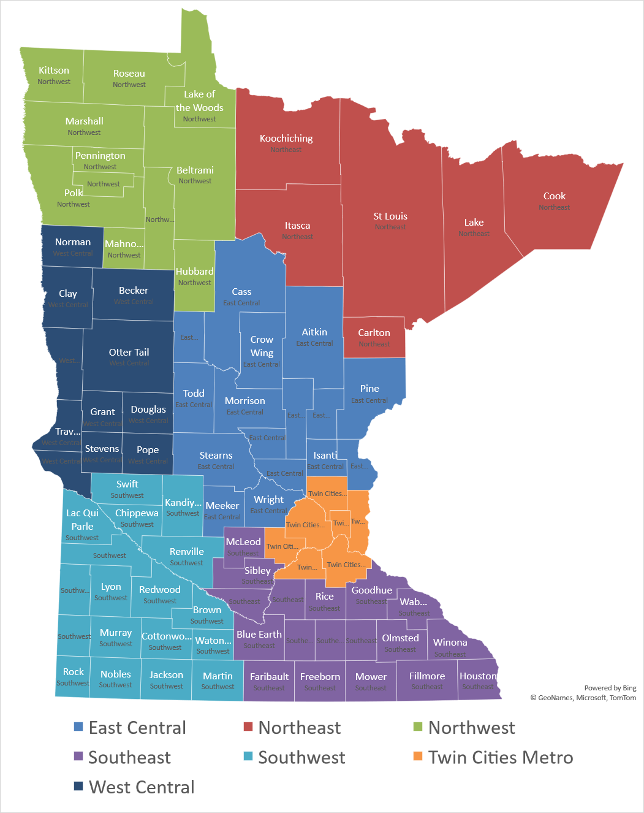
Region
East Central
Northeast
Northwest
Southeast
Southwest
Twin Cities Metro
West Central
220 Survey Responses for First Two Quarters of 2023

Slide 3
Nursing Home Occupancy Remains Low- Still Far Below Pre-Pandemic Levels
Source: Combined Association Occupancy Surveys

Slide 4
Occupancy for Minnesota’s Nursing Homes – Twin Cities Metro Consistently above state avg since beginning of 2022
Source: Combined Association Occupancy Surveys

Slide 5
Occupancy for Minnesota’s Nursing Homes – Northeast Fell to lowest occupancy in the state in second quarter 2023
Source: Combined Association Occupancy Surveys

Slide 6
Occupancy for Minnesota’s Nursing Homes – Northwest Above avg for last two years, highest occupancy in second quarter 2023
Source: Combined Association Occupancy Surveys

Slide 7
Occupancy for Minnesota’s Nursing Homes – East Central Slightly below state avg since beginning of 2022
Source: Combined Association Occupancy Surveys

Slide 8
Occupancy for Minnesota’s Nursing Homes – West Central Fell back below state avg in second quarter 2023
Source: Combined Association Occupancy Surveys

Slide 9
Occupancy for Minnesota’s Nursing Homes – Southeast Region most harmed by Labor Shortage- well below avg since beginning of 2022
Source: Combined Association Occupancy Surveys

Slide 10
Occupancy for Minnesota’s Nursing Homes – Southwest Above avg since beginning of 2022
Source: Combined Association Occupancy Surveys

Slide 11
Limiting Census Due to Staffing Drops in First Quarter 2023 Considerable improvement since early 2022 in most regions
Source: Combined Association Occupancy Surveys

