Slide 1
Nursing Facility Occupancy Survey Data 2025

Slide 2
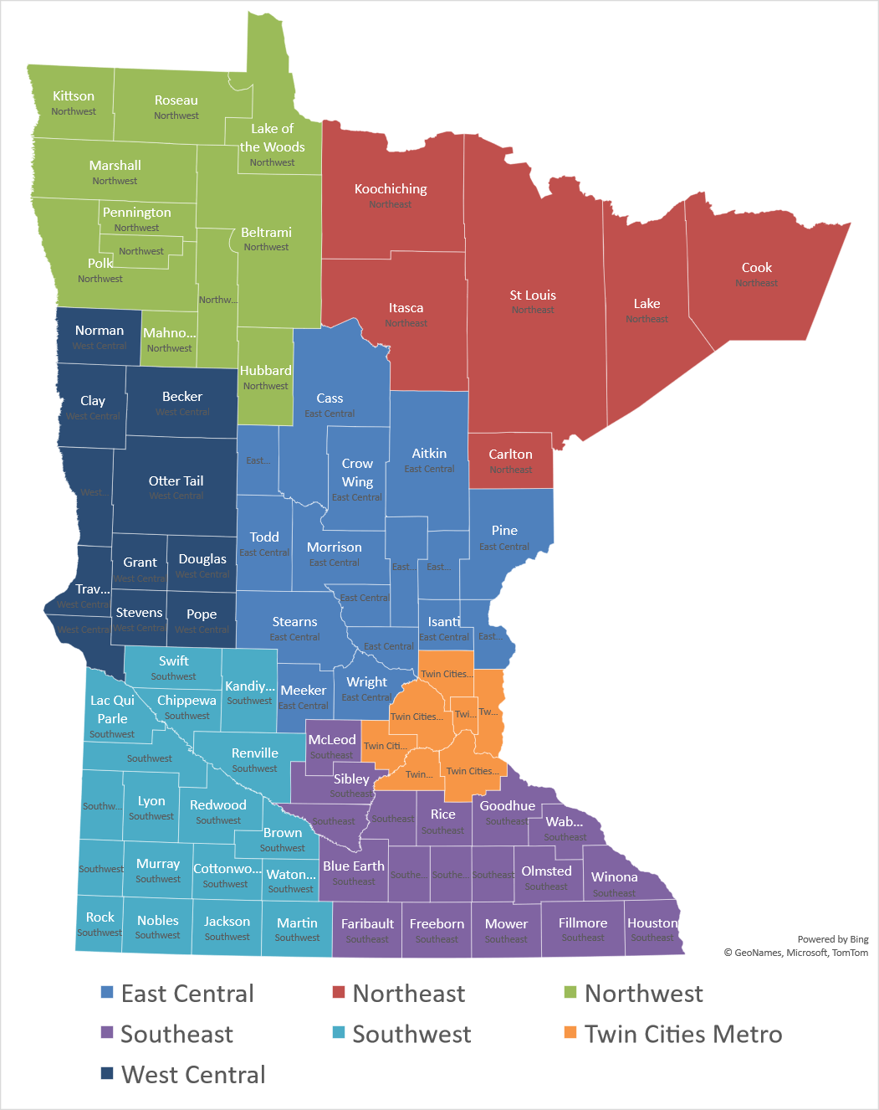
Region
East Central
Northeast
Northwest
Southeast
Southwest
Twin Cities Metro
West Central
225 Survey Responses

Slide 3
Nursing Home Occupancy Improving but Still Below Pre-Pandemic Levels- 4th Qtr 2025 highest since 2020
Source: Combined Association Occupancy Surveys

Slide 4
Occupancy for Minnesota’s Nursing Homes – Twin Cities Metro Consistently Above State Avg since Beginning of 2024, Highest Occupancy Region in all of 2025
Source: Combined Association Occupancy Surveys

Slide 5
Occupancy for Minnesota’s Nursing Homes – Northeast Well Below State Average since Beginning of 2024, Lowest Occupancy Region by a Wide Margin in 2025
Source: Combined Association Occupancy Surveys

Slide 6
Occupancy for Minnesota’s Nursing Homes – Northwest Occupancy grew throughout 2025 Ending the Year above State Average
Source: Combined Association Occupancy Surveys

Slide 7
Occupancy for Minnesota’s Nursing Homes – East Central Occupancy grew in Second Half of 2025 Ending the Year above State Average
Source: Combined Association Occupancy Surveys

Slide 8
Occupancy for Minnesota’s Nursing Homes – West Central Despite some Improvement in 2025 Continues to Lag Behind State Average
Source: Combined Association Occupancy Surveys

Slide 9
Occupancy for Minnesota’s Nursing Homes – Southeast Despite some Improvement in 2025 Continues to Lag Behind State Average
Source: Combined Association Occupancy Surveys

Slide 10
Occupancy for Minnesota’s Nursing Homes – Southwest Running Just Below State Average throughout 2025
Source: Combined Association Occupancy Surveys

Slide 11
Limiting Census Due to Staffing Becoming Less of a Problem- Every Region saw Improvement in 2025 Some Regions Still Facing More Significant Staffing Challenges
Source: Combined Association Occupancy Surveys

