Slide 1
LEADERSHIP ROUNDING
A Strategy for Safe Care
DAN JOHNSON
President and CEO
Catholic Eldercare
JULIE APOLD
Vice President of Quality & Performance Excellence
LeadingAge Minnesota
JODI BOYNE
Vice President of Public Relations
LeadingAge Minnesota
LeadingAge Minnesota
Annual Meeting & Leadership Forum
September 19, 2019
2:45 – 3:45 p.m.

Slide 2
Does this
sound familiar?
What can you do as a leader to provide an environment where staff feel safe to speak up?
You take a safety issue to your staff. They nod and say yes, that has been happening for a while.
You are investigating a safety event and you find that no one is really following the policy because it really doesn’t work for them.
Senior
Leadership
Rounding

Slide 3
Why Start with Senior Leadership Rounding?
Notes:
Demonstrates the importance of safety; begins establishing the culture

Slide 4
It’s about relationships and trust
Notes:
Tip: Before Rounding ask yourself, What am I going to learn about this person that I don’t already know? Encourage staff to share something about themselves to deepen your relationship with them.

Slide 5
It’s about proactively identifying and addressing obstacles to staff performance

Slide 6
It’s about reinforcing positive behaviors through recognition.

Slide 7
“See and be seen. Get out of your office, walk around, make yourself visible and accessible.”
J. Willard Marriott

Slide 8
Senior Leadership Rounding CANNOT be delegated.
Critical to establishing culture
Serves as a model that can cascade to other levels of the organization – e.g., managers and their direct reports.

Slide 9
Individual
PLEDGE
Individual Pledge and Actions
I pledge to do my best every day to increase the safety of the people I serve, and my fellow team members, by:
1) I will always treat the people in my care with respect and dignity and take steps to get to know them as a person.
2) I will speak up if I see something that may be unsafe or makes me feel uncomfortable.

Slide 10
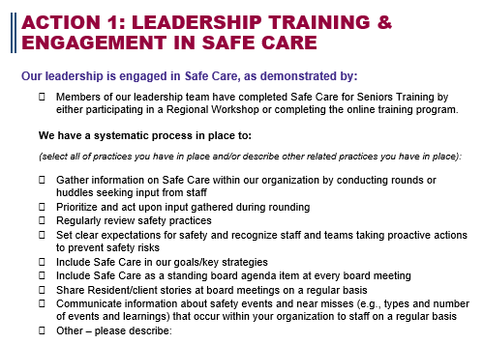

Slide 11
Senior Leadership Rounding – Establishing Culture; Building Relationships and Trust between Staff and Senior Leaders
Model Behaviors that cascade down to Unit-Based/Manager Level Rounding
Huddles/Stand-Ups
What key information do we need for today/this week?
Creates culture of trust and transparency that encourages speaking up and makes other safety strategies more effective
Environment/Safety Checks
Proactive but more technical; focus on environment, process issues, etc.
Notes:
Huddles/Stand-ups – What’s going on today – resident issues; something happening that we should be aware of; supply issues; policy change; staffing/staff issues; concerns raised by residents/families; concerns that came from rounding that should be prioritized – quick meeting to share and discuss important information
Leadership Rounding – long-game – setting the culture; how things are going for your staff; engaging staff; make sure staff is heard; Organizational purpose to build relationships between C-suite and front-line staff; relationship building – so when concerns happen you are going to hear about it; making the pledge work; proactive - creating an open and transparent culture; improving communication – adaptive/culture piece – this sets the foundation for all the other pieces to work well….recognizing and reinforcing positive behaviors
Manager Rounding – Unit-Level purpose to build and maintaining manager/staff relationships
Environmental/Safety Rounding – proactive to identify more specific issues – focus is on environment/process etc. as you get better at Leadership Rounding and manager rounding you will be relying less on environmental safety rounding. Technical piece

Slide 12
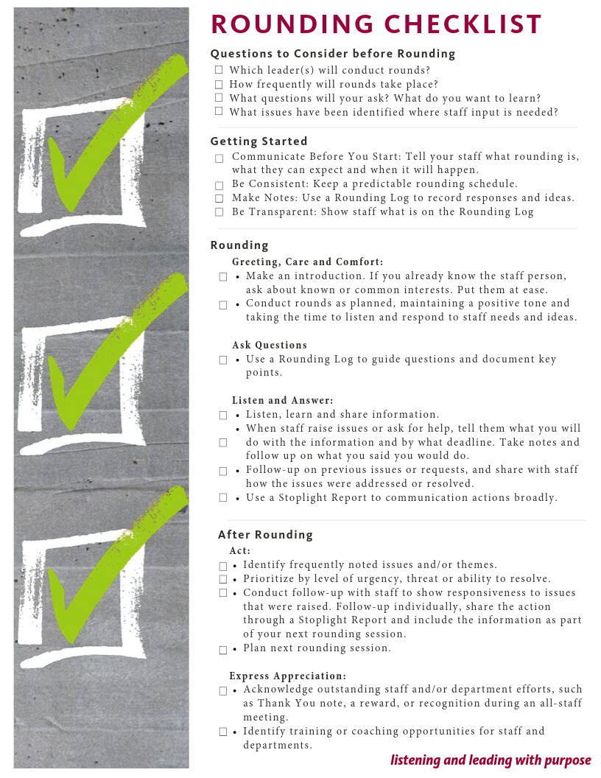
Getting Started
Review the Rounding Checklist and Establish Your Process
Who will conduct rounds?
How frequently and when will they take place?
What questions do you want to ask (what do you want to learn)?
How will you document rounds?
When and how will you track, and address, follow-up items?
How will you recognize staff identified during rounds?
How will you engage and reassure staff?

Slide 13
Getting Started: Who and When?
WHO CONDUCTS ROUNDS?
Senior Leaders
No Delegation
WHEN TO CONDUCT?
Keep consistent schedule; make sure it works with department schedule
Pre-assign and schedule
Insist all rounds are completed
HOW FREQUENTLY?
30 min/week per leader
Visit 1 department/week
WHERE WILL THEY TAKE PLACE?
Ensure all shifts are included
Make conversational, avoid office/desk/chair

Slide 14
KEY ELEMENTS Rounding on Staff
Greetings, care and comfort
Ask questions
Listen and Answer
Take Action
Express Appreciation

Slide 15
Provide an introduction
If you know the staff person, ask about common interests or other topics
Put them at ease

Slide 16
BEFORE ROUNDING
Do some scouting with the Department Manager
Is there anything special going on in the department that I should know about?
DURING ROUNDING – ASK & LISTEN
What is working well in your area?
What are some things that make it difficult for you to do your job?
What safety concerns do you have?
Are there any individuals or groups you think I should be recognizing for doing exceptional work?
Ask about any special projects, focus areas, etc. that may apply.

Slide 17
Use a Structured but Informal Approach
Don’t let everyone make up their own questions – they will settle into their comfort zone.
Ask Open-Ended Questions
If answer yes or no; delve deeper; tell me more.

Slide 18
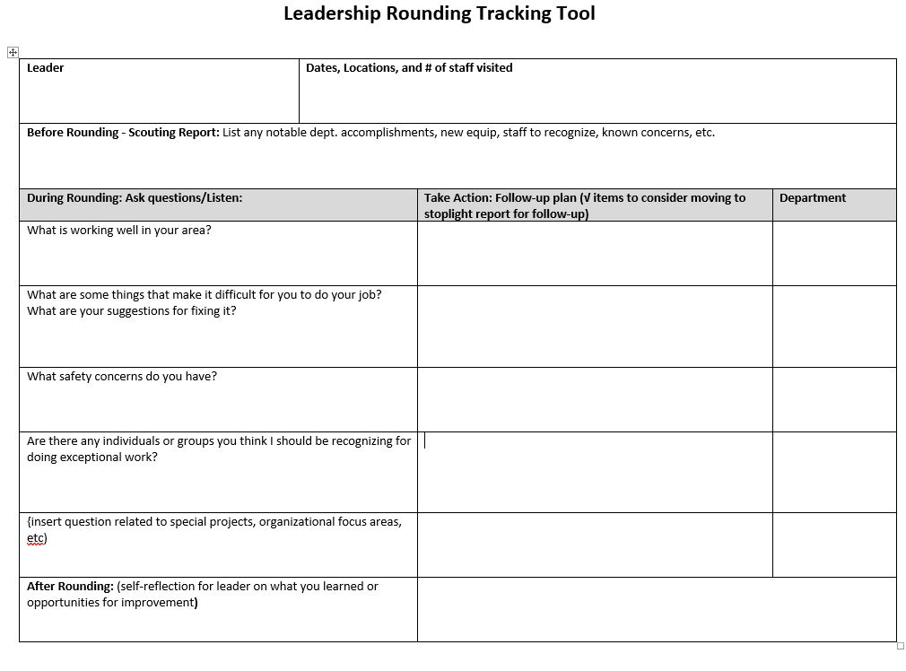
Tracking Rounding Information

Slide 19
Listen, Learn and Share Information
Listen More Than You Talk
Take up no more than 20% of the talking time
Act. Delegate.
Don’t feel you have to personally fix every problem that is shared with you.
Delegate issues to managers
Don’t micro-manage the process

Slide 20
Tell staff what you will do with the information and by what deadline.
Take notes and make sure to follow up on actions.
Recommend using a visual tool to follow up and communicate actions.
Opportunity to review your performance improvement process.
Do you have good systems in place to delve deeper into identified problems as needed to identify root causes and strong solutions?

Slide 21
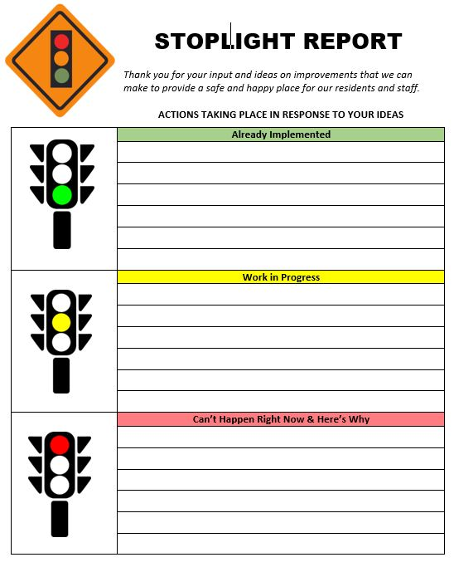
STOPLIGHT REPORT
Easily and visually communicate how ideas and/or concerns gathered during rounding are dealt with.

Slide 22
Say thank you.
Follow up as promised.
A thank you card is a nice touch.
Consider recognizing staff at a team or all-staff meting.

Slide 23
Core Principles
APPROACHABILITY
“You need to create a safe environment for people to speak up or you’re not going to know what’s going on.” Alan Mulally, CEO, Ford Motor Company
COMMITMENT
“Unless commitment is made, there are only promises and hopes…no plans.” Peter Drucker, Management Consultant
BUILDING TRUST
“When I walk through the hospital, it is a great opportunity to gather information and build trust by listening and responding to concerns. Rounding takes me beyond the paper dashboard so I can get a true pulse on the health of the organization.” Mike Sherrod, CEO, Coliseum Northside Hospital
OBSERVATION
“You can observe a lot just by watching.” Yogi Berra
Notes:
In June of 2017, the LeadingAge Minnesota Board of Directors commissioned a task force to develop a prevention action plan with recommendation for actions members could take to prevent harm before it occurs.

Slide 24
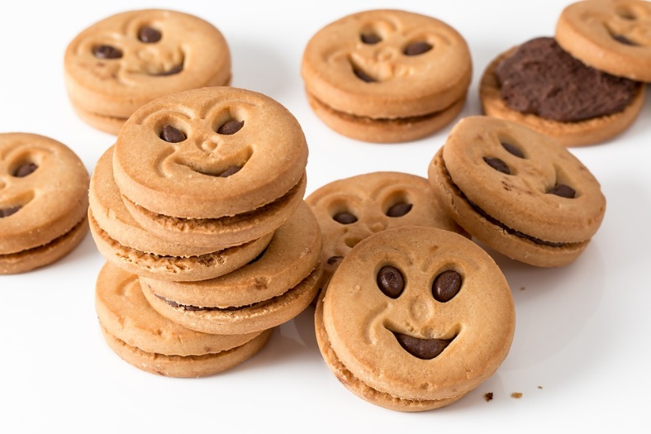
Approachability
Be Yourself!
Smile ☺
Get and Stay in the Right State of Mind

Slide 25
Commitment
Carve out time, stick to it
Regular schedule
“It’s OK, I have the time.”

Slide 26
Building Trust
Ask open-ended questions
Listen to concerns and act on them
Don’t make promises that can’t be kept
Round on all shifts
“Get your hands dirty”

Slide 27
Observation
Be Present
Watch how work is actually performed
View the facility from staff/resident perspective
Recognize jobs well done
Look for good ideas to harvest (not a rote exercise)

Slide 28
Tools and Resources
New Toolkit and Training Video Helps You Effectively Leadership Round on Staff
The Why and What of Leadership Rounding
Leadership Rounding Preparation Checklist
Leadership Rounding Log
The Stoplight Report
Sample Communication to Staff
www.leadingagemn.org/safecare

Slide 29
Rolling Out the Program
Know Your Purpose
Build Buy-In
Communicate

Slide 30
Engaging and Empowering Staff
Know Me. Respect Me. Recognize The Work I Do.
Share why Leadership Rounding is important to you, them and your shared mission.
Spread the message through email, newsletters team meetings, message boards, posters, etc.
Establish a “no fault zone” and let them know this is not a compliance check.
Explain what you will be talking about; share questions in advance.
Let them know when you are coming.
Share results.
Recognize and reward staff for good work.
What’s In It
For Me?
Remember: No Surprises!

Slide 31
Managing Tough Conversations
Be willing to have the tough conversations.
Don’t assume negative intent.
Accept criticism and negative feedback with humility.
You don’t have to fix every problem, but you do need to validate concerns.
Answer questions honestly.
Don’t make promises you can’t keep.
Thank them for sharing.

Slide 32
8 Must Haves and 2 Don’ts
8 MUST HAVES
Who: Senior Leaders – no delegation!
Where: All departments; All shifts
Frequency: 30 minutes a week; 1 department a week
Structured but informal approach
Incorporate teaching for leaders
Use open-ended questions
Make sure follow-up happens
Performance improvement
2 DON’TS
NO TEAMS – Do not conduct leadership rounds in teams; go individually.
NO TOWN HALL MEETINGS – These are good but are not a replacement for Leadership Rounding.

Slide 33
Listening & Leading with Purpose
Leadership Perspective:
How I am thinking about implementing this in my organization

Slide 34
JULIE APOLD
Vice President of Quality & Performance Excellence
651.659.1407 | japold@leadingagemn.org
JODI BOYNE
Vice President of Public Relations
651.659.1430 | jboyne@leadingagemn.org

