Slide 1
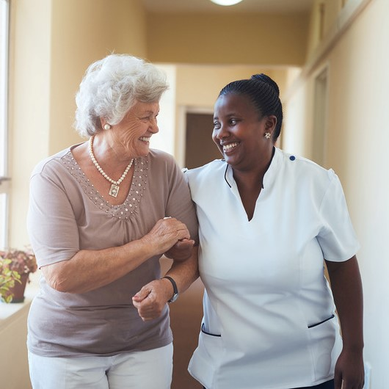
OUR CALLING
OUR COMMITMENT
OUR CULTURE

Slide 3
Eliminate Preventable Harm in the Course of Caregiving

Slide 4
Objective 1:
Eliminate unintended instances of serious harm in the course of caregiving in nursing homes, assisted living/housing with services and adult day settings.
Objective 2:
Eliminate cases of abuse, drug diversion and financial exploitation in nursing homes, assisted living/housing with services settings and adult day settings.

Slide 5
The Safe Care for Seniors Plan

Slide 6
Public POLICY
PUBLIC
RELATIONS
MEMBER INITIATIVES
Strategic
Integrated
Actionable
Notes:
Safe Care for Seniors is an integrated, three-part strategy: Member Initiatives, Public Policy and Public Relations.
Each on its own is a strong, proactive and forward looking program with their own individual components that will shape your culture, your organization and our field as a whole.
But it is imperative that they work together – in sync – via the core purpose of what we want to accomplish and cohesive messaging that will be reflected throughout each strategy.
But the success of this campaign relies on member-led initiatives. By improving our ability to detect and prevent harm, improve safety, engage residents/families, and empower our teams, we will see less focus on calls for regulatory oversight and an alignment with our public relations campaign to enhance consumer confidence in all that we do.

Slide 7
MEMBER INITIATIVES
Individual & Organization Action
Notes:
The most important component of Safe Care for Seniors campaign is the member-led initiatives – and it speaks to our core value of Better Together.
This is our call to action.

Slide 8
It Begins with a Pledge
Individual & Organization Action
Notes:
Many of you may have attended the October District Meetings where Gayle Kvenvold shared the inspirational story of what one member – PioneerCare in Fergus Falls – did to renew their commitment to safe care and quality of life for those they serve.
That action has served as an example of what our members have created in our own Safe Care Pledge and Action Plan.

Slide 9
Making a Public Commitment ____________ THE SAFE CARE PLEDGE
1
Deploy a statewide campaign for all staff to take an Individual Safe Care for Seniors pledge
2
Organizations commit to Implement the Safe Care for Seniors Action Plan
3
LeadingAge MN provides training, resources and recognition to support implementation
Notes:
The Safe Care Pledge will be promoted by LeadingAge MN to its members. And the goals and the objectives of the campaign will be shared beyond our members – to the public…via social media, stakeholder meetings/events and even in our testimony at the State Capitol.
The work that our members are doing around the state to prevent harm should be known to all – and can help us demonstrate the high quality care that more than 70,000 seniors receive from 60,000 dedicated caregivers in our settings each day.

Slide 10
Individual
PLEDGE
Individual Pledge and Actions
I pledge to do my best every day to increase the safety of the people I serve, and my fellow team members, by:
1) I will always treat the people in my care with respect and dignity and take steps to get to know them as a person.
2) I will speak up if I see something that may be unsafe or makes me feel uncomfortable.
Notes:
The Safe Care for Seniors pledge is a pledge that everyone can take.
It is renewed commitment and an opportunity to bring people – leaders, supervisors, staff residents and families -- together around a shared vision.
Preventing harm and improving safety will take more than a pledge. Individuals who take the pledge will come to work each day with this vision and this commitment at the core of what they do.
Organizational leaders who take the pledge are making a commitment to put action behind the words.

Slide 11
More than an Initiative…
a Mission
Awareness
SUPPORT
MOMENTUM
SUSTAINABILITY
Notes:
I was already interested in starting this campaign at my community after your presentation but an incident on Friday of this week expedited my passion for getting this started as soon as possible. We had a resident assistant, after finding a resident with dementia who had fallen on the floor, step over him without acknowledgment that he was there to close the blinds, accidently tripped over him on the way back and did not apologize and then got him up without explaining the process of using the lift to him. We filed a VA for the occurrence, but more than that I am deeply troubled by her actions.
To me, and how you explained it in your presentation, the Safe Care Pledge goes beyond just “ not hitting a resident.” Exactly like it says in the Pledge: we aim to do our best each day to treat people in our care with respect, dignity and take steps to get to know them as a person. I want all residents at my community to be treated this way and feel like launching this campaign would be a great start to building this culture.

Slide 12
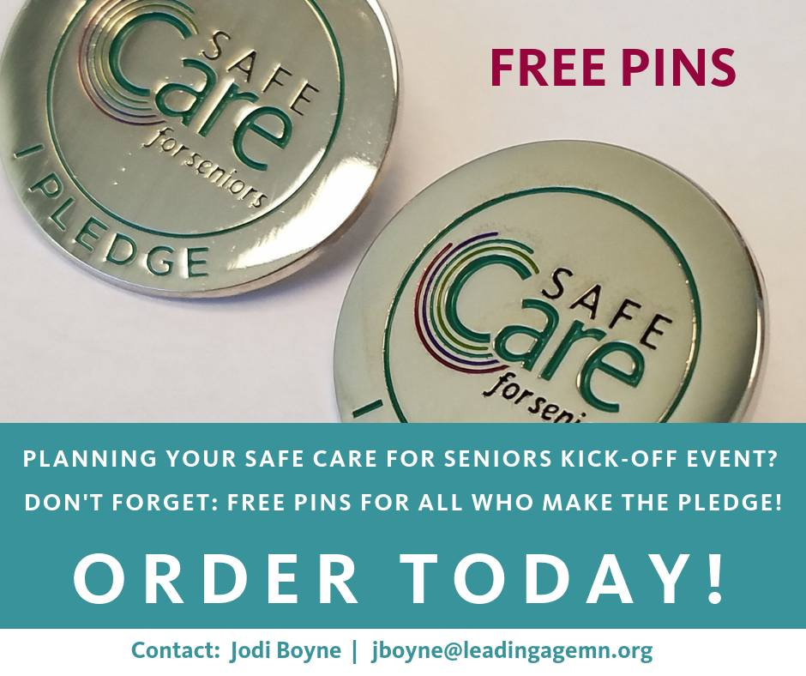
www.leadingagemn.org/safecare

Slide 13
Organizations Demonstrate Action
Notes:
A pledge will ring hollow if people do not see action – proactive and responsive – in their setting. The Safe Care Pledge for organizations is accompanied by a 5-point action plan – and it is some of the most impactful work we have ever done.

Slide 14
Words + Action = Positive Change
Talking vs Doing
Action is More Important than Intention
Activity vs Action
Talking and Planning is Different than Taking the Step Forward
Progress vs Perfection
Incremental Steps Lead to Positive Change
Has My Organization Made the Pledge?
Check the Safe Care for Seniors Honor Roll – Commitment Level
www.leadingagemn.org/safecare
Check with Your Site Leader or Your Corporate Office
Contact Julie Apold
japold@leadingagemn.org
If Not, Make the Pledge
The Power is in the Doing, Not in the Talking.
Notes:
Jodi

Slide 15
Safe Care: 5-Point Action Plan
1
Leadership Engagement and Training in Safe Care
2
Designate a Safe Care for Seniors Safety Champions
3
Participate in at least one Collaborative Learning & Improvement Opportunity each year
4
Partner in New Ways with Residents and Families to improve Communication, Safety and Quality
5
Build and Strengthen Our Safety Culture
Notes:
The plan help eliminate preventable harm and foster a safety culture embedded in trust, accountability, strong systems, continuous learning, collaboration and inclusive communication.
We are going to walk through each point – defining the action step, giving examples of what an organization can do (or maybe is already doing) to accomplish that action step.
This is whether the interactive discussion takes place and I encourage you to be frank in your comments and to share what you may already be doing to accomplish these goals.
We are interesting in learning about your existing safety practices as much as we want to know what LeadingAge MN can do to help you successfully implement this plan.

Slide 16
Notes:
Will be going into each of these actions more in depth throughout the day.

Slide 17
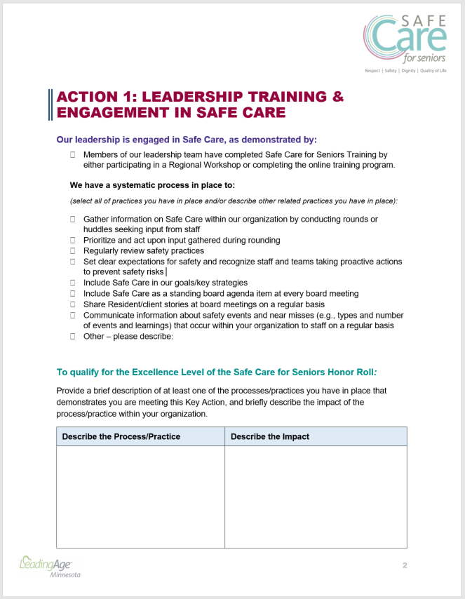

Slide 18
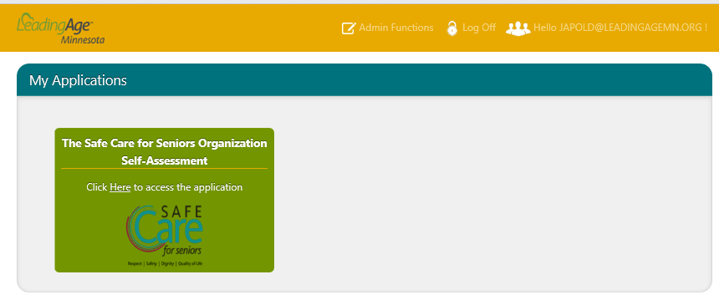
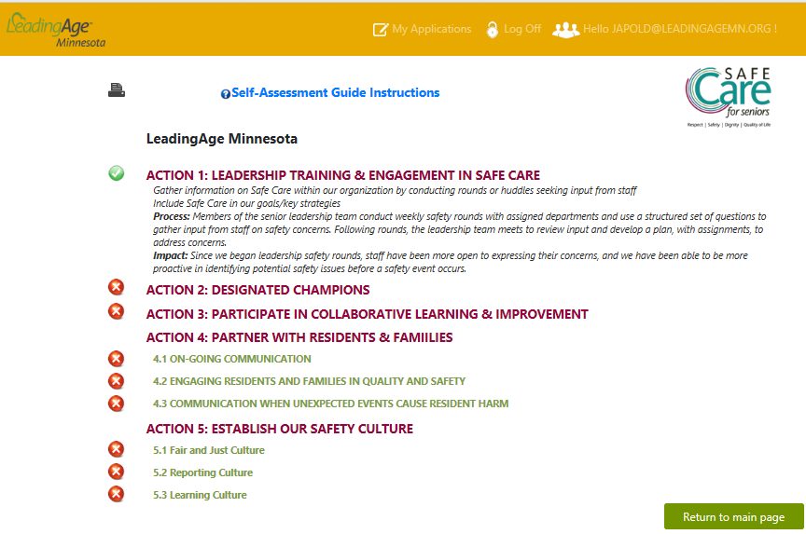
Data Portal

Slide 19
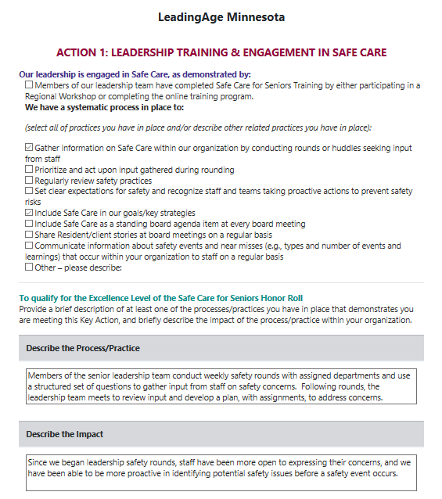

Slide 20
Committed Organization
Make the Safe Care for Seniors Organization Pledge
Honor Roll Action Level
Demonstrate Action on 5 Actions
Honor Roll Excellence Level
Demonstrate Action on 5 Actions & Key Sub-Actions
RECOGNITION
Notes:
Jodi

Slide 21
Individual Recognition
Nominate individuals who demonstrate:
Respect, Dignity, Knowing Resident as a Person
Speaking Up to Prevent Harm
Notes:
Jodi

Slide 22
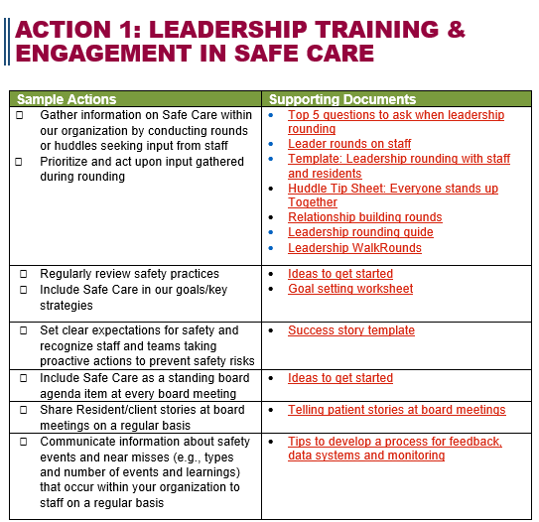

Slide 23
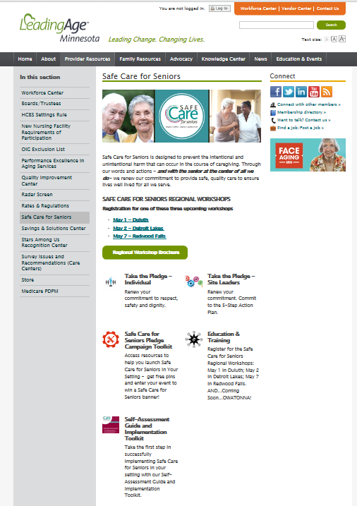
How to Access On-line Tools & Resources
Log-in to the LeadingAge Minnesota website: www.leadingagemn.org
Under the “Provider Resources” tab, click on “Safe Care for Seniors” in the left-hand column.
Click on the Safe Care for Seniors Pledge Toolkit, or
Self-Assessment Guide and Implementation Toolkit

Slide 24
Julie Apold
japold@leadingagemn.org
Jodi Boyne
jboyne@leadingagemn.org

