Slide 1
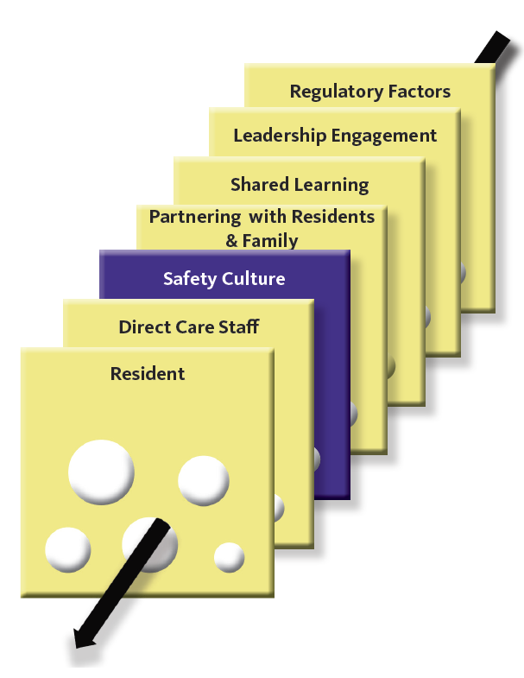
An Introduction to a Culture that is Fair & Just
Alison Page, MHA, MS, FACHE
Chief Executive Officer
Western Wisconsin Health

Slide 2
“Just Culture”: A Key to Quality and Safety
Alison H. Page, MHA, MSN, FACHE
Chief Executive Officer
Western Wisconsin Health

Slide 3

Goal for today

Slide 4
Learning objectives
At the conclusion of this session, attendees will be able to:
Examine the philosophy and key elements of a Just Culture
Describe how a Just Culture can impact quality and safety
Differentiate between human error, at-risk behavior, and reckless behavior
Identify appropriate organizational response to human error, at-risk behavior, and reckless behavior
Notes:
Required for continuing education.

Slide 6
We’ve all been there……

Slide 7
Medication error

Slide 8
Failure to check patient identification

Slide 9
Why did these accidents happen? How what can we do to prevent them from happening again? How do we judge the clinicians involved?

Slide 10
Just Culture –It is about
Creating a common philosophy
Using a common language
Resulting in a common experience for participants

Slide 11
The Problem Statement
Accountability
Who is responsible for the system performance?
Who is responsible for individual performance?
Punishment
Where does it work?
When is it needed?

Slide 12
We can do two things: 1. Design systems to accommodate human beings 2. Manage human behavior within the systems

Slide 13
Managing Systems

Slide 14
“Systems produce precisely the outcomes they are designed for.”
Don Berwick

Slide 15
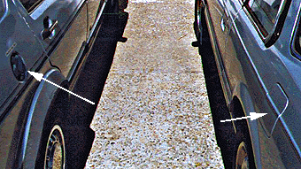

Slide 17
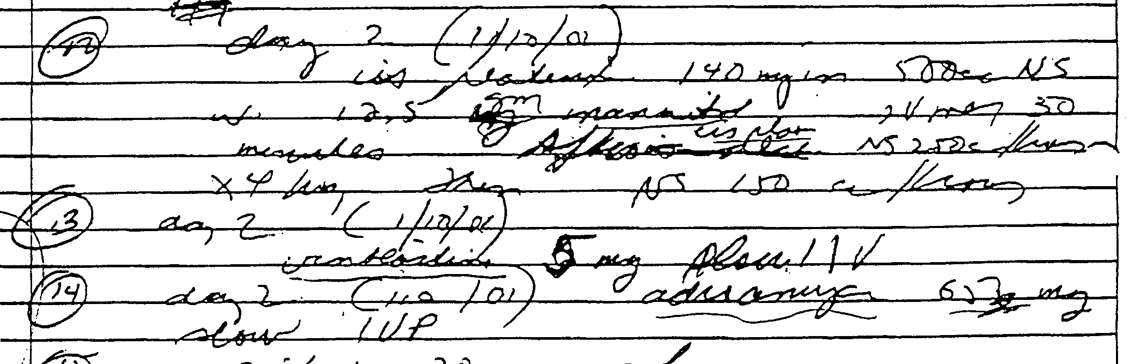

Slide 18
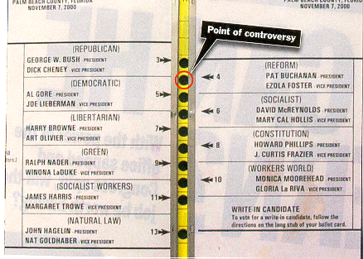
2000 Presidential Election
Florida Ballot

Slide 19
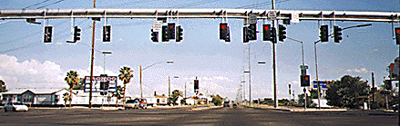

Slide 20
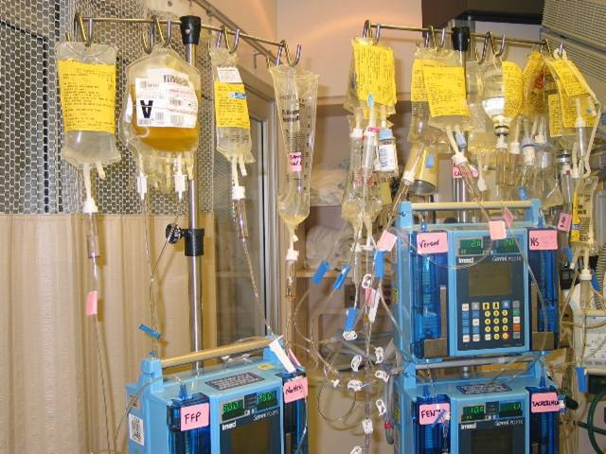

Slide 21
Epinephrine Ephedrine

Slide 22
Dopamine Dobutamine

Slide 23
EPInephrine EPHEDrine DOPamine DoBUTamine

Slide 24
The framework we start with: Reason’s ‘Swiss cheese’ model – our defences, barriers and safeguards are imperfect.
Some holes due
to active failures
Hazards
Other holes due to
latent conditions
Losses
James Reason 1997

Slide 25
Managing human behavior is a bit harder. Why?

Slide 26
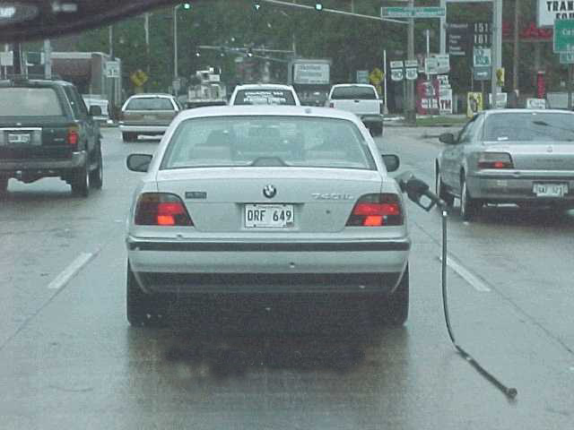
Because – to error is human

Slide 28
Paris
in the
the spring

Slide 30
Nominal Human Error Rates
Activity
Probability
Error of commission (misreading a label)
0.003
Error of omission without reminders
0.01
Error of omission when items imbedded in a procedure
0.003
Simple math error with self-checking
0.03
Monitor or inspector fails to detect error
0.1
Personnel on different shifts fail to check hardware unless required by checklist
0.1
General error in high stress when dangerous activities occurring rapidly
0.25
Salvendy G. Handbook of human factors & ergonomics 1997.

Slide 31
Aoccdrnig to rscheearch at Cmabrigde Uinervtisy, it deosn't mttaer inwaht oredr the ltteers in a wrod are, the olny iprmoetnt tihng is that the frist and lsat ltteer be at the rghit pclae. The rset can be a total mses and you can sitll raed it wouthit porbelm. Tihs is bcuseae the huamn mnid deos not raed ervey lteter by istlef, but the wrod as awlohe.

Slide 32
The human brain cannot have multiple simultaneous foci of interest. This lack of cognitive resource is the single limiting factor of human activity.
Francois Clergue

Slide 33
Lessons from Human Factors Research
Errors are common
The causes of errors are known
Errors are byproducts of useful cognitive functions

Slide 34
“We can’t change the human condition, but we can change the conditions under which humans work”
James Reason

Slide 35
We know….to error is Human

Slide 36
But….To Drift is also Human
Brittany Spears

Slide 37
Why do we drift?
To accomplish more
Because we do not see the risk

Slide 38
Consequences of behavior
GO THE SPEED LIMIT
Desired behavior
Satisfaction of being a law abiding citizen
Reduce chance of accident
SPEED
Undesired behavior
Save time now

Slide 39
However…. Humans are accountable for their behavioral choices

Slide 40
Just Culture
David Marx, JD
https://www.outcome-eng.com/

Slide 41
Just Culture is about:
Creating an open, fair, and just culture
Creating a learning culture
Designing safe systems
Managing behavioral choices
Adverse
Events
Human
Errors
System Design
Managerial and Staff Behaviors
Learning Culture / Just Culture

Slide 42
A Model that Focuses on Three Duties balanced against Organizational and Individual Values
The Three Duties
The duty to avoid causing unjustified risk or harm
The duty to produce an outcome
The duty to follow a procedural rule
Organizational and Individual Values
Excellence
Integrity
Service
Teamwork
Safety
Stewardship
Notes:
42

Slide 43
Two Specific Classes of Duty
Meet me at 7:00 pm at Sally’s Bar
Leave your apartment at 6:45 pm. Go south on Oak Street, turn right on Washington. Do not cross the river. It will be on your left.
The Duty to Produce an Outcome
The Duty to Follow a Procedural Rule

Slide 44

My Husband
Father of many
Dentist
Nice guy

Slide 45
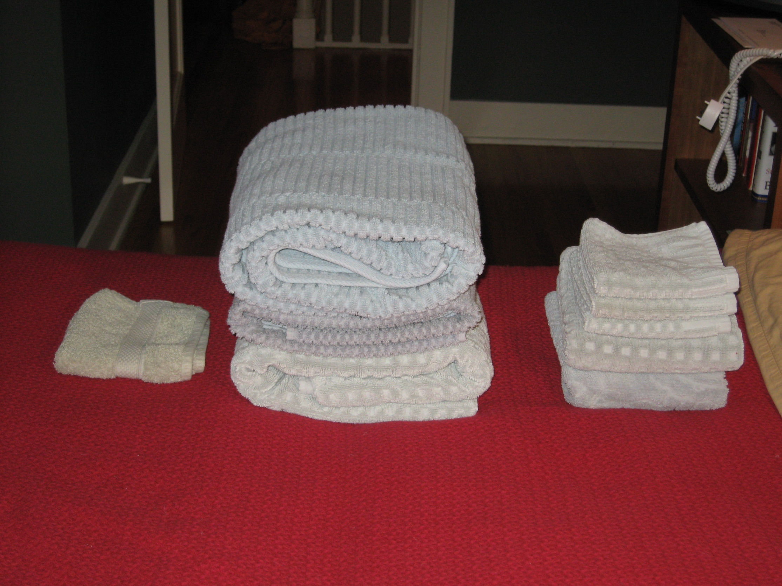

Slide 46
Managing Behavioral Choices: Everyone Takes Risks, Every Day
RISK
SOCIAL UTILITY
Notes:
46
Examples of these kinds of decisions:
Retaining a marginal employee because you don’t think they will cause harm (risk) and recruiting/training a new one would be time-consuming.
Keeping an OB service going in an underserved area, even though there are physician coverage issues.

Slide 47
The Behaviors We Can Expect
Human error - inadvertent action; inadvertently doing other that what should have been done; slip, lapse, mistake.
At-risk behavior - behavior that increases risk where risk is not recognized, or is mistakenly believed to be justified.
Reckless behavior - behavioral choice to consciously disregard a substantial and unjustifiable risk.
Notes:
47

Slide 48
Examples
Failure to check the name band
Notes:
48

Slide 49
Accountability for our Behavioral Choices
Human
Error
At-Risk
Behavior
Reckless
Behavior
Product of our current
system design
Unintentional Risk-Taking
Intentional Risk-Taking
Manage through changes in:
System Design
Processes
Procedures
Environmental factors
Manage through:
Removing incentives for at-risk behaviors
Creating incentives for healthy behaviors
Increasing perception of risk
Manage through:
Remedial action
Disciplinary action
Console
Coach
Punish

Slide 50
Managing Human Error
Two questions:
Did the employee make the correct behavioral choices in their task?
Is the employee effectively managing his/her own performance shaping factors?
If yes, the only answer is to console the employee – the error happened to him / her
Notes:
50

Slide 51
Managing Multiple Human Errors
What is the source of a pattern of human errors?
The system? If yes, address the system.
If no, can the repetitive errors be addressed through non-disciplinary means?
If no, how will disciplinary sanction reduce the rate of human error?
Notes:
51

Slide 52
Managing At-Risk Behaviors
A behavioral choice
Driven by perception of consequences
Immediate and certain consequences are strong
Delayed and uncertain consequences are weak
Rules are generally weak
Notes:
52

Slide 53
Managing At-Risk Behaviors
A behavioral choice
Managed by adding forcing functions (barriers to prevent non-compliance)
Managed by changing perceptions of risk
Managed by changing consequences
Coaching
Notes:
53

Slide 54
Why not punish “at-risk” behavior?
Because….
Somewhere along the line your organization has likely tacitly approved certain at-risk behaviors.
2. If you punish at-risk behavior people will likely not be honest about the at-risk behavior next time

Slide 55
Often you did not fully recognize the at-risk behavior until an event occurs.

Slide 56
Who judges risk and behaviors?
Brittany Spears
Us
Risk = Severity of Possible Outcome x Likelihood
Safety ~ Reasonableness of Risk

Slide 57
Managing Reckless Behavior
Reckless Behavior
Conscious disregard of substantial and unjustifiable risk
Manage through:
Disciplinary action
Notes:
57

Slide 58
Managing Behavioral Choices
Human
Error
At-Risk
Behavior
Reckless
Behavior
Product of our current
system design
Unintentional Risk-Taking
Intentional Risk-Taking
Manage through:
Removing incentives for at-risk behaviors
Creating incentives for healthy behaviors
Increasing perception of risk
Manage through:
Remedial action
Disciplinary action
Manage through changes in:
System Design
Processes
Procedures
Environmental factors
Console
Coach
Punish

Slide 59
Doves and Hawks

Slide 60
Questions?
Alison Page
715-684-1100
alison.page@wwhealth.org

