Slide 1
Vaccination Rates Remain Short of Goal for Staff
Service Area | % of Staff Fully Vaccinated | % of Residents Fully Vaccinated | National Goal %
Care Center | 59% | 84% | 75%
Assisted Living | 50% | 87% | 75%
Data as of April 28
Providers with 70% of staff and resident having two doses are now maintenance mode and only report once a month (26% of providers currently on maintenance mode)
Source: MDH

Slide 2
Staff Vaccination Rates Vary Substantially by Provider
Data as of April 28
MDH Reaching out to those in the lowest tiers to work on improvement strategies
Source: MDH

Slide 3
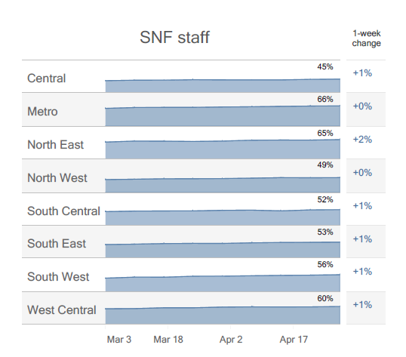
Staff Vaccination Rates Vary Substantially by Location (full vaccination rates)
Data as of April 28
AL Staff Data Shows Similar Pattern
Source: MDH

Slide 4
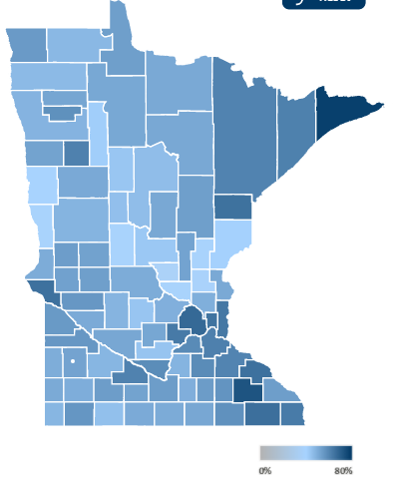
General Population (16+) Vaccination Rates Vary Substantially by County
Data as of April 30
Lowest County is Benton at 27%, highest is Cook at 70%
Source: MDH

Slide 5
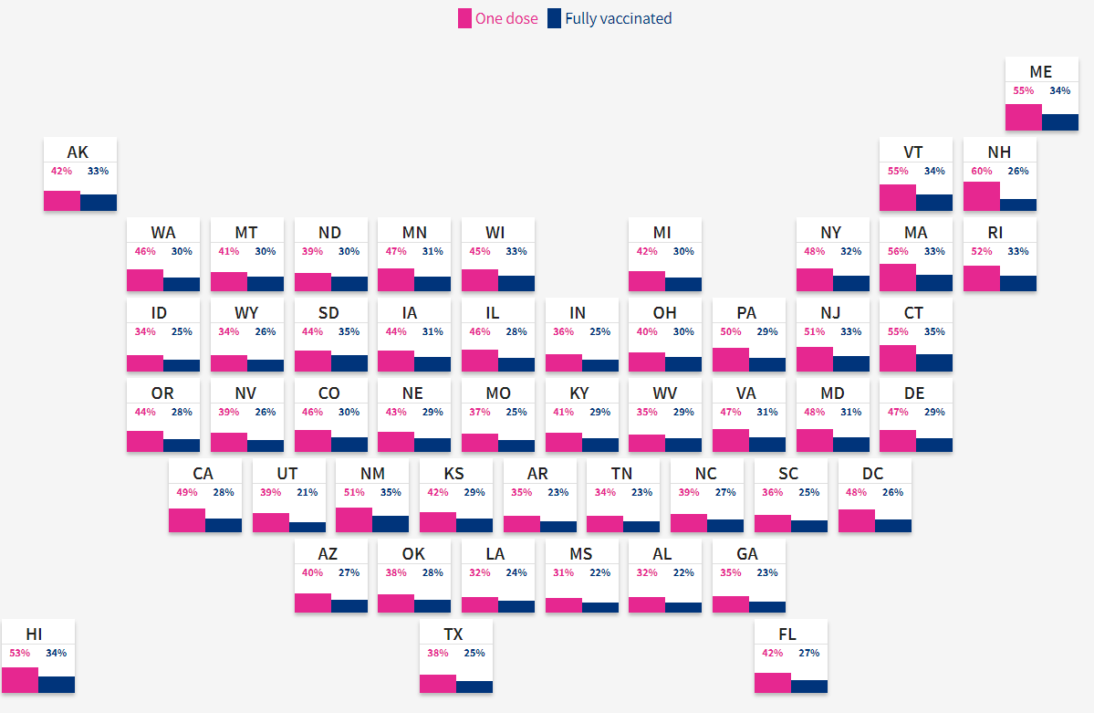
Minnesota Doing Better than National Average on General Population Vaccination Rate
Data as of May 1
MN at 31% Fully Vaccinated vs 28% National Rate
Source: USA Facts.org

Slide 6
Positivity Rates Above January Levels Despite Vaccinations
Source: CMS

