Slide 2
Minnesota is Aging Fast
60,000
Minnesotans are turning 65 every
year through 2030
Source: U.S. Census Bureau, Minnesota State Demographic Center, 2016

Slide 3
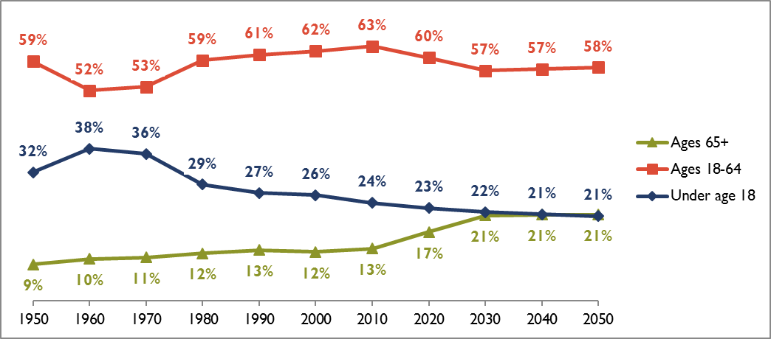
1 in 5 Minnesotans
will be 65+ in 2030
Source: Minnesota State Demographer, 2016

Slide 4
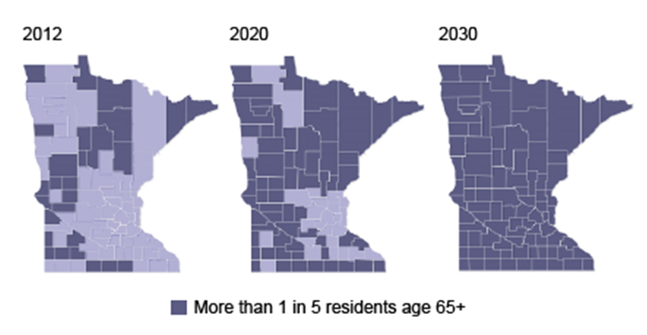
Progression of an Aging Minnesota
Source: Minnesota Compass

Slide 5
Between 2020 and 2040, the number of people age 85+ will more than double
2020
2030
2040
24.5%
60.1%
126,461
157,415
246,000
Source: Minnesota State Demographer Census Data, 2016 Projections

Slide 6
Labor Force Fails to Keep Pace with Growth in Aging Population
Ratio of People Age 20-60 to 85+
46%
in
20
Years
15:1
8:1
2015
2035
Source: Minnesota State Demographer, 2016
Notes:
Ratio of people age 20-65 to 80+

Slide 7
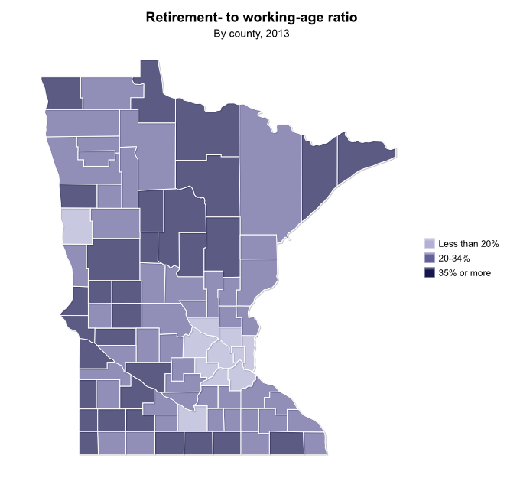
Ratio of Working Age
Adults to Seniors
Percentage of Working Age Adults to Seniors
Rural Areas
Face
Toughest Workforce Challenges
Source: Minnesota Compass, 2016

Slide 8
¾ of Older Adults with Long-Term Care Needs Live at Home
Source: Anne Tumlinson Innovations; Table 2, Freedman and Spillman (2014)

Slide 9
The Reliance on Unpaid Caregivers
Nearly 2/3 of Older Adults with Long Term Care Needs Living At Home Receive All Help from Family and Friends
Source: Anne Tumlinson Innovations; Table 4, Freedman and Spillman (2014)

Slide 10
Direct Care Workers: The Largest Occupation Group in the US
Direct Care
4,999,100
Retail Sales
4,968,400
K-12 Teachers
3,902,000
Public Safety
3,667,000
Food Service
3,553,000
RNs
3,449,300
Source: Paraprofessional Healthcare Institute, 2012

Slide 11
Continued Job Growth in Senior Living Field
30%
More
Home Health Aides by 2024
Senior Living Jobs Outpacing Average U.S. Job Growth by…
3.7%
Source: Argentum, 2015; Minnesota Department of Employment & Economic Development Occupation Forecasts

Slide 12
Race to Hire: Today’s Competitive Market for Available Workers
Average Wage
Vacancy Rates
Retail Sales
$12.35
7,096
8%
Food Service
$9.64
3,266
5.2%
Nursing
Assistant
$13.93
2,179
6.9%
Home Health Aides
$12.34
831
3.0%
Source: Minnesota Department of Employment & Economic Development, 2016

Slide 13
Race to Hire is a Marathon Total Openings from 2014 - 2024
Replacement
Openings
Total
Openings
Retail Sales
30,380
35,300
5.6%
Food Service
20,660
25,980
8.3%
Nursing
Assistant
9,180
6,730
8.2%
Home Health Aides
6,940
16,190
30.1%
Source: Minnesota Department of Employment & Economic Development, 2016
Notes:
Average Position Growth for all Minnesota jobs (between 2014 – 2014) is 4.3%

Slide 14
The State of Workforce in Older Adult Services

Slide 15
Rising Employee Vacancy Rates
Housing with Services
Source: LTC Imperative Housing with Services Workforce Legislative Survey, 2017

Slide 16
Turnover Rates Improving… Still Unsustainable
Housing with Services
Source: LTC Imperative Housing with Services Workforce Legislative Survey, 2017

Slide 17
Why Housing with Services Struggle to Attract Applicants
Competition with Other Employers
45.1%
No Applicants
40.6%
No Qualified Applicants
29.7%
Non-Competitive
Wages/Benefits
25.1%
Source: LTC Imperative Housing with Services Workforce Legislative Survey, 2017

Slide 18
High Employee Vacancy Rates
Care Centers
2,800
Open Direct Care Positions in Minnesota
Source: LTC Imperative Legislative Surveys, 2013 - 2017

Slide 19
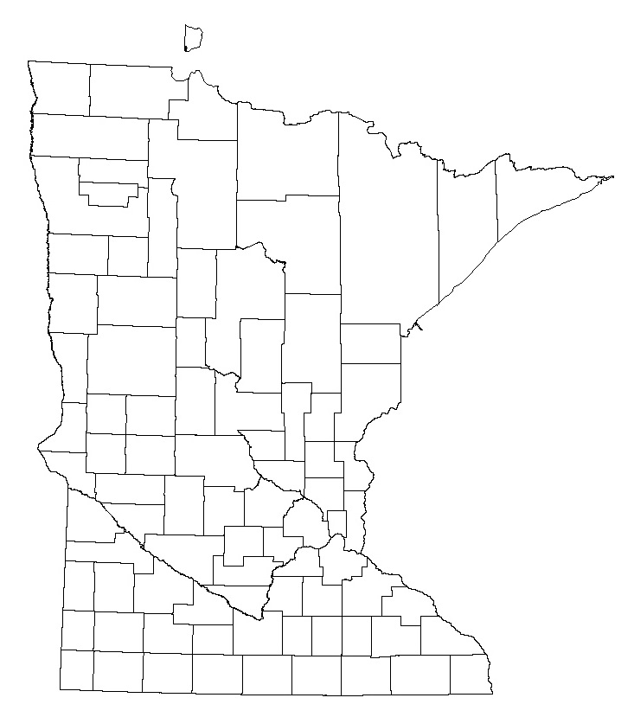
STATEWIDE AVERAGE
RN = 14%; LPN = 15.8%; NAR = 15.8%
RN = 18.2%
LPN = 19.2%
NAR = 19.7%
RN = 11.1%
LPN = 15.9%
NAR = 17.0%
High Vacancy Rates in Care Centers
RN = 12.7%
LPN = 19.5%
NAR = 17.0%
RN = 12.2%
LPN = 16.5%
NAR = 18.2%
RN = 13.4%
LPN = 12.4%
NAR = 13.6%
RN = 17.4%
LPN = 15.6%
NAR = 14.1%
RN = 17.4%
LPN = 21%
NAR = 19.9%
Source: LTC Imperative Legislative Surveys, 2013 - 2017

Slide 20
Continual Decline in Nurse Retention
Care Centers
Source: DHS Nursing Home Cost and Statistical Reports, 2011 - 2015

Slide 21
Workforce Shortages Affect Consumers
More than 5,000
Nursing Home Admissions Were Denied Due to Shortages in Essential Staff
Source: LTC Imperative Legislative Survey, 2016

Slide 22
Why Care Centers Struggle to Attract Applicants
75.8%
Competition with Other Employers
Unable to Hire
16 & 17 Year Olds
13.4%
70.1%
No Applicants
Non-Competitive Wages & Benefits
42.7%
51.6%
No Qualified
Applicants
Source: LTC Imperative Legislative Survey, 2017

Slide 23
Higher Wages in Care Centers: Progress But Challenge Remains
Average 14% increase from June 2015 to July 2016
Source: Long Term Care Imperative 2016 and 2017 Payment Reform Benchmark Surveys

Slide 24
Enhanced Benefits in Care Centers: Improvement, Not Solution
Average 20% increase from June 2015 to July 2016
Source: Long Term Care Imperative 2016 and 2017 Payment Reform Benchmark Surveys

Slide 25
RN Wage Gap
$37,000
more per year in a Hospital than in a Care Center
Wage Gap = $16.41/hr
Wage Gap = $17.93/hr
Wage Gap = $15.41/hr
Wage Gap = $17.25/hr
Source: Minnesota Hospital Association and LTC Imperative Legislative Survey, 2012 - 2015

Slide 26
Workforce Solutions Strategy Assessment

Slide 27
We ask staff at all levels what they think.
We ask staff if they are satisfied or dissatisfied, and feel engaged in their work environment.
We have an effective and systematic process in place for
onboarding new team members.
We have in place opportunities for ongoing learning and
development for staff at all levels.
We have processes in place to identify successful
practices and share these broadly.

Slide 28
We have a process in place to engage staff in all areas of the organization in quality and performance improvement.
We have a process in place to recognize staff.
We are tracking meaningful data to help us understand our environment and experiments.
We are maximizing all the partnerships, tools and resources available to us.
Find resources and tools to help you achieve these strategies at: www.LeadingAgeMN.org/providers/workforce-center/

Slide 29
Visit the Knowledge Center
www.leadingagemn.org

